Slide 1
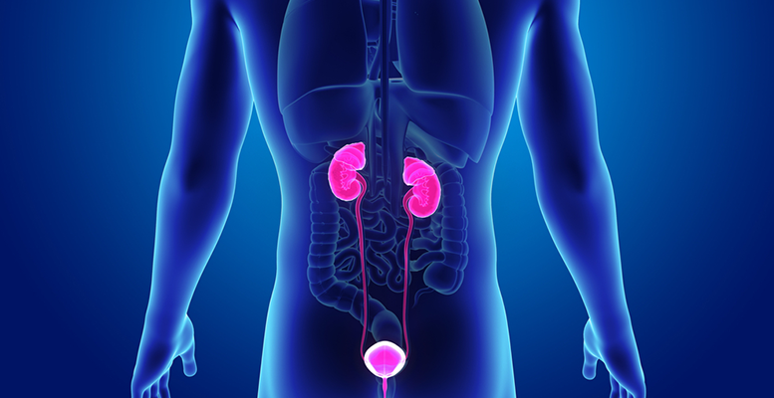
Excretory and Urinary System
T. Rick

Slide 2
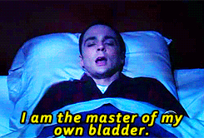
Have you ever been to the movies and had popcorn and a big soda drink?

Slide 3
Excretory organs
The Lungs excrete carbon dioxide and water vapor in exhaled air.
The Kidneys excrete nitrogen wastes, salts, water, and other substances in urine.
The Skin excretes water, salts, small amounts of nitrogen wastes, and other substances in sweat.

Slide 4
Urinary System
The urinary system maintains homeostasis in several ways:
Removal of urea (nitrogenous waste) from the bloodstream.
Control of water and salt balance in the bloodstream.
Involved in blood pressure regulation.
Excretion is the process of removing metabolic wastes.

Slide 5
The Renal System

Slide 6
Kidneys
The body must get rid of nitrogenous wastes from the breakdown of proteins.
Excretion of water is necessary to dissolve waste.
Kidneys regulate the chemical composition of the blood.

Slide 7
Structure of Kidneys
The Renal Cortex makes up about a third of the kidney’s tissue mass.
The Renal Medulla is the inner two-thirds of the kidney.
The Renal Pelvis is a funnel-shaped structure in the center of the kidney.

Slide 8
Urea
The most common mammalian metabolic waste is Urea.
Urea is a nitrogenous product made by the liver.
Nitrogenous wastes are initially brought to the liver as Ammonia, a chemical compound of Nitrogen so toxic that it can harm cells.
The Liver removes Ammonia from the blood and changes it into a less harmful substance called Urea.

Slide 9
Elimination of Urine
From the Renal Pelvis the urine will flow into a narrow tube called a Ureter.
The Ureter leads from each kidney to the Urinary Bladder, a muscular sac that stores urine.
Muscular contractions force urine out of the body through a tube called the Urethra.
500 Ml of Urine must be eliminated every day to remove toxic materials.

Slide 10
Nephrons
Urea, water, and mineral salts are removed from the body in the form of Urine.
Nephrons make Urine in the kidneys.
Nephrons are responsible for Filtration, Reabsorption, and Secretion.
There are 1 million Nephrons in a kidney.

Slide 11
Anatomy of Nephron
Glomerulus
Proximal tubule
Loop of Henle
Distal tubule

Slide 12
Glomerulus
This is the only place in the system where the blood is actually “filtered.”
Blood pressure is used to push plasma through capillary walls and into the Bowman’s capsule.

Slide 13
Proximal tubule
Nutrients (salts, vitamins, etc.) are moved out of the tubule through active transport.
Water follows the nutrients by osmosis.

Slide 14
Loop of Henle
Tissue around the Loop of Henle is salty, from active transport and diffusion of sodium chloride.
The salty conditions allow water to diffuse out of the loop.

Slide 15
Distal tubule
Active transport is used to move more nutrients out of the concentrated urine.
Some ions, drugs, and toxins are actively pumped into the tubule.

Slide 16
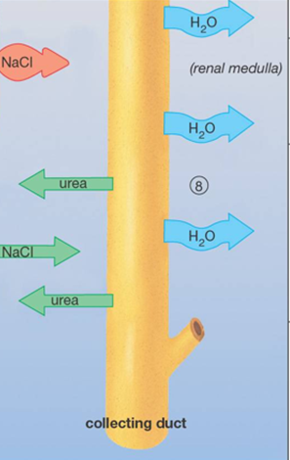
Collecting Duct
More water leaves the tube by osmosis, since the tube is surrounded by salty tissue.
Some urea leaves by diffusion, and may be cycled through the system.

Slide 19
Which of these happens during filtration?
Salt is actively pumped out.
Water is removed osmotically from the filtrate.
Plasma moves from capillaries into the capsule.
Toxins are actively removed from plasma.

Slide 20
What drives filtration in the glomerulus?
Osmosis
Smooth muscle contractions
Salt gradients
Blood pressure

Slide 21
Which of these aids in water recovery from the filtrate?
Active transport of water out of the tubules.
Active transport of sodium out of the filtrate.
Peristalsis in the Loop of Henle.
Concentration of urea in the urine.

Slide 22
W
O
R
K
T
O
G
E
T
H
E
R
Notice that sodium is actively recovered in the system, while potassium may be pumped out. A “natural” diet such as hunter-gatherers eat (mostly fresh plant material supplemented with lean meat) is low in sodium and high in potassium. Why does our salty, low-vegetable diet cause problems?

Slide 23
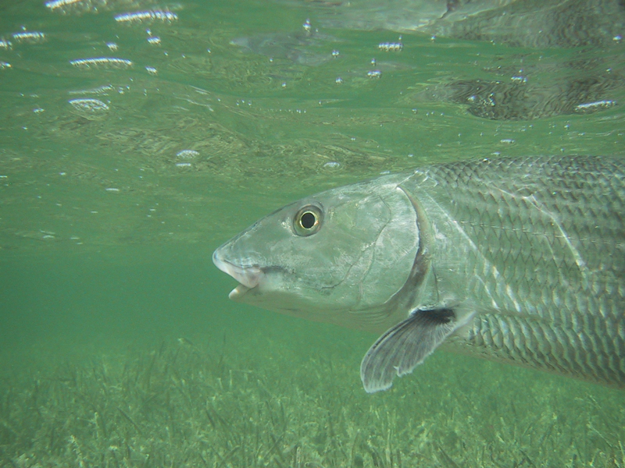
Water Regulation

Slide 24
Regulating water
Antidiuretic hormone (ADH, also called vasopressin) is part of a negative feedback system that regulates water in the mammalian body.
ADH increases the permeability of the distal tubule, allowing greater water recovery.

Slide 25
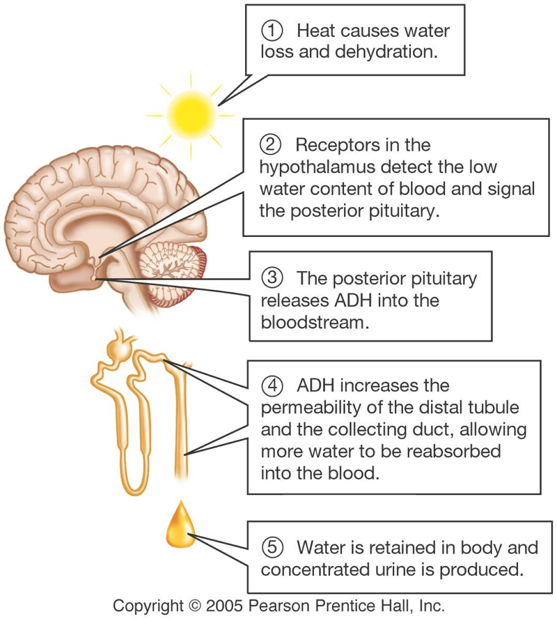

Slide 26
W
O
R
K
T
O
G
E
T
H
E
R
Caffeine and alcohol are diuretics. Alcohol inhibits ADH release, while caffeine interferes with its activity. Part of the symptoms of a hangover are due to dehydration. What causes the dehydration? And why is a cup of coffee not a good cure for a hangover?

Slide 27
If a person were given a dose of ADH, what would happen?
More water lost through kidneys.
More potassium secreted by nephron.
More water retained in the kidneys.
More sodium secreted by nephron.

Slide 28
W
O
R
K
T
O
G
E
T
H
E
R
Many over-the-counter herbal diet aids claim to “detoxify” the body or “flush fat.” Many of these contain dandelion leaves, parsley, or other herbs known to be diuretics. If a person tries these products and appears to lose pounds, what is actually lost? Could there be health problems with using these products?

Slide 29
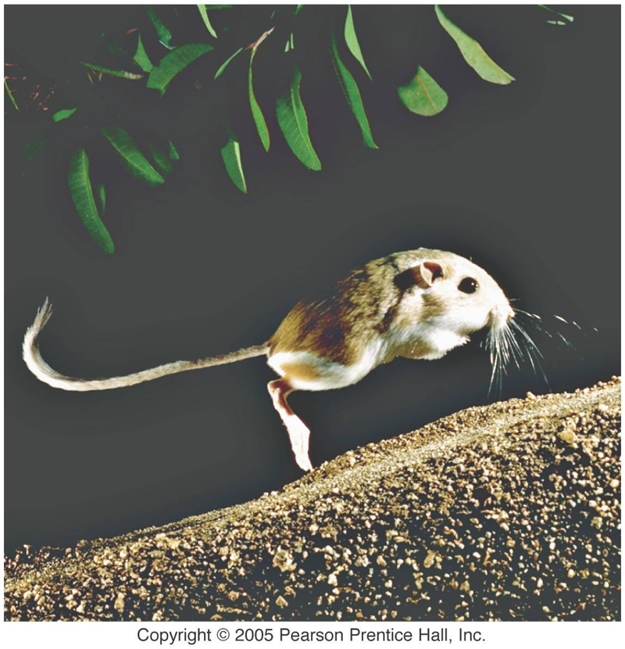
Final thinking question:
The kangaroo rat is adapted to desert life. It survives on very little water. List some ways in which its kidneys might be different from the human kidney to allow it to conserve as much water as possible.

