Slide 1
The Reproductive Systems

Slide 2
Reproductive system
Reproductive system
Purpose: continue the human species by the production of offspring.
The Male and Female Reproductive systems produce gametes, sperm and egg cells, and ensure the union of gametes in fertilization following sexual intercourse.

Slide 3
What you will learn:
Explain the events during spermatogenesis and oogenesis that produce haploid sperm from diploid cells
Describe the structure and function of the organs of the male and female reproductive system
Describe the structure and function of the sperm cell
Identify the importance of testosterone in male reproductive function

Slide 4
Mitosis and Meiosis
Mitosis is the type of cell division that occurs in non-reproductive cells.
Produces exact copies of the parent cell
The cell division process of meiosis produces the gametes – sperm of egg cells.
Diploid number of chromosomes (46 for humans) divides twice to form 4 cells, each with the haploid number of chromosomes.
Haploid means half the usual diploid numbers (23 for humans)
Produces egg and sperm cells with half the genetic material of the parent cells.

Slide 5
Spermatogenesis
Spermatogenesis is the meiosis in the testes, the site of sperm production.
Within each of the testes are seminiferous tubules that contain spermatogonia (stem cells that generate sperm).

Slide 6
Hormones during Spermatogenesis
Follicle-stimulating hormone (FSH) initiates sperm production.
From anterior pituitary gland
Testosterone promotes maturation of sperm.
Secreted by testes
Testosterone is stimulated by Luteinizing hormone (LH) from anterior pituitary gland
Inhibin decreases secretion of FSH.
Secreted by testes
Sperm production begins at puberty (10 -14 years of age). There is usually no complete cessation

Slide 7
Oogenesis
Oogenesis is the process of meiosis for egg cell formation; it begins in the ovaries.
Oogonium is a stem cell for egg cell production.

Slide 8
Hormones during Oogenesis.
FSH initiates the growth of ovarian follicles, each of which contains an oogonium.
FSH stimulates the follicle cell to secrete estrogen, which promotes maturation of ovum.
Production of ova begins at puberty (10 to 14 years of age) and continues until menopause (45 – 55 years of age), when the ovaries no longer respond to pituitary hormones.
Egg production is cyclical, with a mature ovum being produced every 28 days.

Slide 9
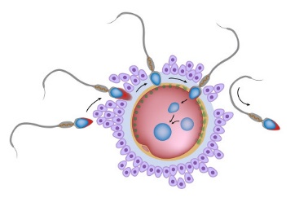
Fertilization
The ovum and sperm cells have each 23 chromosomes.
When fertilization occurs the nuclei of the egg and sperm merge, and the fertilized egg (zygote) has 46 chromosomes, the diploid number.

Slide 10
Male Reproductive System

Slide 11
Male Reproductive System Anatomy

Slide 12
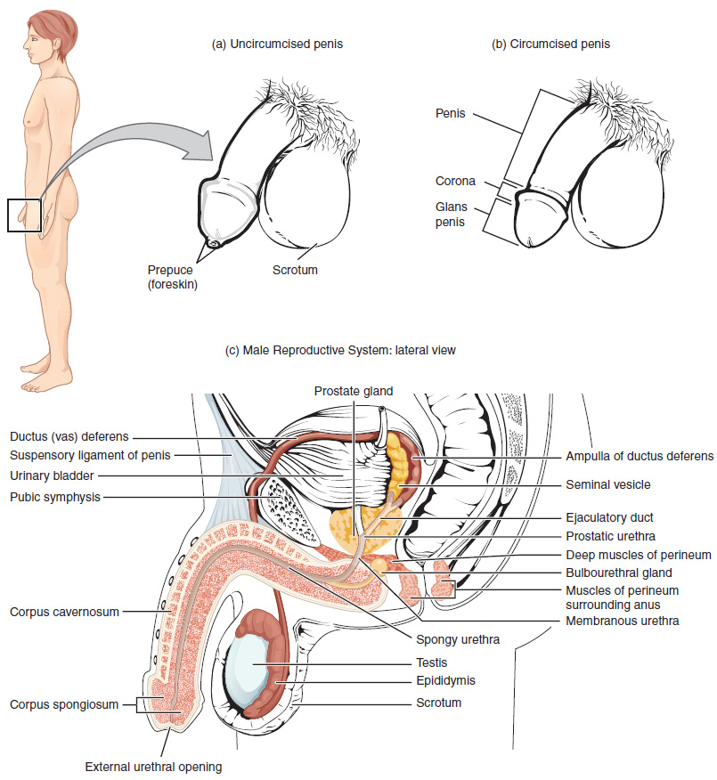

Slide 13
Scrotum
Testes are located in the scrotum.
Temperature = 35.5 degrees Celsius
Cryptorchidism is the condition in which the testes fail to descend from kidneys.

Slide 14
Testes
Testes are about 4 cm by 2.5 cm and are divided in lobes.
Seminiferous tubes are in the lobes.
Several cells are located in the Seminiferous tubes:
Spermatogonia
Sustentacular cells (inhibin)
Interstitial cells (testosterone)

Slide 15
Structure of Sperm cells
The head contains 23 chromosomes.
The tip of the head is the acrosome, enzyme to digest the membrane of an egg cell.
Within middle piece are mitochondria that produce ATP.
The flagellum provides motility.

Slide 16
Epididymis
In the Epididymis sperm matures and flagella becomes functional.
Peristalsis waves move sperm into Vas Deferens.

Slide 17
Vas Deferens
The Vas Deferens extends from epididymis through the inguinal canal into the abdominal cavity.
The Vas Deferens goes upward over the bladder, then down the posterior side to join the ejaculatory duct.

Slide 18
Ejaculatory Ducts
Each of the two ejaculatory ducts receives sperm from the Vas Deferens and secretion of the seminal vesicle.
Both ejaculatory ducts empty into the single urethra.

Slide 19
Seminal Vesicles
The paired seminal vesicles are posterior to the urinary bladder.
They secrete fructose to provide energy for sperm.
It is alkaline (basic acidity) to enhance sperm mobility.

Slide 20
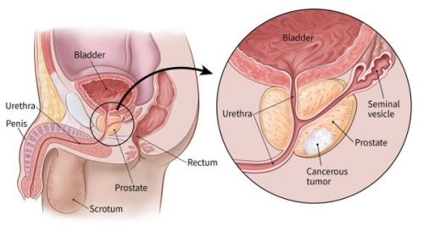
Prostate Gland
A muscular gland just below the urinary bladder, the prostate gland (3 cm by 4 cm).
The prostate excretes alkaline fluid to promote sperm mobility.
The smooth muscle of the prostate gland contracts during ejaculation to contribute to the expulsion of semen.
The alkaline secretion assists to neutralize the acidic environment of the female reproductive system.

Slide 21
Bulbourethral glands
The bulbourethral glands secrete alkaline secretion just before ejaculation to neutralize acidic urine.

Slide 22
Urethra - Penis
The Urethra is the duct and longest portion is enclosed within the penis.
The Penis is an external genital organ.
Within the penis are 3 masses of cavernous (erectile) tissue. Each consists of framework of smooth muscle and connective tissue that contains blood sinuses.

Slide 23
Semen
Semen consists of sperm and the secretions of seminal vesicles, prostate gland, and bulbourethral gland.
Average PH is 7.4
2 – 4 ml is expelled and has between 200 to 400 millions sperm cells.

