Slide 1
The Female Reproductive System

Slide 2
Student Objectives:
Describe the functions of the ovaries, fallopian tubes, uterus, and vagina.
Describe the structure of the mammary glands and the functions of the hormones involved in lactation.
Describe the menstrual cycle in terms of the hormones involved and the changes in the ovaries and endometrium.

Slide 3
The Female Reproductive system in short
The female reproductive system consists of the paired ovaries and fallopian tubes, the single uterus and vagina, and the external genital structures.
Egg cells (ova) are produced in the ovaries and travel through the fallopian tubes to the uterus. The uterus is the site for growth of the embryo-fetus.

Slide 4
Ovaries
The ovaries are a pair of oval structures about 4cm long on each side of the uterus in the pelvic cavity.
The ovarian ligament extends from the medial side of an ovary to the uterine wall, and the ligament is a fold of the peritoneum that covers the ovaries.
The ligaments keep the ovaries in place.

Slide 5
Primary follicles
Within the ovaries are several hundred thousand primary follicles, which are present at birth.
300-400 produce mature ova.
Each primary follicle contains an oocyte.
Surrounding oocyte are follicle cells which secrete estrogen.
Maturation of follicle requires FSH and estrogen.

Slide 6
Maturing Follicles
A mature follicle is called graafian follicle, and the hormone LH causes ovulation.
Ovulation is rupture of the mature follicle with release of the ovum.
Other developing follicles deteriorate (atretic follicles), and have no further purpose.
The ruptures follicle becomes the corpus luteum, and begins to excrete progesterone and estrogen (also inhibin and relaxin in small amounts).

Slide 7
Fallopian Tubes
There are 2 fallopian tubes, about 10 cm long.
They connect an ovary and the uterus.
The end at the ovary has fimbriae; finger-like projections that create currents in the fluid surrounding the ovary to pull the ovum into the fallopian tubes.
Smooth muscle propels ovum together with ciliated epithelial tissue.

Slide 8
Fertilization in fallopian tubes
Fertilization usually takes place in the fallopian tube.
If not, an ovum dies between 24-48 hours.
If fertilized, the ovum becomes a zygote and is swept into the uterus, this takes 4-5 days.

Slide 9
Ectopic Pregnancy
Sometimes the zygote will not reach the uterus but will still continue to develop (ectopic pregnancy).
Fallopian tube
Ovary
Elsewhere in abdominal cavity.
Termination is result of bleeding in the mother.

Slide 10
Uterus
During pregnancy contains placenta to nourish the embryo-fetus, it can increase greatly in size, and expels the baby at the end of gestation.
Fundus: upper portion above entry of fallopian tubes
Body: the large central portion
Cervix: open into the vagina

Slide 11
Myometrium and endometrium
The myometrium is the smooth muscle layer; during pregnancy these cells increase in size to accommodate the growing fetus and contract for labor and delivery at the end of pregnancy.
The lining of the uterus is the endometrium (becomes placenta during pregnancy), which itself consists of two layers.
Basilar layer next to myometrium and is vascular but very thin.
Functional layer is regenerated and lost during each menstrual cycle.

Slide 12
Vagina
The vagina is a muscular tube, 10 cm long, that extends from the cervix to the vaginal opening in the perineum (pelvic floor).
The functions of the vagina are:
to receive sperm from the penis during sexual intercourse
to provide the exit for menstrual blood flow
to become the birth canal at the end of pregnancy

Slide 13
The pH of vagina
The membrane of the vagina is stratified squamous epithelial tissue, and is resistant to pathogens.
The flora of the vagina creates an acidic environment that inhibits the growth of pathogens.

Slide 14
External Genitals
The female external genital structures may also be called the vulva.
Vulva includes the clitoris, labia majora, and minora, and vestibular glands.

Slide 15
Clitoris
The clitoris is the small mass of erectile tissue above the urethral opening.
The only function is sensory; it responds to sexual stimulation.

Slide 16
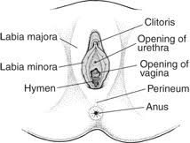
The mons pubis
The mons pubis is a pad of fat over the pubic symphysis, covered with skin and pubic hair.
Further to the back there are two folds of skin: Labia majora and labia minora.
The labia cover the openings of the urethra and vagina to prevent drying of their mucous membranes.

Slide 17
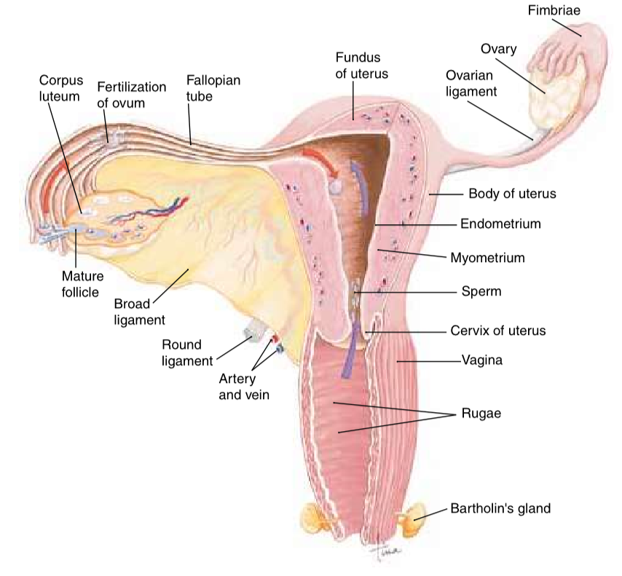
Vestibular glands
The vestibular glands are within the floor of the outside opening and their secretion lubricates the vagina during sexual intercourse.

Slide 18
Mammary Glands
The mammary glands are functionally related to the reproductive system, because they produce milk for the nourishment of offspring.
The alveolar glands produce milk after pregnancy. The glands are surrounded by adipose tissue.
The skin around the nipple is a pigmented area called areola.

Slide 19
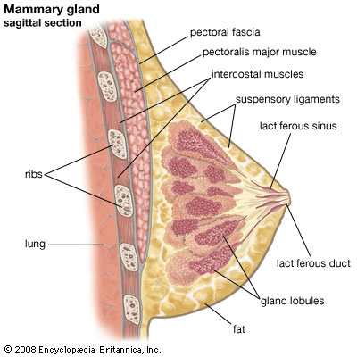
Milk
The formation of milk is under hormonal control.
During pregnancy, high levels of estrogen and progesterone prepare glands for milk production.
Prolactin from the anterior pituitary causes the actual synthesis of milk after pregnancy.
The sucking of the infant causes the release of milk.

Slide 20
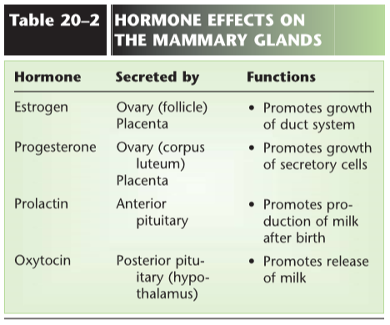
Overview hormones Mammary glands

Slide 21
Menstrual Cycle
The menstrual cycle includes the activity of the hormones of the ovaries, anterior pituitary gland (apg), and the changes in the ovaries and uterus.
4 hormones involved: FSH (apg), LH (apg), Estrogen (ovarian follice), and Progesterone (corpos luteum).
3 phases:
Menstrual phase
Follicular phase
Luteal phase

Slide 22
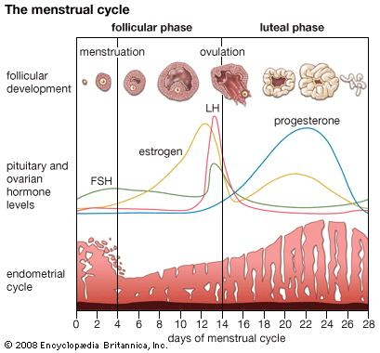
Menstrual Phase
The loss of the functional layer of the endometrium is called menstruation.
Menstruation may last 2 – 8 days.
Secretion of FSH is increasing, and several ovarian follicles begin to develop.

Slide 23
Follicular phase
FSH stimulates growth of ovarian follicles and secretion of estrogen by the follicle cells.
FSH and Estrogen promote the growth and maturation of the ovum, and estrogen stimulates the growth of blood vessels in the endometrium to regenerate the functional layer.
This phase ends with ovulation, when LH causes rupture of mature ovum from the follicle.

Slide 24
Luteal Phase
LH influences the ruptured follicle to become the corpus luteum, and starts to secrete progesterone and estrogen.
Progesterone further stimulates the growth of blood vessels in functional layer.
If the ovum is not fertilized the secretion of progesterone begins to decrease and endometrium cannot be maintained resulting into menstruation.

Slide 25
Inhibin and relaxin
The corpus luteum secretes the hormones inhibin and relaxin.
Inhibin inhibits the secretion of FSH.
Relaxin is believed to help the embryo implant to the uterus wall.

Slide 26
Overview hormones

Slide 27
Aging and reproductive system for women
For women there is a definite end of the reproductive capability; the menopause (between 45 – 55 years of age).
Estrogen decreases
Ovulation and menstrual cycles become irregular and cease

Slide 28
Review questions
Describe the location of the ovaries, and name the hormones produced by the ovaries.
Explain how an ovum or zygote is kept moving through the fallopian tube.
Describe the function of myometrium, basilar layer of the endometrium, and functional layer of the endometrium.
Name the hormones necessary for the growth of the endometrium.
State the functions of the vagina, labia majora and minora, and the vestibular glands.

