Slide 1
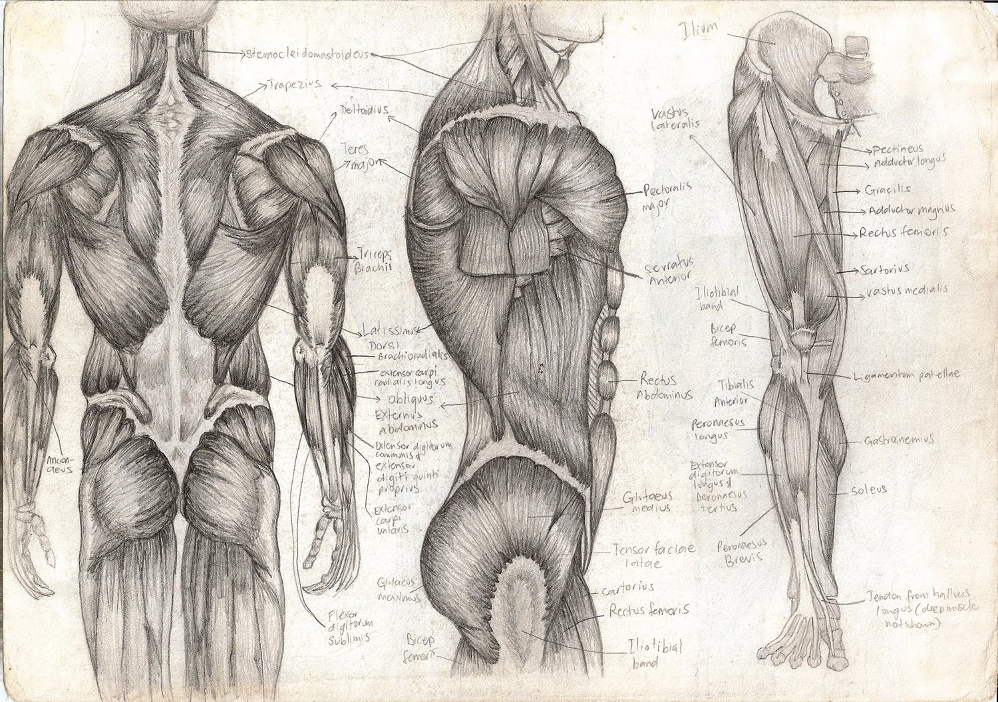
Muscle Tone and Muscle Sense
T. Rick

Slide 2
Muscle Tone
Most of our muscles are in a state of slight contraction; this is called muscle tone.
It is important for humans to keep an upright position.
Only a few muscle fibers are contracted to keep muscle tone.
Alternate fibers contract to avoid the muscle as a whole become fatigued.
Muscle tone is regulated by the cerebellum of the brain.
Muscle fibers need the energy of ATP (Adenosine Triphosphate)

Slide 3
Exercise
Good muscle tone improves coordination.
When muscle fibers are slightly contracted, they can react more rapidly if and when greater exertion is necessary.
Muscles with poor tone are usually soft and flabby, but exercise will improve muscle tone.
There are 2 general types of exercise:
Isotonic exercise
Isometric exercise

Slide 4
Isotonic exercise
In isotonic exercise, muscles contract and bring about movement.
Isotonic exercise improves muscle tone, muscle strength, and muscle size.
It also improves cardiovascular and respiratory efficiency.
If done 30 minutes or longer, exercise may be called aerobic, because it strengthens the heart and respiratory muscles as well.

Slide 5
Isotonic contractions
A concentric contraction is the shortening of a muscle as it exerts force.
An eccentric contraction is the lengthening of a muscle as it still exerts force.

Slide 6
Isometric exercise
Isometric exercise involves contraction without movement.
This exercise will improve muscle tone and muscle strength, but is not considered aerobic.
Many of our actions involve both isotonic and isometric contractions.

Slide 7
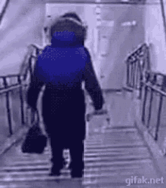
Muscle sense
Muscle sense (proprioception) is the brain’s ability to know where our muscles are and what they are doing, without consciously looking at them.
Within muscles are receptors called stretch receptors. The general function of all sensory receptors is to detect changes.
The impulses for muscle sense are integrated in the parietal lobes of the cerebrum (conscious muscle sense) and in the cerebellum (unconscious muscle sense) to be used to promote coordination.

