Slide 1
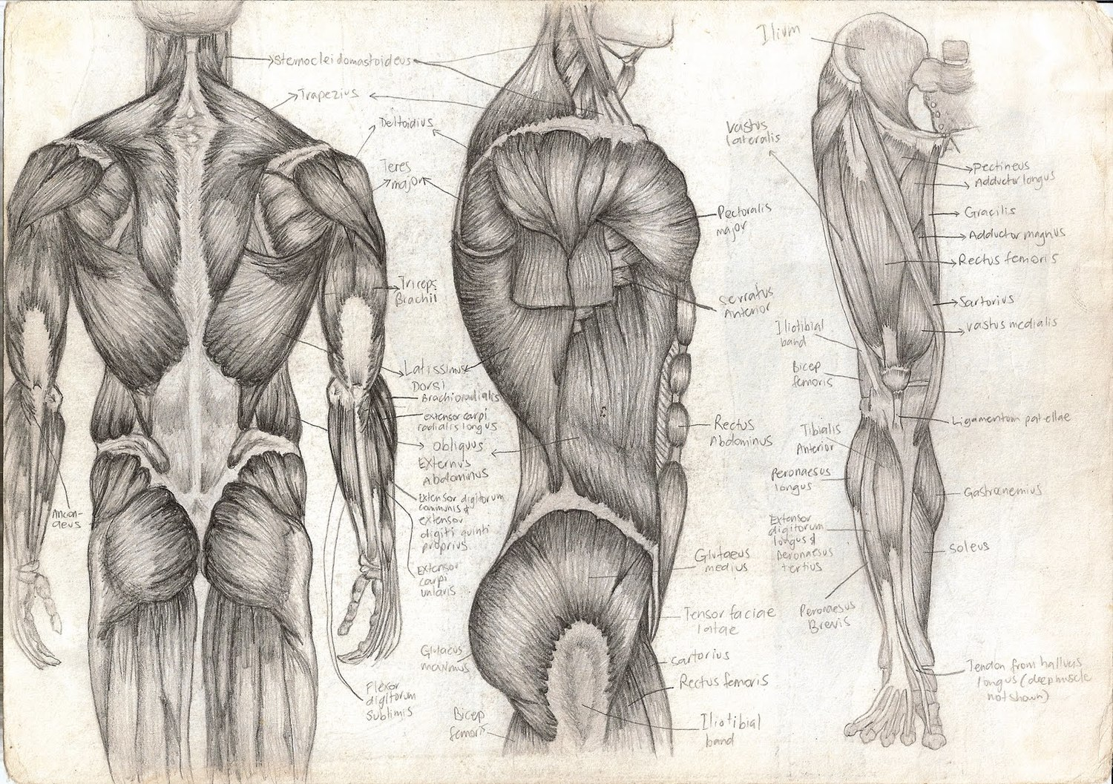
Intro to The Muscular System
T. Rick

Slide 2
The muscular system intro
There are more than 600 muscles in the human body.
The primary function of the muscular system is to move the skeleton.
The muscle contraction produce heat which contributes to the maintenance of body temperature
The nervous, respiratory and circulatory systems are involved in movement.
3 types of muscles: smooth, cardiac, and skeletal muscles.

Slide 3
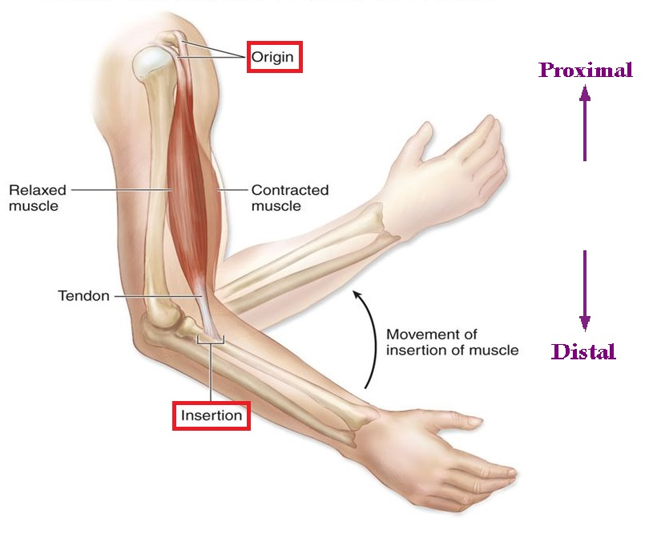
Muscle structure
All muscles are specialized for contraction.
Skeletal muscle is made of thousands of individual cells; muscle fibers.
Muscle has usually 2 tendons; origin and insertion.
Most muscles are anchored firmly to bones by tendons.
Fibrous connective tissue
Merges with fascia and connects to periosteum

Slide 4
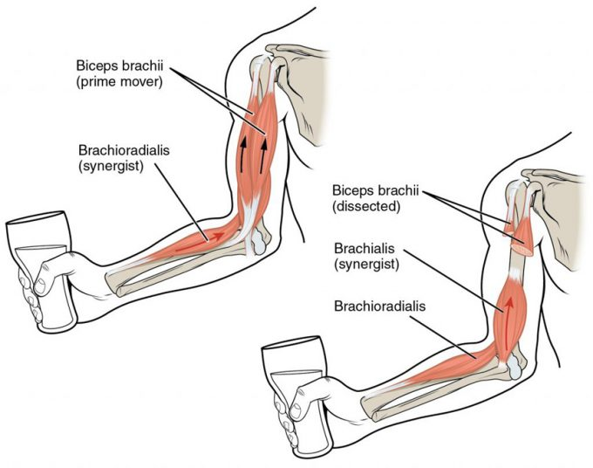
Muscle arrangements
Muscles are arranged around the bod to bring about variety of movements.
Antagonistic (opposite movement)
Synergists (supports movement)

Slide 5
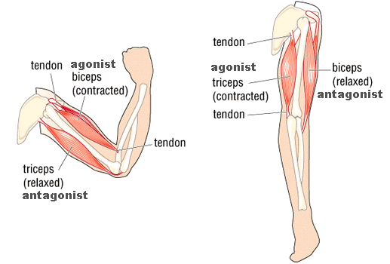
Antagonistic muscles
Antagonistic muscles are muscles that have opposing functions.
Joints that are capable of a variety of movements have several antagonists.
ROM Exercise are often recommended to preserve muscle function and joint mobility.

Slide 6
Synergistic muscles
Synergistic muscles are muscles with the same function.
The prime mover is the muscle that does most of the work.
Synergists can also stabilize or steady a joint to make more precise movement possible.

Slide 7
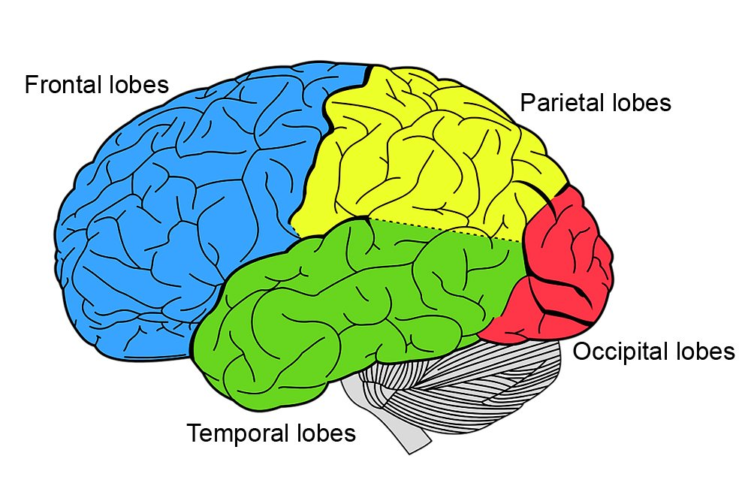
Role of the Brain
The contraction of muscles depend on the brain.
The nerve impulses come from the frontal lobe of the cerebrum.
The motor areas of the frontal lobes generate electrochemical impulses that travel along motor nerves to fiber muscles.
Some muscles must relax while other contract.
Coordination is unconscious and is regulated by cerebellum.

