Slide 1
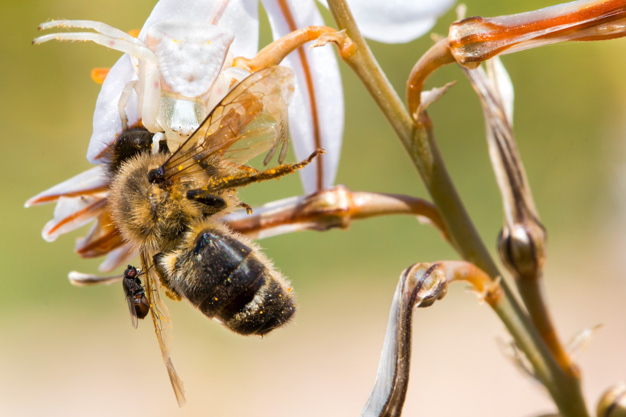
Introduction to Ecology

Slide 2
Ecology
Ecology is the study of the interactions between organisms and the living and nonliving components of their environment.
Each organism depends on some way on other living and nonliving things in its environment.
Ecology is a broad science that involves collecting information about organisms and their environments, observing and measuring interactions, looking for patterns, and seeking to explain these patterns.

Slide 4
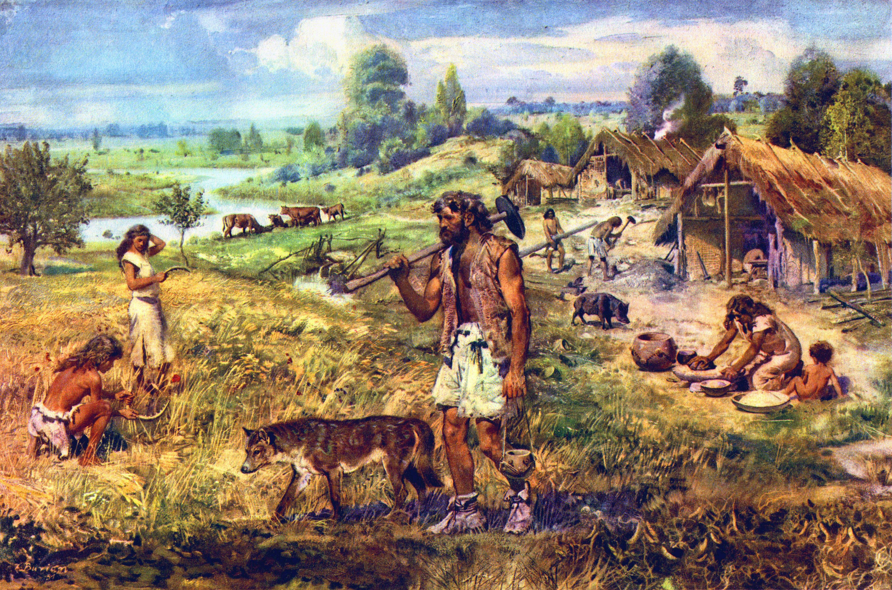
Picture of hunter-gatherers

Slide 6
A Key Theme in Ecology
All organisms interact with other organisms in their surroundings and with the nonliving portion of their environment.
Scientists refer to this as interdependence.

Slide 8
Effects of Interdependence
Any change in the environment can spread through the network of interactions and affect organisms that appear far removed from that change.

Slide 9
Ecological Models
Ecology is extremely complex and difficult to study.
Ecologists deal with the complexity by using Ecological Models to represent or describe the components of an ecological system.
A model may be physical, conceptual, or mathematical.

Slide 10
Levels of Organization
Organism
Population
Community
Ecosystem
Biosphere

Slide 11
Organism
The smallest level of organization is the organism.
An organism is an individual living thing.
A living thing can be a single or multi-cellular organism.

Slide 12
Population
A group of individuals that belong in the same species and live in the same area at the same time is called a population.
Species is a group of similar organisms that can mate and reproduce fertile offspring.

Slide 13
Community
A community is all the populations of all the different species that live together in a particular area.
A community only includes species or organisms. Nonliving factors are not included.
A community is very complex and may contain thousands of species.

Slide 14
Ecosystem
An ecosystem includes all the organisms and nonliving environment found in a particular place.
Organisms interact in a way that affects their survival.
An ecosystem also includes the nonliving aspects (physical and chemical) that influences its inhabitants.

Slide 15
Biosphere
The Biosphere includes all layers where organisms live. It includes the air, water, and earth.
The biosphere connects many ecosystems to each other.
The most famous example of a biosphere is our planet Earth.

