Slide 1
Cardiocascular System
Maedhus 512 No.7
Dhanabordee 512 No.20

Slide 2
What is cardiovascular system?

Slide 3
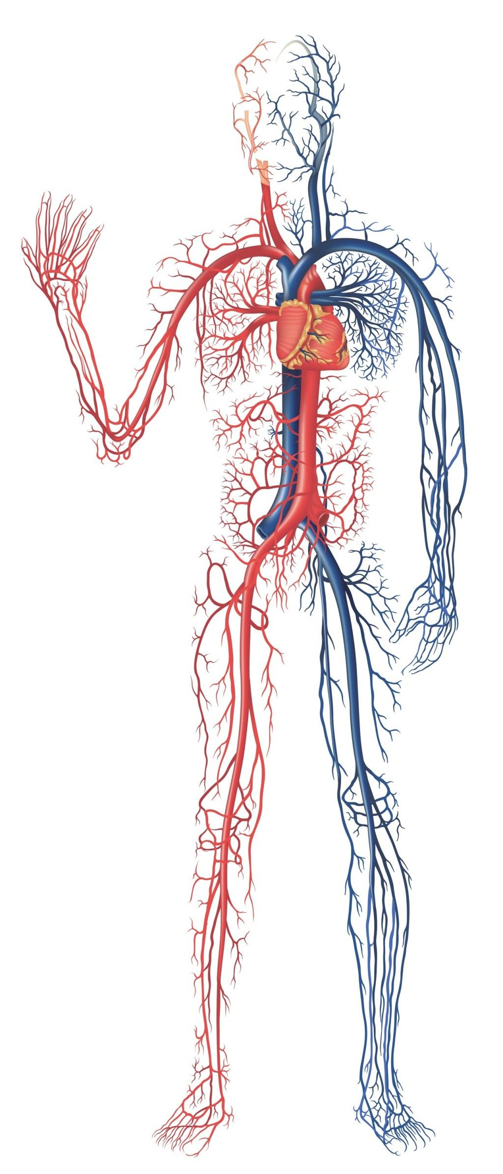
Cardiovascular System
Cardiovascular system is an organ system that circulate the blood throughout our body in order to carry the necessary substances to cells

Slide 4
What is involved ?

Slide 5
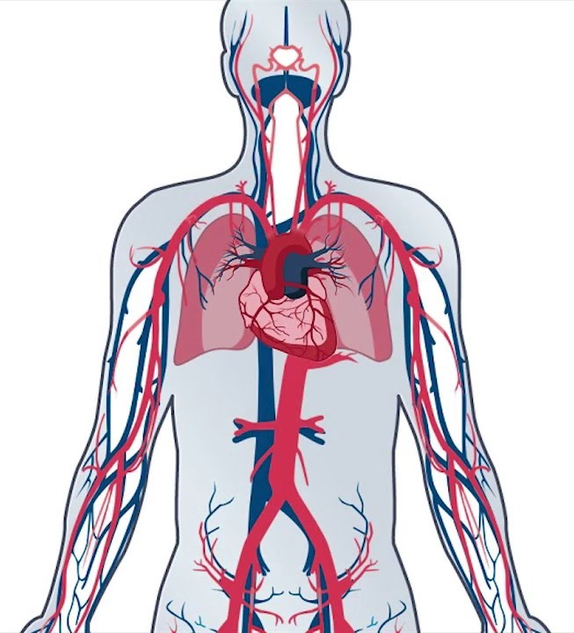
Main Components
01
Heart
An organ that pumps blood thorughout your body.
Lungs
02
Organ that exchange the gases between O2 and CO2

Slide 6
Main Components
03
05
Arteries
Blood vessels that carries oxygenated blood
Veins
04
Blood vessels that carries deoxygenated blood
Blood
A fluid in a body that carries necessary substances

Slide 7
How does it work?

Slide 8
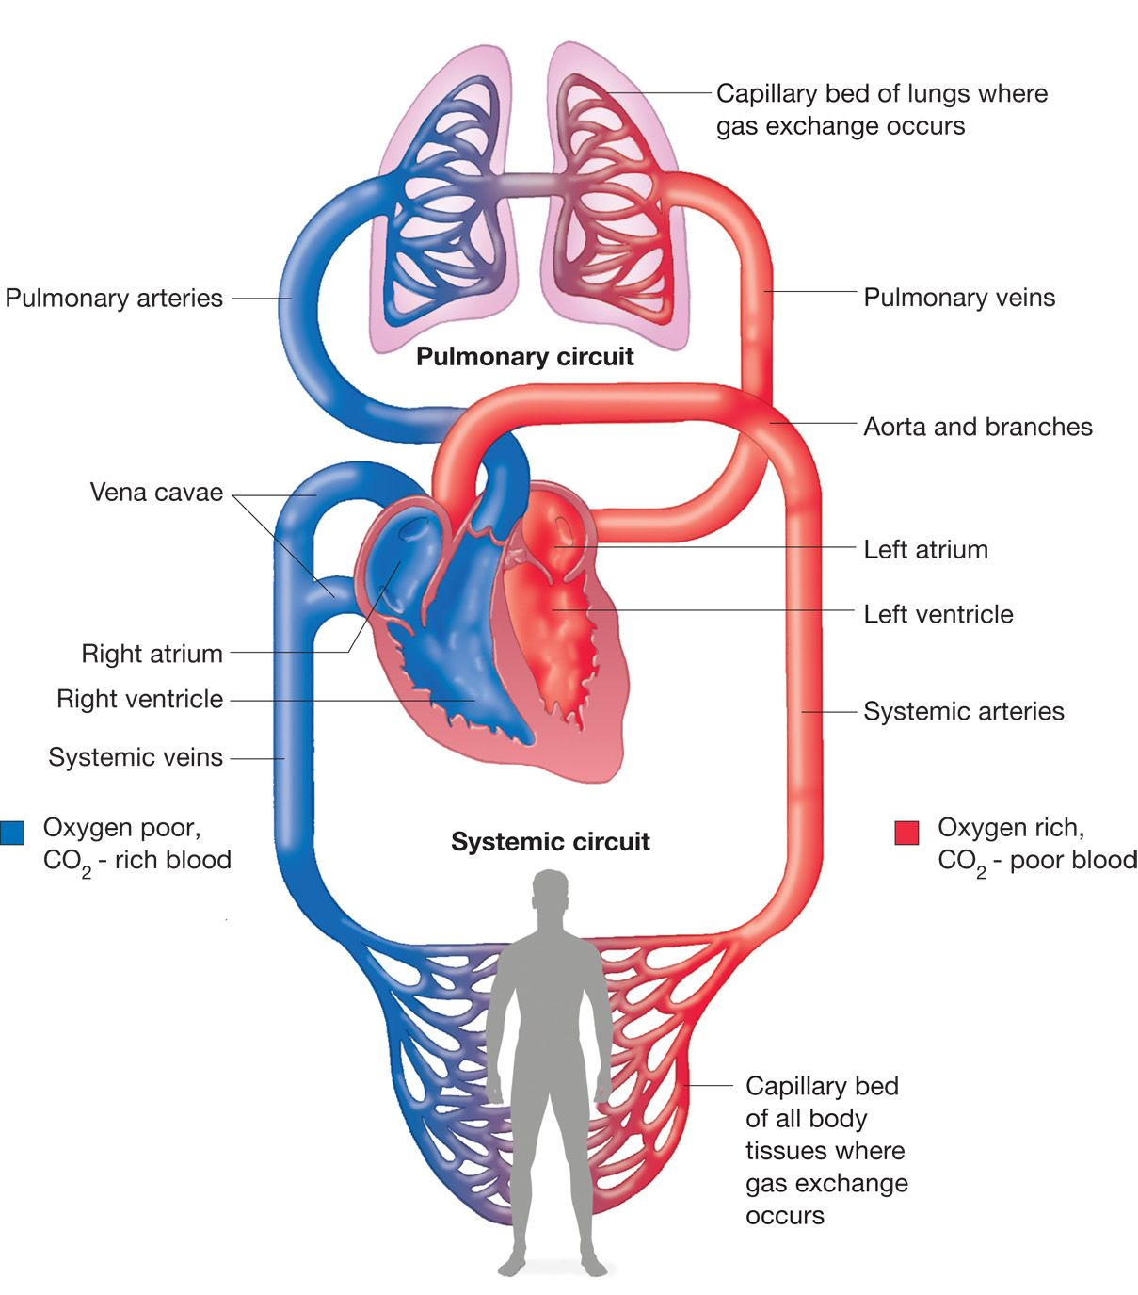
01
The right atrium receives deoxygenated blood from the body and pumps it to the right ventricle
04
The left atrium receives oxygenated blood from the lungs and pumps it to the left ventricle
02
The right ventricle pumps the deoxygenated blood to the lung
05
The left ventricle pumps the oxygenated blood to the rest of the body
03
The lung exchange the gases in the blood

Slide 9
What kind of tissue types are involved?

Slide 10
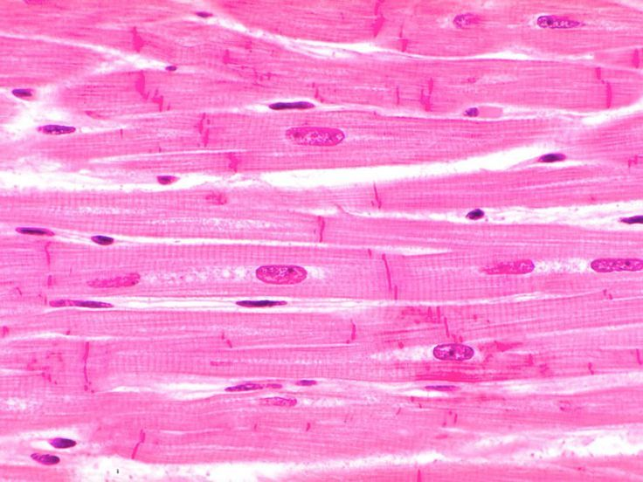
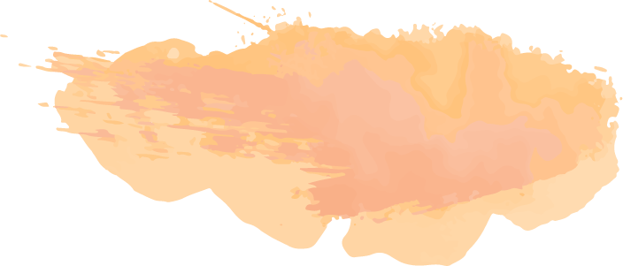
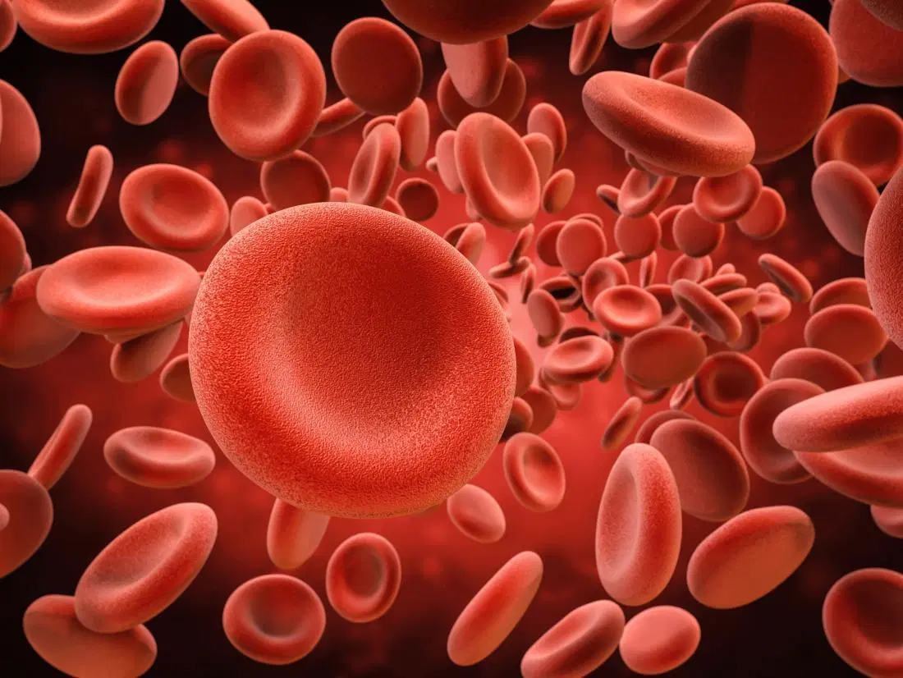
Types of tissues
Muscle Tissue
Cardiac Muscle Tissue
Connective Tissue
Blood
Red Blood Cells (Erythrocytes)
White Blood Cells (Leukocytes)

Slide 11
What major cavities are involved ?

Slide 12
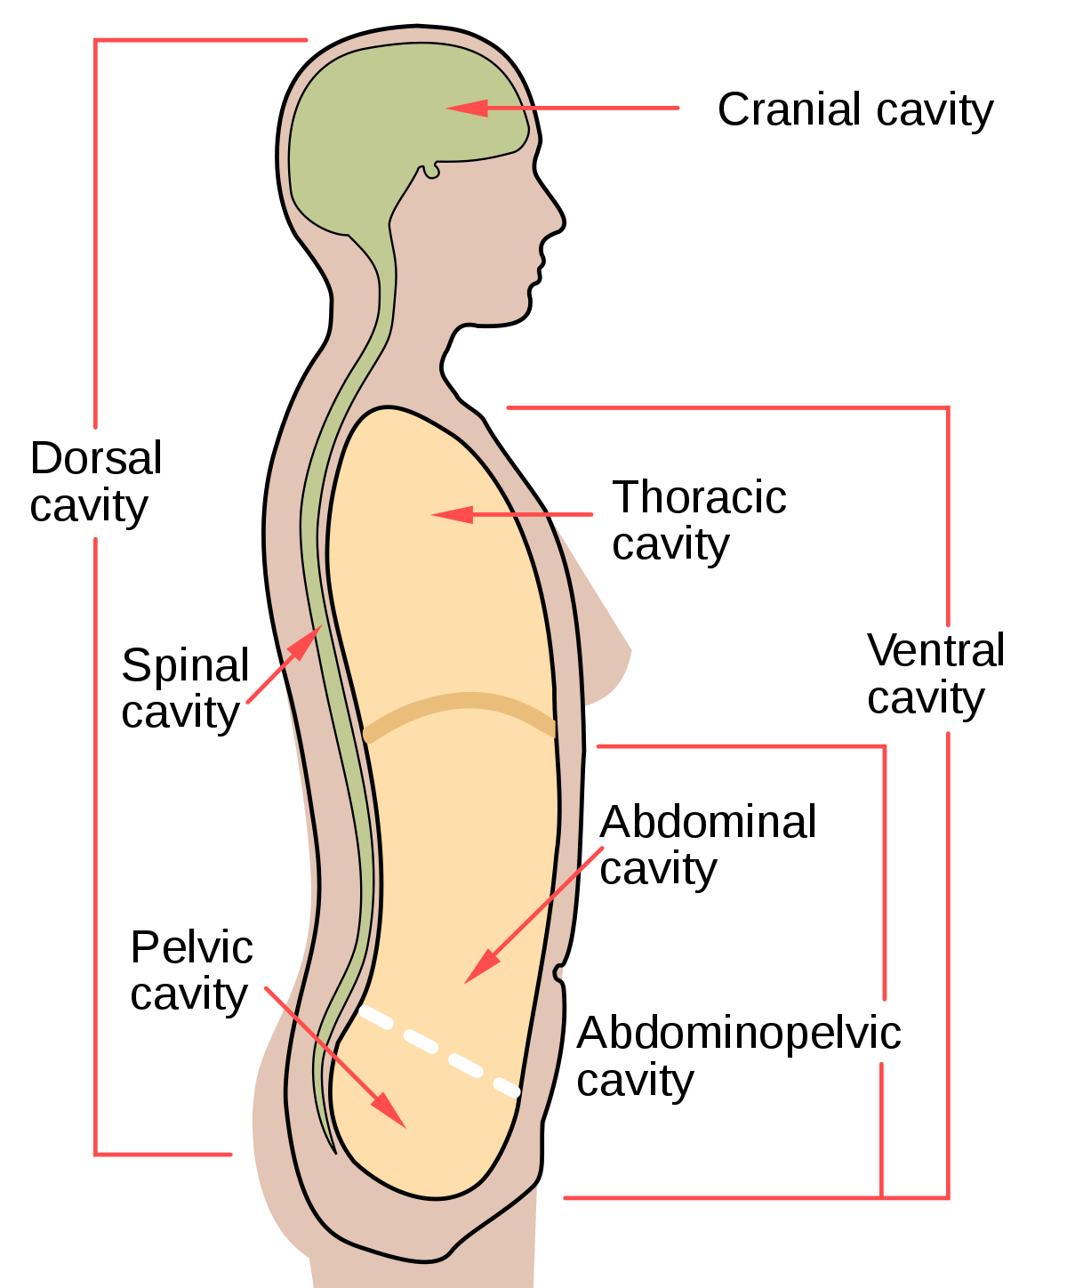
Major Cavity
The major cavity of cardiovascular system is the Thoracic Cavity

Slide 13
How to have a healthy cardiovascular system ?

Slide 14
Maintaining a Good Health
Exercise 30 mins a day
Do not smoke
Maintain a good diet

Slide 15
Failed Cardiovascular System

Slide 16
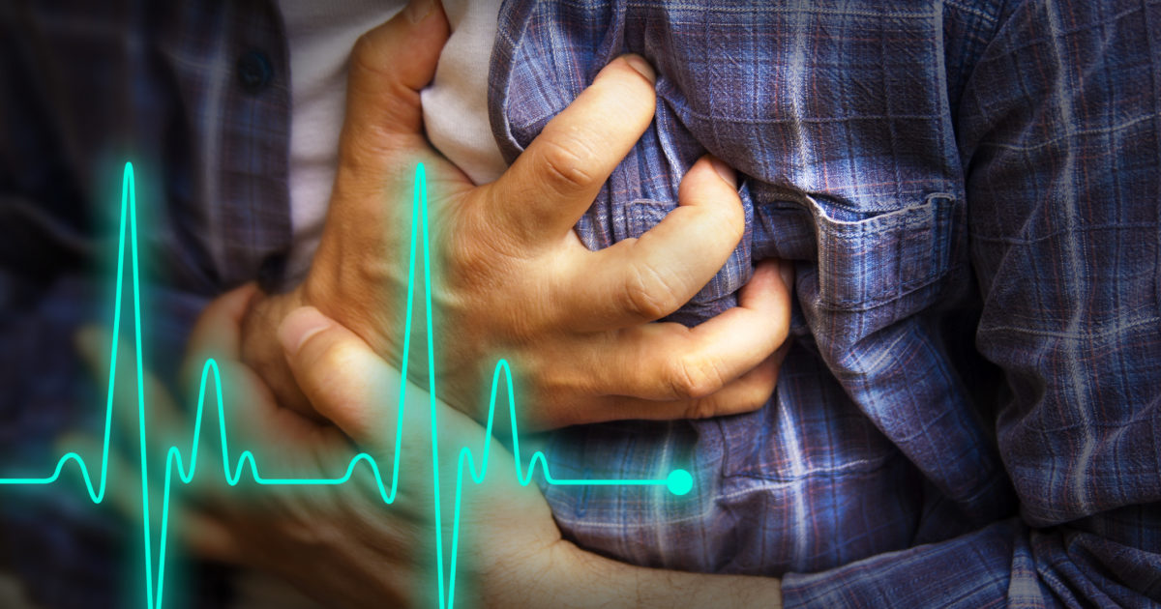
Failed System
Cardiac arrest:
Oxygen and blood won’t reach each part of the body
Lose consciousness and most likely to result in death
Heart stop pumping
Other body system stop working

Slide 17
Fun Facts

Slide 18
2,000 gallons
of blood were pumped by the heart within a day

Slide 19
60,000 miles
If you stretch out blood vessel system, it would extend over…

Slide 20
Questions?

Slide 21
References
https://www.medicinenet.com/script/main/art.asp?articlekey=2738
https://wa.kaiserpermanente.org/kbase/topic.jhtml?docId=tx4097abc
https://www.betterhealth.vic.gov.au/health/conditionsandtreatments/circulatory-system
https://embryology.med.unsw.edu.au/embryology/index.php/Cardiovascular_System_-_Heart_Histology
https://www.ncbi.nlm.nih.gov/books/NBK26848/
https://www.healthline.com/health/fun-facts-about-the-heart

Slide 22
Thank you!

