Slide 1
Nervous System
Warit 3
Thanop 14
Kantanat 25

Slide 2
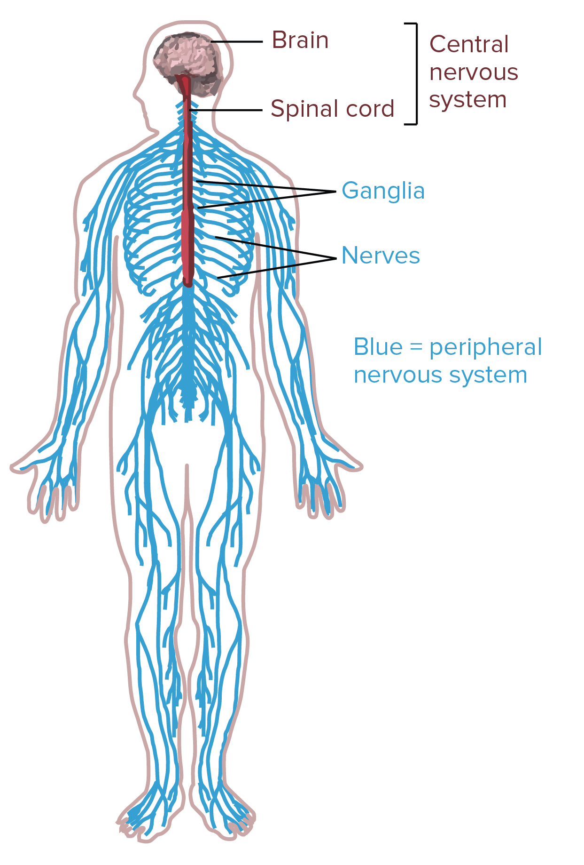
What is it?
The nervous system is a complex network of nerves and cells that carry messages to and from the brain and spinal cord to various parts of the body. It is also essential in keeping the other bodily systems operating.

Slide 3
How does it work?
Transmitting and receiving electrical impulses inside the body.
It works through a complex network of neurons, which are the basic functioning cells of the nervous system. The neurons conduct the signals or impulses between the two components of the nervous system, the central and the peripheral nervous system.

Slide 4
What is involved?
Central Nervous System
Peripheral Nervous System

Slide 5
The central nervous system (CNS)
Is composed of the brain and spinal cord
responsible for integrating and coordinating the activities of the entire body.

Slide 6
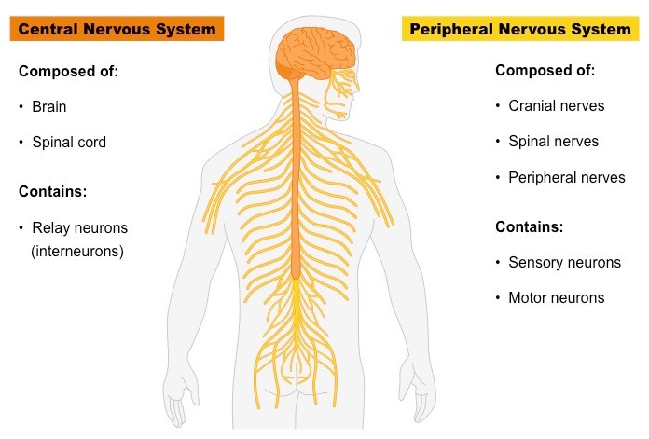
The peripheral nervous system (PNS)
It connects the CNS to the rest of the body
Responsible for controlling movements of specific parts of the body

Slide 7
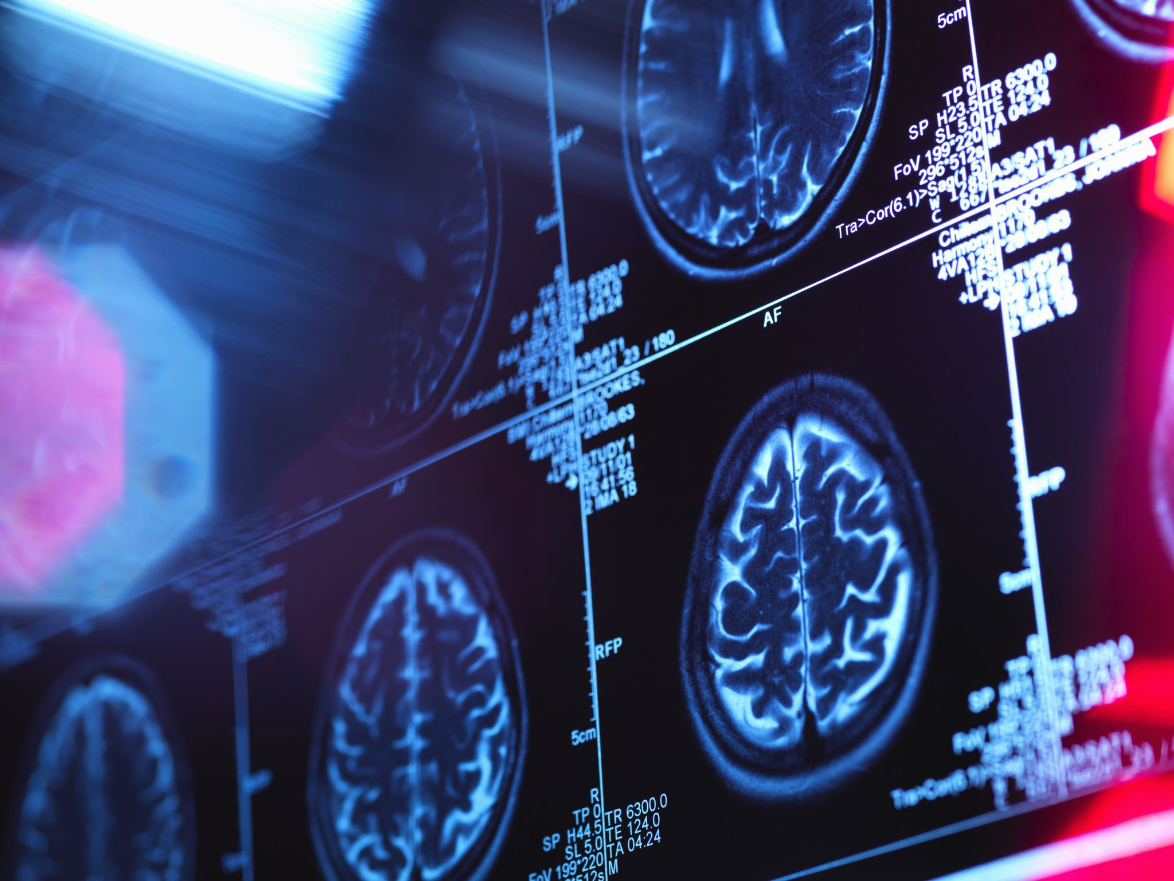
The connection between CNS and organs allows the system to be in two different functional state. Sympathetic Parasympathetic

Slide 8
Sympathetic nervous system (SNS)
Reacting to the environment

Slide 9
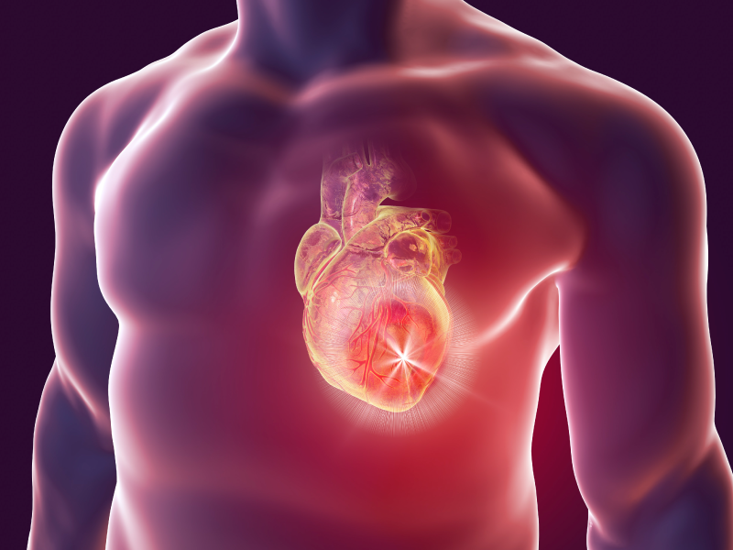
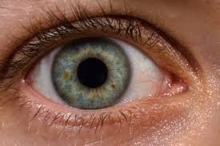
Parasympathetic nervous system (PSNS)
Activation of the SNS causes the pupils of the eyes to dilate, inhibits digestion, increases sweat secretion, and increases the heart rate.

Slide 10
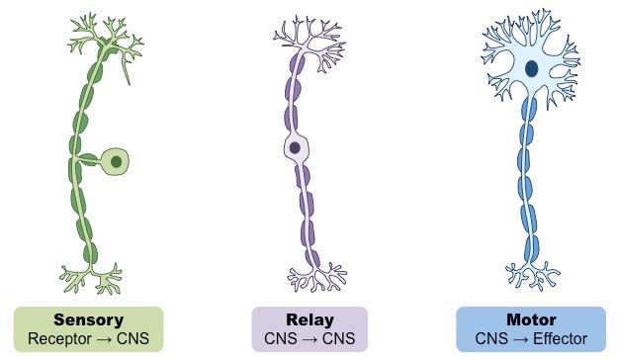
Fun Fact
There are 3 types of neuron:
Sensory neurons
Motor neurons
Relay neurons

Slide 11
What tissue are involved???
Nervous tissue makes up the nervous system

Slide 12
How its effect in real life?
When the nervous system is damage neither by , it may cause paralyze or male functioning to the body.
Disease:
Alzeimer’s disease
Celebral palsy
Motor neuron disease
Pakinson’s disease

Slide 13
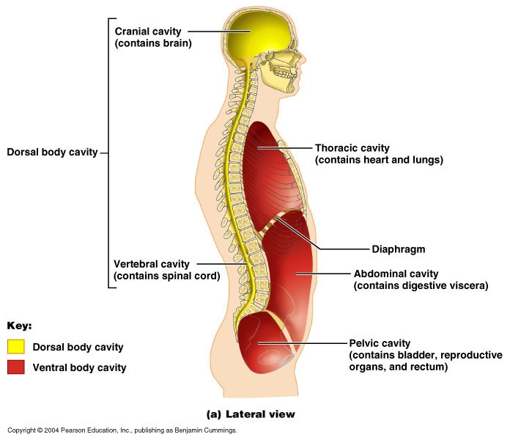
What cavity are involve
The cranial cavity is the area within the skull that contains the brain. The vertebral cavity encloses the vertebral column and the spinal cord

Slide 14
Reference
https://bodytomy.com/how-does-nervous-system-work
https://www.webmd.com/brain/what-is-nervous-system
https://biologydictionary.net/central-nervous-system/
https://www.verywellmind.com/what-is-the-peripheral-nervous-system-2795465

