Slide 1
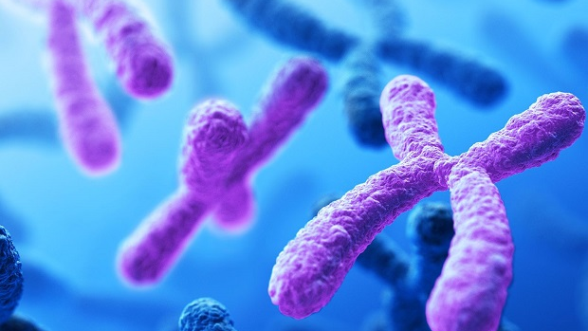
8.2 The Cell Cycle
Unit 5: Cell Reproduction

Slide 2
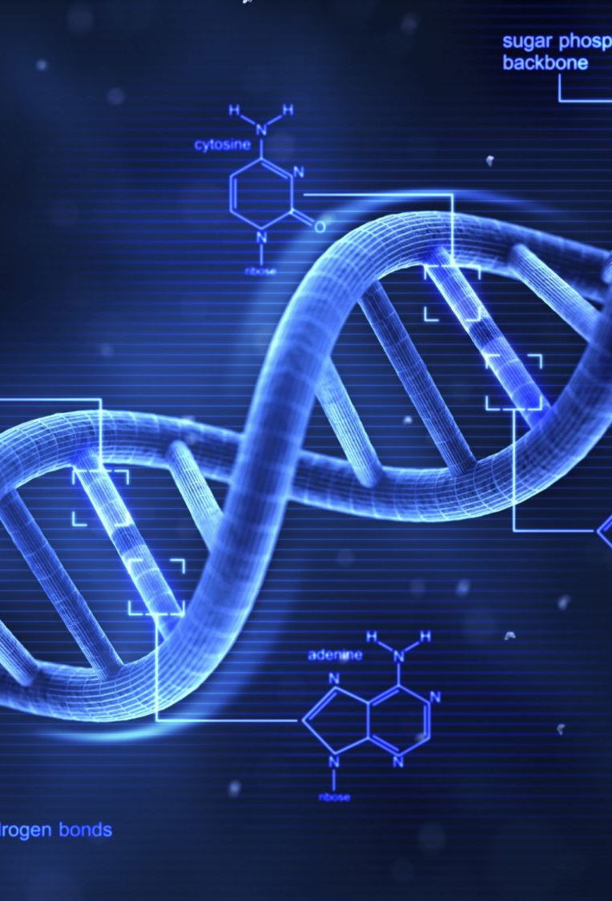
About __ ______ cells per second are produced by an adult human body every day. All cells come from the _________ of pre-existing cells.

Slide 3
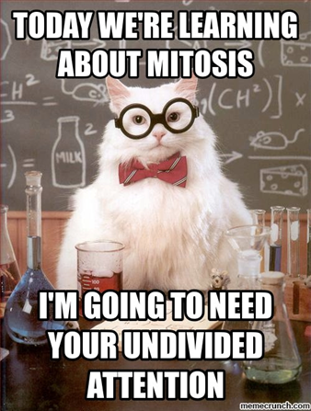
Student Objectives
Describe the events of cell division in prokaryotes.
Name the two parts of the cell that are equally divided during cell division in eukaryotes.
Summarize the events of interphase.
Describe the stages of mitosis.

Slide 4
Cell Division

Slide 5
What are reasons for cell division?

Slide 6
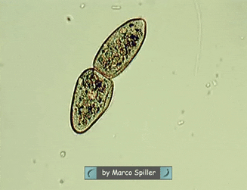
Cell Division in Prokaryotes
For most prokaryotes, cell division takes place through a process called _______ ________.
Binary fission is the division of a prokaryotic cell into two offspring cells.
DNA is copied
New material is added to the cell
Cell membrane develops between the two DNA copies
Splits up into two identical cells

Slide 7
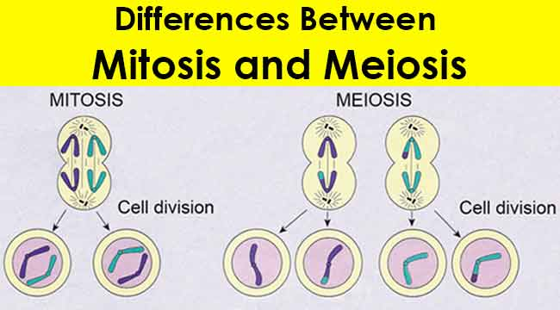
Cell Division in Eukaryotes
In eukaryotic cell division, both the _________ and the ________ divide.
Two types of cell division:
_______
_______

Slide 8
Mitosis
Mitosis results in new cells with genetic material that is ________ to the genes of the original cell.
Mitosis occurs in organisms undergoing growth, development, repair, or asexual reproduction.
_________ reproduction is the production of offspring from one parent.

Slide 9
Meiosis
Meiosis occurs during the formation of ________.
Gametes are ________ _________ ______.
Meiosis reduces the chromosome number in half by new cells. Each new cell has the potential to join with another haploid cell to produce a diploid cell with a complete set of chromosomes.

Slide 10
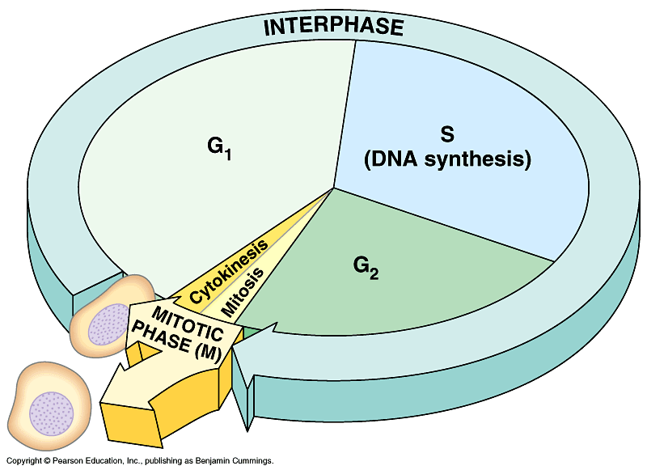
The Cell Cycle
The cell cycle is the repeating set of events in the life of a cell.
The time between cell divisions is called interphase (3 phases).
Cell division is divided into two phases:
___________
_______ _____
During cell division, the chromosomes and cytoplasm are equally divided between the two offspring cells.
Mitosis is the division of the nucleus.
Cytokinesis is the division is the cell’s ________.

Slide 12
Interphase
Cells spend most of the cell cycle in the interphase.
G₁ phase: offspring cells _____ and mature size.
S phase: the cell's ___ is _______
G₂ phase: the time during which the cell prepares for cell division.
G₀ phase: Cells do not copy their DNA and do not prepare for cell division.

Slide 14
Stages of Mitosis
Mitosis is the division of the nucleus, which occurs during cell division.
Mitosis is a continued process that allows for the organized distribution of a cell’s copied DNA to offspring cells.
Mitosis has four stages:
__________
__________
__________
__________

Slide 15
Control of Cell Division
In eukaryotes, ________ regulate the progress of cell division at certain checkpoints.
Cell growth (G₁) checkpoint Proteins at this checkpoint control whether the cell will divide.
DNA synthesis (G₂) checkpoint DNA repair enzymes check the results of ____ _________.
Mitosis checkpoint. Proteins signal the cell to exit mitosis.

Slide 16
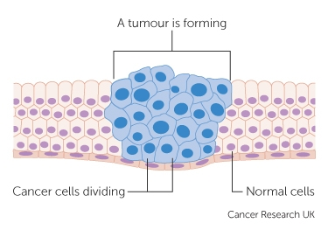
When is lost: Cancer
The proteins that regulate cell growth and division are coded for by genes.
If a mutation occurs in one of these genes, the proteins may not function properly.
Disruption in cell growth and division may lead to cancer, the _____________ _______ ___ ______.

Slide 19
Review Questions
Name the process by which prokaryotic cells divide.
What is the name of the process by which the cell’s cytoplasm divides?
During which of the phases of interphase does an offspring cell grow to mature size?
During which phase of mitosis do chromatids separate to become chromosomes?
Which type of molecule controls the cell cycle?
What would happen if cytokinesis took place before mitosis?
What would result if chromosomes did not replicate during interphase?
Why are individual chromosomes more difficult to see during interphase that during mitosis?

