Slide 1
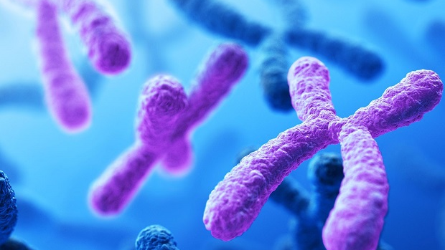
8.1 Chromosomes
Unit 5: Cell Reproduction

Slide 2
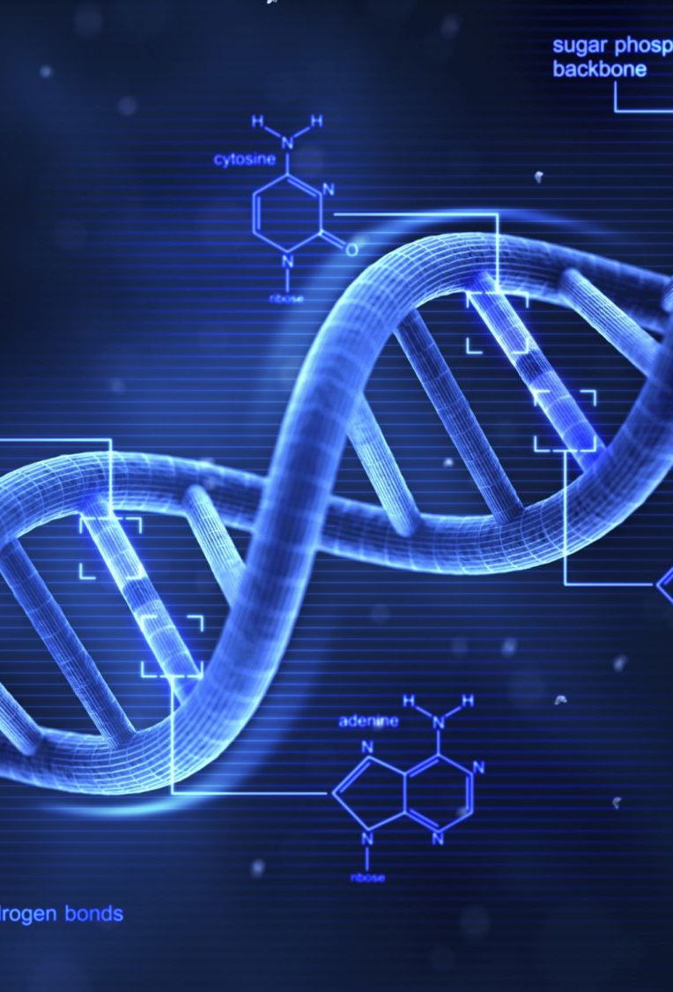
DNA are long, thin molecules that store _______ ________. The DNA of a human cell has about 3 billion nucleotides.

Slide 3
Student Objectives
Describe
Describe the structure of a chromosome.
Identify
Identify the differences in structure between prokaryotic chromosomes and eukaryotic chromosomes.
Compare
Compare the numbers of chromosomes in different species.
Explain
Explain the differences between sex chromosomes and autosomes.
Distinguish
Distinguish between diploid and haploid cells.

Slide 4
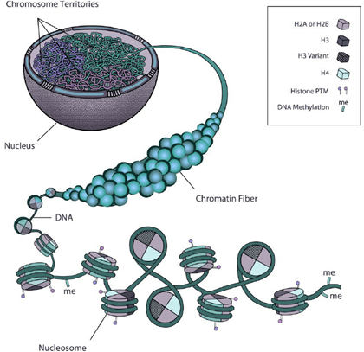
Chromatin
When there is no cell division, DNA is not so tightly coiled into chromosomes.
Regions of DNA uncoil in between cell division so they can be read and so the information can be used to direct the activities of the cell.
The less tightly coiled DNA-protein complex is called ___________.

Slide 5
Chromosome Structure
During cell division, the DNA in a eukaryotic cell’s nucleus is coiled into very compact structures called ___________.
Chromosomes are rod-shaped structures made of _____ and _______.
The DNA in eukaryotic cells wraps tightly around proteins called __________.
Histones help maintain the ______ of the chromosome and aid in _____ _______of DNA.

Slide 6
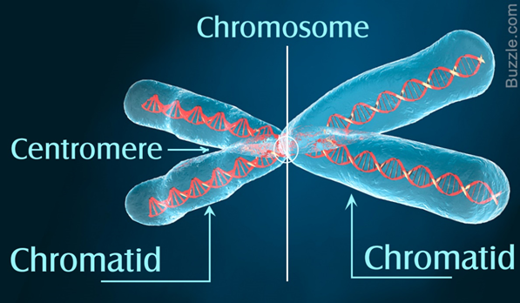

Slide 7
Parts of Chromosomes
Chromatids form as the DNA makes a copy of itself before ____ ________.
A chromosome consists of two identical halves.
Each of these identical halves in a chromosome is called a ___________.
The two chromatids of a chromosome are attached at a point called a ________.
The centromere holds the two chromatids together until they separate during cell division.

Slide 8
Prokaryotic vs Eukaryotic Chromosomes
The DNA of most prokaryotes consists of only one chromosome, which is attached to the inside of the cells membrane.
Prokaryotic chromosomes consist of a single circular DNA molecule.
Eukaryotic chromosomes must be very compact to fit into the cell.

Slide 9
Chromosome numbers
Each ______ has a characteristic number of chromosomes in each cell.
Some species of organisms have the same number of chromosomes, for example, potatoes, chimpanzees, and plums all have 48 chromosomes.

Slide 10
Sex Chromosomes and Autosomes
Human and animal chromosomes are categorized as either ____ __________ of _________.
Sex chromosomes are chromosomes that determine the sex of an organism.
In humans, sex chromosomes are either X or Y.
All the other chromosomes in an organism are called autosomes.

Slide 11
Homologous Chromosomes
Every cell of an organism produced by sexual reproduction has two copies of each autosome.
The two copies of each autosome from each parent are called __________ ___________. These chromosomes are the ___ _____and _____ and carry genes for the same ______.
A karyotype is a _________________ of the chromosomes in a normal dividing cell found in human.

Slide 12
Diploid and Haploid Cells
Cells having two sets of chromosomes are called diploid.
Diploid cells have two autosomes for each homologous pair. Diploid cells also have two sex chromosomes in animals. Diploid cells are normally abbreviated as ‘2n’.
All human cells, except the reproductive cells are normally _____ ____.
Sperm cells and egg cells are haploid cells, which contain only ___ ____ of chromosomes.
Haploid cells have half the number of chromosomes that are present in diploid cells. Haploid is abbreviated as ‘1n’.

Slide 13
Review Questions
Name the proteins that DNA wraps around to form a chromosome in eukaryotic cells.
How do the structure and location of a prokaryotic and eukaryotic chromosome differ from each other?
Does chromosome number indicate whether an organism is a plant or an animal? Explain.
Contrast sex chromosomes with autosomes.
Is there a correlation between the number of chromosomes and the complexity of an organism? Give support of your answer.
What would be a consequence for future generations of cells if sperm and egg cells were normally diploid?

