Slide 1
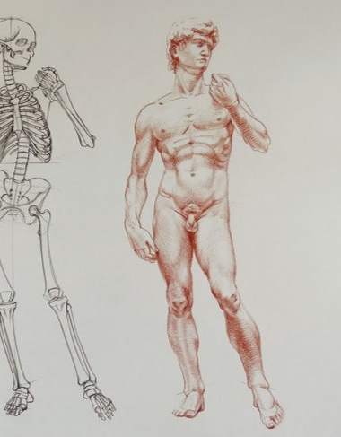
51.2 The Male Reproductive System
Unit 3: The Reproductive Systems

Slide 2
Student Objectives
Describe
Describe the location and functions of the testes.
Explain
Explain the functions of the epididymis, ductus deferens, ejaculatory duct, and urethra.
Explain
Explain the functions of the seminal vesicles, prostate gland, and bulbourethral glands.
Describe
Describe the composition of semen, and explain why its pH must be alkaline.
Name
Name the parts of a sperm cell, and state the function of each.

Slide 3
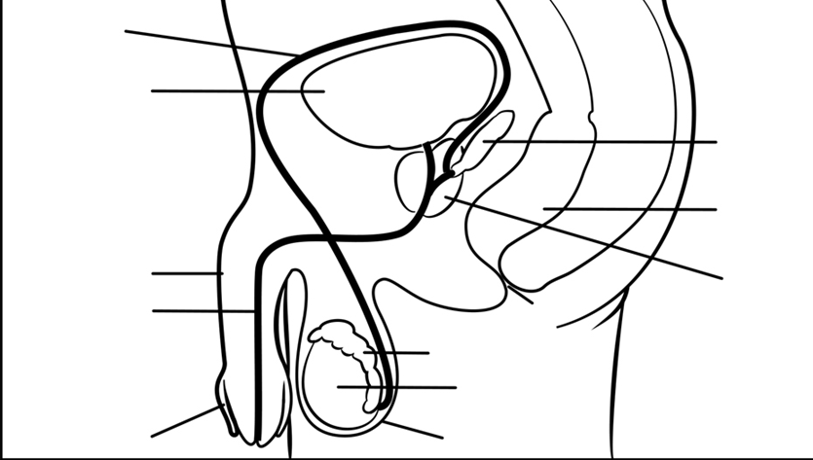
Male Reproductive System Anatomy

Slide 4
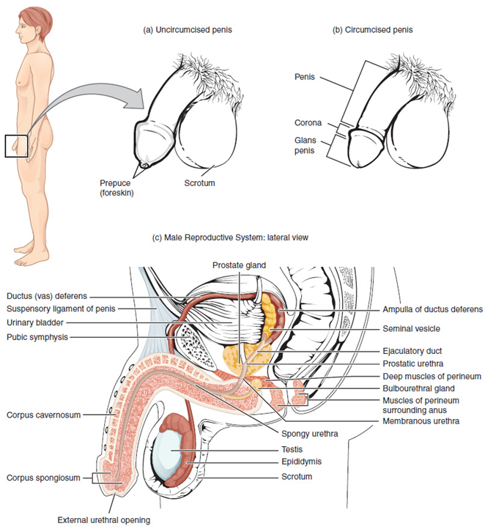

Slide 5
Scrotum
Testes are located in the scrotum.
Temperature = 35.5 degrees Celsius
Cryptorchidism is the condition in which the testes fail to descend from kidneys.

Slide 6
Testes
Testes are about 4 cm by 2.5 cm and are divided in lobes.
Seminiferous tubes are in the lobes.
Several cells are located in the Seminiferous tubes:
Spermatogonia
Sustentacular cells (inhibin)
Interstitial cells (testosterone)

Slide 7
Structure of Sperm cells
The head contains 23 chromosomes.
The tip of the head is the acrosome, enzyme to digest the membrane of an egg cell.
Within middle piece are mitochondria that produce ATP.
The flagellum provides motility.

Slide 8
Epididymis
In the Epididymis sperm matures and flagella becomes functional.
Peristalsis waves move sperm into Vas Deferens.

Slide 9
Vas Deferens
The Vas Deferens extends from epididymis through the inguinal canal into the abdominal cavity.
The Vas Deferens goes upward over the bladder, then down the posterior side to join the ejaculatory duct.

Slide 10
Ejaculatory Ducts
Each of the two ejaculatory ducts receives sperm from the Vas Deferens and secretion of the seminal vesicle.
Both ejaculatory ducts empty into the single urethra.

Slide 11
Seminal Vesicles
The paired seminal vesicles are posterior to the urinary bladder.
They secrete fructose to provide energy for sperm.
It is alkaline (basic acidity) to enhance sperm mobility.

Slide 12
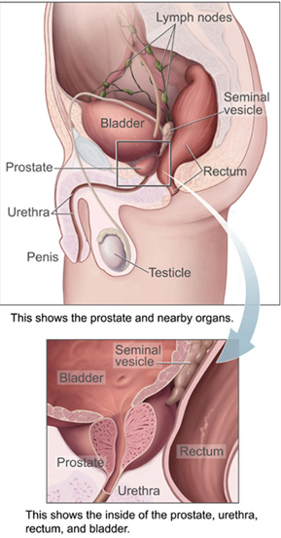
Prostate Gland
A muscular gland just below the urinary bladder, the prostate gland (3 cm by 4 cm).
The prostate excretes alkaline fluid to promote sperm mobility.
The smooth muscle of the prostate gland contracts during ejaculation to contribute to the expulsion of semen.
The alkaline secretion assists to neutralize the acidic environment of the female reproductive system.

Slide 13
Bulbourethral glands
The bulbourethral glands secrete alkaline secretion just before ejaculation to neutralize acidic urine.

Slide 14
Urethra - Penis
The Urethra is the duct and longest portion is enclosed within the penis.
The Penis is an external genital organ.
Within the penis are 3 masses of cavernous (erectile) tissue. Each consists of framework of smooth muscle and connective tissue that contains blood sinuses.

Slide 15
Semen
Semen consists of sperm and the secretions of seminal vesicles, prostate gland, and bulbourethral gland.
Average PH is 7.4
2 – 4 ml is expelled and has between 200 to 400 million sperm cells.

Slide 16
Review Questions
What's the location and function of the testes?
Why pH of semen alkaline?
Differentiate between the functions of the epididymis, ductus deferens, ejaculatory duct, and urethra.
List the three structural parts of semen cells.

