Slide 1
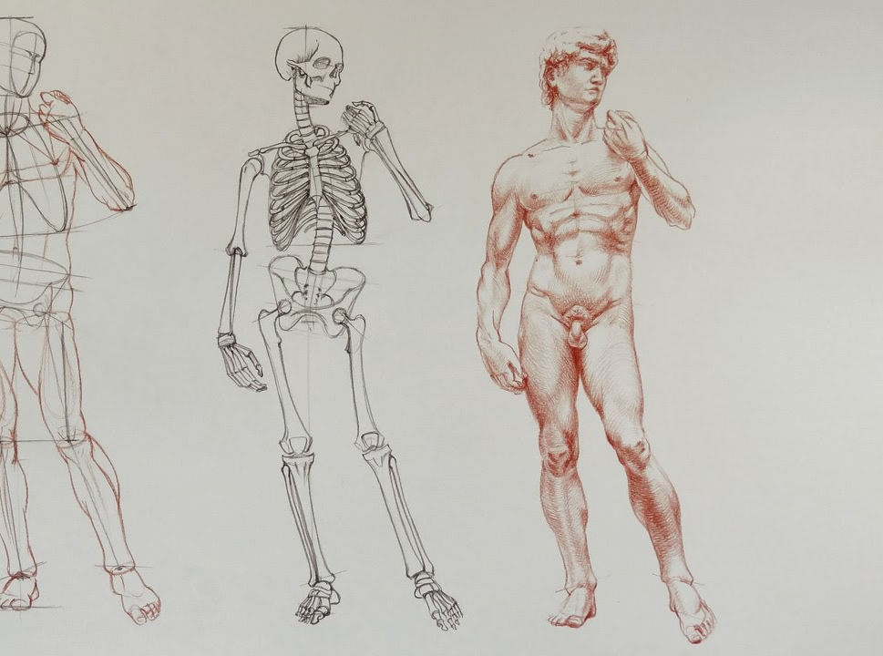
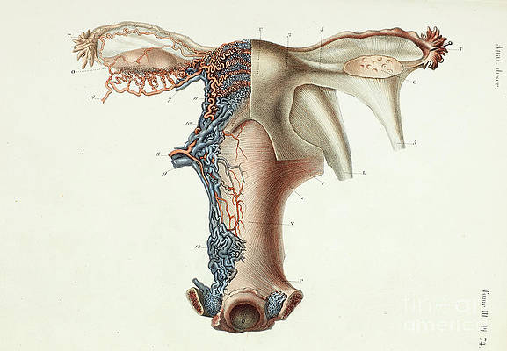
51.1 Meiosis
Unit 3: The Reproductive Systems

Slide 2
Reproductive system
Purpose: continue the human species by the production of offspring.
The Male and Female Reproductive systems produce gametes, sperm and egg cells, and ensure the union of gametes in fertilization following sexual intercourse.

Slide 3
Student Objectives:
Describe
Describe the process of meiosis. Define diploid and haploid.
Describe
Describe the difference between spermatogenesis and oogenesis.
Name
Name the hormones necessary for formation of gametes and state the function of each.

Slide 4
Mitosis and Meiosis
Mitosis is the type of cell division that occurs in non-reproductive cells.
Produces exact copies of the parent cell
The cell division process of meiosis produces the gametes – sperm of egg cells.
Diploid number of chromosomes (46 for humans) divides twice to form 4 cells, each with the haploid number of chromosomes.
Haploid means half the usual diploid numbers (23 for humans)
Produces egg and sperm cells with half the genetic material of the parent cells.

Slide 5
Spermatogenesis
Spermatogenesis is the meiosis in the testes, the site of sperm production.
Within each of the testes are seminiferous tubules that contain spermatogonia (stem cells that generate sperm).

Slide 6
Hormones during Spermatogenesis
Follicle-stimulating hormone (FSH) initiates sperm production.
From anterior pituitary gland
Testosterone promotes maturation of sperm.
Secreted by testes
Testosterone is stimulated by Luteinizing hormone (LH) from anterior pituitary gland
Inhibin decreases secretion of FSH.
Secreted by testes
Sperm production begins at puberty (10 -14 years of age). There is usually no complete cessation.

Slide 7
Oogenesis
Oogenesis is the process of meiosis for egg cell formation; it begins in the ovaries.
Oogonium is a stem cell for egg cell production.

Slide 8
Hormones during Oogenesis
FSH initiates the growth of ovarian follicles, each of which contains an oogonium.
FSH stimulates the follicle cell to secrete estrogen, which promotes maturation of ovum.
Production of ova begins at puberty (10 to 14 years of age) and continues until menopause (45 – 55 years of age), when the ovaries no longer respond to pituitary hormones.
Egg production is cyclical, with a mature ovum being produced every 28 days.

Slide 9
Fertilization
The ovum and sperm cells have each 23 chromosomes.
When fertilization occurs the nuclei of the egg and sperm merge, and the fertilized egg (zygote) has 46 chromosomes, the diploid number.

Slide 10
Review Questions
https://forms.office.com/Pages/ResponsePage.aspx?id=YzWx4RGiPUyPO79ZhA9cN52asZGNOU5NsDR9d4NVtd9UQzFEN0JEQUQ1NVNDOFY0OFRMNTBIOFkxOS4u

