Slide 1
Immune system
Peerawich Jirathun Phattarapol

Slide 2
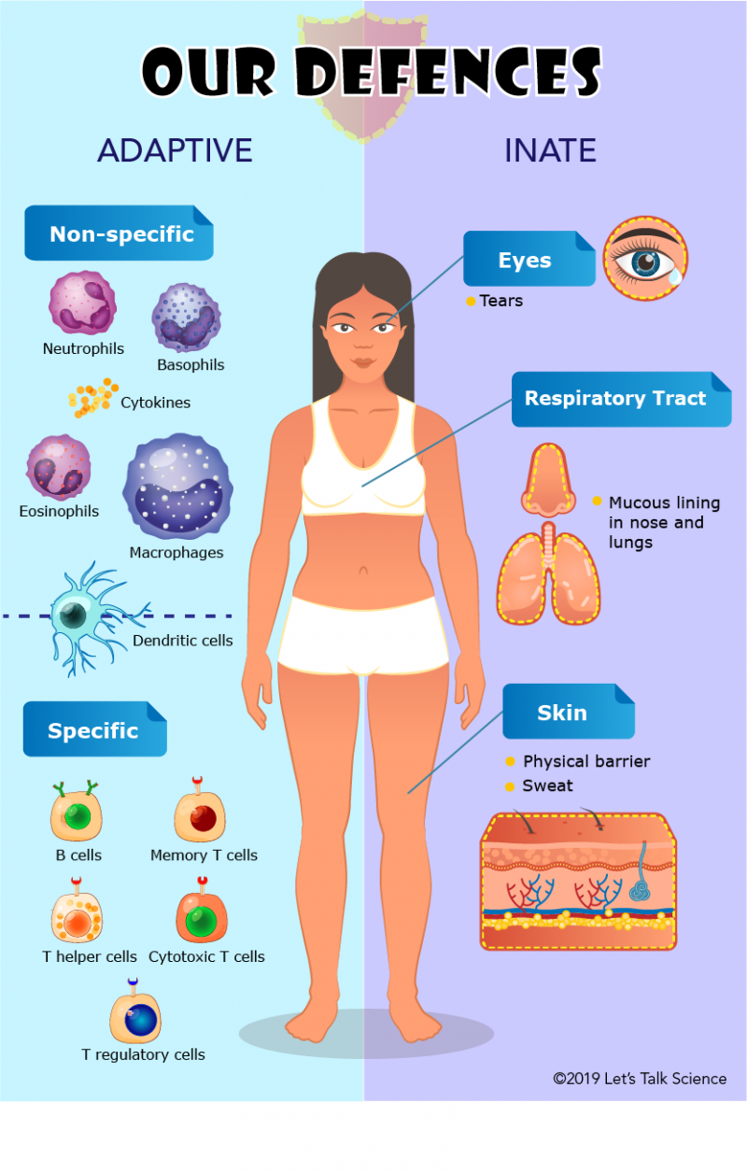
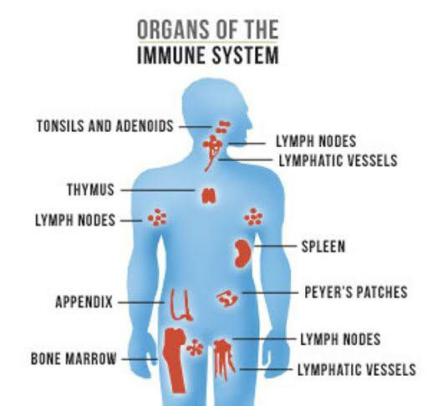
What is it?
- A complex network of cells, tissues and organs that helps the body fight infections and other diseases.
-The immune system includes white blood cells and organs and tissues of the lymph system, such as the thymus, spleen, tonsils and bone marrow.

Slide 3
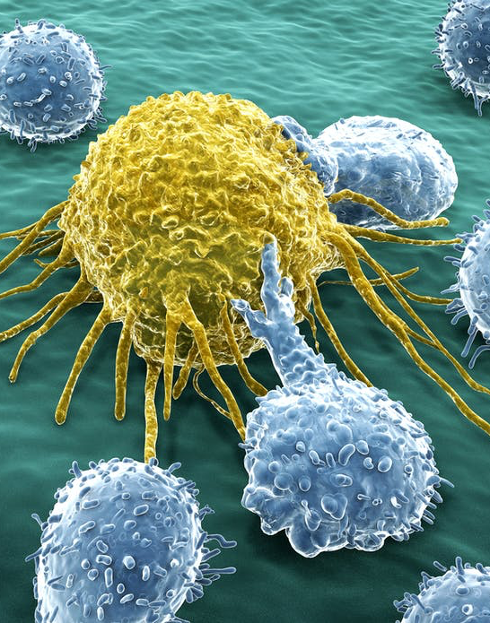
How does it work?
-The immune system is activated by things that the body doesn’t recognize as its own called antigens.
-Examples of antigens include the proteins on the surfaces of bacteria, fungi and viruses.
When the antigens attach to special receptors on the immune cells (ex.White blood cells)
-A series of processes are triggered in the body when it comes into contact with a disease
- If it is the first time that they come across such a germ they usually document the information on it and how to fight it.
- So if it comes across the same germ again it can fight it off more effectively

Slide 4
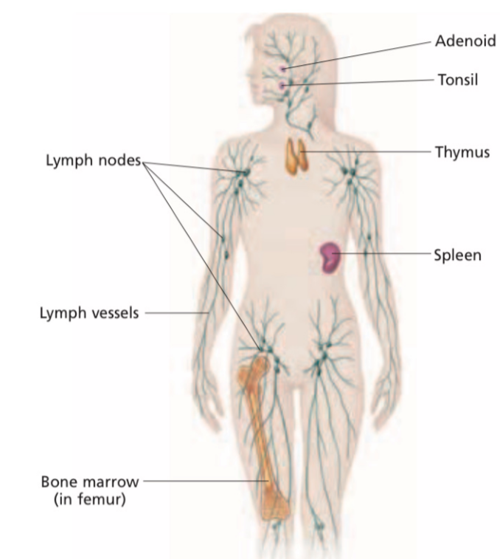
What is involved?
Made up of several tissues and white blood cells, and each part of immune system plays a special role to defending the body against pathogens.
Found through out the body, the tissues include the bone marrow, thymus, lymph nodes, spleen, tonsils, and adenoids
White blood cell call lymphocytes
Contain lymphocytes
Are masses of lymph tissue found in the nose and throat
blood vessel that carry lymph
A gland that helps produce a special kind of lymphocyte
Stores healthy blood cells, break down red blood cells, and develop lymphocytes also the other type of white blood cells
Soft material found inside long bones make a new lymphocytes

Slide 5
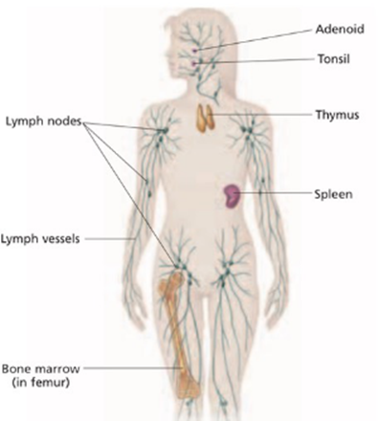
Which king of tissue types are involved?
Primary
The site where the cell being produce and sent out
Bone marrow and thymus
Secondary
A place where the adaptive immune system response.
Spleen

Slide 6
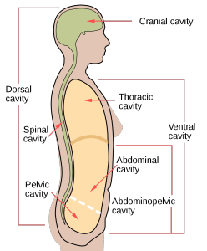
Which major cavities are involved
Thoracic cavity – Thymus
Abdominal cavity – Spleen, lymph nodes
Oral cavity – Tonsil, Adenoid

Slide 7
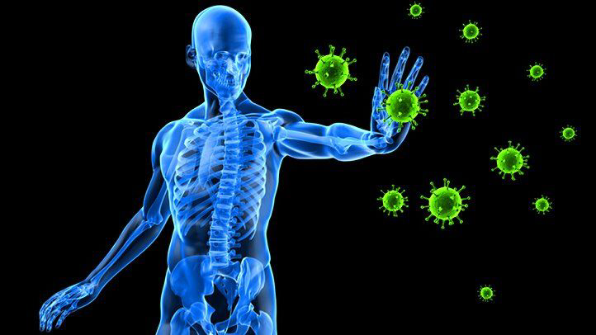
Application
Here are some benefits of a healthy immune system
Overall health –Makes you overall a healthier person and less vulnerable to diseases
Oxygenated blood – The blood is better and has more oxygen which helps the cells and organs allowing them to function better
Improved production of lymph – Allows better circulation of white blood cells and other nutrients throughout the body.
Healthy skin, nails and hair – You’ll have brighter skin, healthier hair, and stronger nails.
Better digestion – Allows food to be fully digested so your body can absorb more nutrients and eliminate waste more efficiently
You can gain a healthy immune system by
- Exercise frequently
-Get enough sleep
- Eat a healthy and balanced diet
-Drink enough water

Slide 8
Application
Here is also an example when the immune system fails and go out of control
Leukemia
-The cause is unknown but you’re more likely to have it if you have a family member who had it , smoking or genetic disorders
- It is a cancer within the bone marrow causing it to produce too many white blood cells
-These white blood cells aren't normal and they cause an autoimmune reaction (start killing other cells)
- The treatment usually requires a donation of the bone marrow to replace the infected ones
A weak immune system can be caused by
- Constant Stress
- Too much alcohol
- Lack of sleep or exercise
- Unhealthy diet
It can cause various symptoms such as
-digestive issues, including loss of appetite and diarrhea
-growth and developmental delays, in infants and children
- become more vulnerable to diseases (get sick easily)
- Wounds heal slower
- Constantly feeling tired

Slide 9
Fun Fact !!!
The immune system is power by 5 liter of bloods and lymph
Having a fever and inflammation are signs that your body is doing its job.
If you’re not getting more than five hours of sleep a night, your immune system can become depressed. This leaves you open to colds, flu, and infection.
Laughter helps immune system

