Slide 1
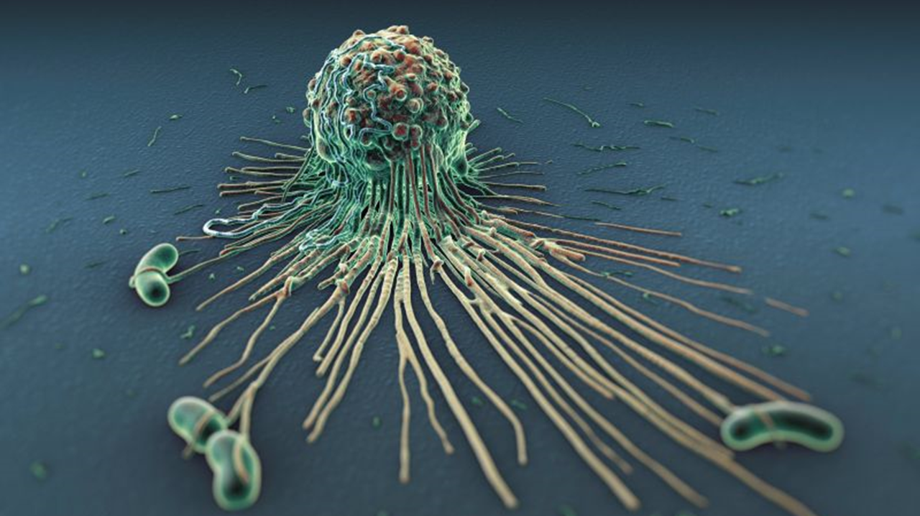
47.3 HIV and AIDS
Chapter 47: The body’s Defense Systems

Slide 2
The immune system normally provides protection against infectious diseases. The importance of the immune system can be seen in diseases of which the immune system does not function properly.

Slide 3
Student Objectives
Describe the relationship between HIV and AIDS.
Distinguish between the three phases of HIV infection.
Identify the two main ways that HIV is transmitted.
Determine how evolution of HIV affects the development of vaccines and treatment.

Slide 4
AIDS
AIDS (acquired immunodeficiency syndrome) is a deadly disease in which the immune system loses its ability to fight off pathogens and cancers.
AIDS was recognized as a disease in 1981.
Since then, it has killed more than 35.4 million people worldwide.

Slide 5
The Course of HIV Infection
AIDS results from infection by the human immunodeficiency virus, or HIV.
Once HIV has entered the bloodstream, HIV must bind to CD4, a receptor protein in the surface of some cells, and an associated protein (co-receptor). Macrophages have CD4 and the co-receptor.
HIV replicates in macrophages and releases the virus.
Viral replication results in many mutations.
HIV attaches and enters T cells and attach to other helper T cells. The virus kills these T cells and cripple the immune system.

Slide 6
Phase I
Phase I of HIV is called the asymptomatic stage, because there are few or no symptoms.
However, the amount of the virus increases due to replication.
The immune system begins an attack, and plasma cells make antibodies to fight the virus.
However, it may take several weeks for anti-HIV antibodies to become large enough to result in a positive HIV test.
HIV-infected people may feel well during phase I, but can still infect other people.
Phase I can last up to 10 years or more.

Slide 7
Phase II
Symptoms mark the start of phase II.
B cells continue to make a large amount of antibody against HIV.
The number of T cells drops steadily as the virus continues to replicate.
As the immune system fails, lymph glands become swollen, and fatigue, weight loss, fever, or diarrhea develop or worsen.
Some infected people may notice mental changes, such as forgetfulness and abnormal thinking patterns.

Slide 8
Phase III
The number of helper T cells drops so low that they can no longer stimulate B cells and cytotoxic T cells to fight invaders.
AIDS is diagnosed when helper T cells drops under 200 cells/mL blood. (normal level is over 600 cells/mL)
AIDS is fatal. Death results from the weakened immune system’s inability to fight opportunistic infections and cancers.

Slide 9
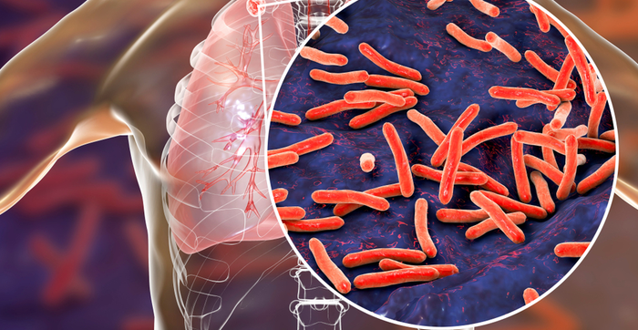
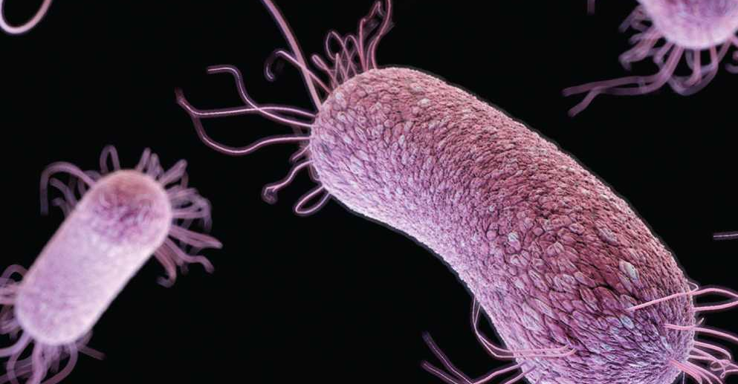
Opportunistic disease
AIDS may be diagnosed when an opportunistic disease has developed.
Opportunistic disease are illnesses caused by pathogens that produce disease in people with weakened immune systems.
These organisms do usually not create problems in people with healthy immune systems.
Opportunistic disease: pneumocystis pneumonia, tuberculosis, toxoplasmosis

Slide 10
Transmission of HIV
HIV is transmitted by the transfer of body fluids containing HIV or HIV-infected cells.
Transmission of HIV:
Sexual contact
Syringes or hypodermic needles
From infected mother before or during birth
Through breastfeeding
Blood transfusion

Slide 12
Vaccines and Treatments
Currently, there is no licensed HIV vaccine on the market, but multiple research projects are trying to find an effective vaccine.
There is evidence from humans that a vaccine may be possible.
The genes that code for the virus’s surface protein mutate frequently. New variants of the virus with different surface proteins are constantly appearing.

Slide 13
Review Questions
Describe the relationship between HIV and AIDS.
State the developments during the course of HIV infection that can lead to a diagnosis of AIDS.
List two ways that HIV can be transmitted and two ways it cannot.
Why have scientists been unable to develop an effective vaccine for HIV?
Evaluate the statement: “HIV infection causes death”.
Identify one similarity and one difference between HIV and a cold virus.

