Slide 1
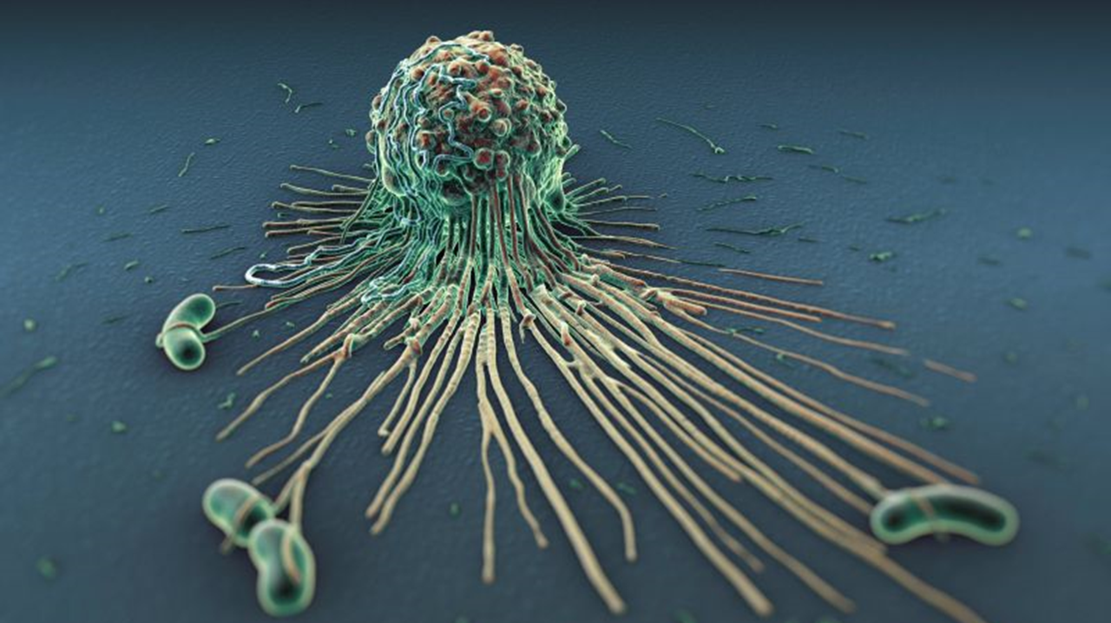
47.2 specific Defenses, The Immune System
Chapter 47: The body’s Defense Systems

Slide 2
Sometimes pathogens break through the nonspecific defenses. In response, the body begins its third line of defense – a response specifically at the pathogen.

Slide 3
Student Objectives
Identify and describe
Identify and describe the parts of the immune system.
Explain
Explain how the immune system recognizes pathogens.
Compare
Compare the actions of T cells and B cells in the immune system.
Relate
Relate vaccination to immunity.
Distinguish
Distinguish between allergy, asthma, and autoimmune disease.

Slide 4
The Immune System
The immune system, the white blood cells and tissues that recognize and attack foreign substances in the body, provides the body’s specific defenses.
The immune system fights pathogens and spread of cancers.
The tissues include the bone marrow, thymus, lymph nodes, spleen, tonsils, and adenoids.
The white blood cells of the immune system are called lymphocytes.

Slide 5
Parts of Immune System
Bone marrow makes billions of new lymphocytes needed by the body every day.
The thymus is a gland located above the heart that produces a special kind of lymphocyte.
Lymph nodes, located throughout the body along the vessels of lymphatic system, contain lymphocytes. Lymph nodes collect pathogens from the lymph and expose them to lymphocytes.
The spleen is the largest lymphatic organ in the body. It stores healthy blood cells, breaks down aging red blood cells, and helps develop lymphocytes and other types of WBCs.
The spleen also collects pathogens from the blood, and the lymphocytes in the spleen attack these trapped pathogens.
The adenoids and tonsils are masses of lymph tissue found in the nose and throat. The tonsils also signal immune response.

Slide 6
Types of Lymphocytes
There are two types of lymphocytes:
B lymphocytes are made in the bone marrow and complete their development there.
T lymphocytes are also made in the bone marrow but complete their development only after traveling to the thymus.

Slide 7
Recognizing Pathogens
Lymphocytes can provide specific defenses because they recognize foreign invaders.
An antigen is any substance that the immune system can recognize and react with.
Almost any molecule that is not a natural part of an individual’s body can act as a foreign antigen.
When lymphocytes recognize an antigen, they bind with it and start a specific attack called an immune response.

Slide 8
How do lymphocytes identify antigens?
A lymphocyte has unique receptor proteins all over the surface of its cells membrane.
These receptor protein recognize and bind to antigens that match their three-dimensional shape.
The surface of a bacterial cell, for instance, can be covered with many different kinds of molecules, each of which can function as an antigen and cause lymphocytes to react.
All of the receptors of a lymphocyte are the same shape or type, thus bind with one kind of antigen.
The immune system makes billions of different kinds of lymphocytes.

Slide 9
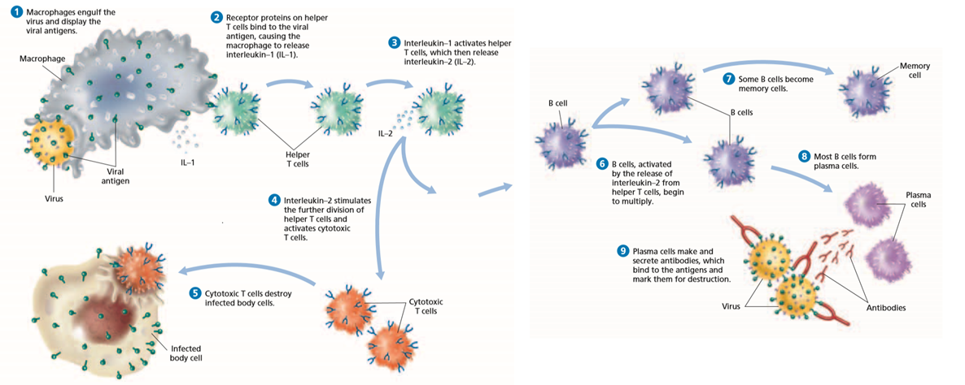

Slide 10
Immune Response
Macrophages engulf the pathogen and display the viral antigens. Then receptor proteins in helper T cells bind to the viral antigen, causing the macrophage to release interleukin-1. Interleukin-1 (Il-1) activates helper T cells, which then release Interleukin-2 (Il-2).
Then the immune response is a two-part assault on a pathogen:
The cell-mediated immune response
The humoral immune response
These responses happen at the same time and require specialized lymphocytes called a helper T cell.

Slide 11
Cell-Mediated Immune Response
More than one type of T cell carries out the cell-mediated immune response.
Il-2 stimulates the further production of helper T cells, that in turn release even more Il-2, allowing T cells to divide even faster.
Il-2 is also responsible for stimulating the production of cytotoxic T cells (killer T cells), which recognize and destroy cells that have been infected by the pathogen. These cells have the antigen on their surface.
Cytotoxic T cells:
Kill by making a hole in cell membrane
Kill cancer cells
Attack parasites and foreign tissues

Slide 12
Humoral Immune Response
The humoral immune response involves that action of B cells.
The release of Il-2 stimulates B cells that have receptors that are complementary to the antigen to divide and change into plasma cells.
Plasma cells are highly specialized cells that make defensive proteins called antibodies that are released into the blood.
An antibody binds to a specific antigen or inactivates or destroys toxins. Antibodies are Y-shapes molecules.
Plasma cells can make up to 30,000 antibody molecules per second.
Antibodies bind to pathogens, but do not destroy them. Antibodies inactivate the pathogen or cause the destruction by the nonspecific defenses.

Slide 13
Primary and Secondary Immune Responses
When an infection is overcome; some memory cells remain in the body throughout an individual’s life.
Memory cells are lymphocytes that will not respond the first time that they meet with an antigen or invading cell, but will recognize and attack that antigen or invading cell during later infections.

Slide 14
Immunity and Vaccination
Immunity is the ability to resist an infectious disease.
The body can undergo a primary immune response and survive the disease
Vaccination is the introduction of antigens into the body.

Slide 15
Vaccines
A vaccine is a solution that contain a dead or weakened pathogen or material from a pathogen.
With the antigens present the body will produce a primary immune response.
The memory cells that remain after the primary immune response can provide a quick secondary immune response if the antigen ever enters the body again.

Slide 16
Problems of the Immune System
Sometimes the immune system reacts to otherwise harmless antigens in ways that can be harmful:
Allergies
Asthma
Autoimmune Diseases

Slide 17
Allergies
An allergy is a physical response to an antigen.
The antigen can be a common substance that produces little or no response in the general population.
Examples: pollen, animal dander, dust mites, food, and fungal spores.
Most allergies are mild, but some can be life-threatening.
Many symptoms of an allergy result from the release of histamine. The drug antihistamine can counteract the effects.

Slide 18
Asthma
Allergies can also trigger asthma, a respiratory disorder that causes bronchioles to narrow. Asthma attacks occur when the muscles covering the bronchioles overreact to substances in the air.
Symptoms: difficulty breathing, shortness of breath, wheezing, and coughing.

Slide 19
Autoimmune Diseases
Autoimmune diseases are a disease in which the immune system attacks the organism’s own cells is called an autoimmune disease.
Lymphocytes that recognize and react to the body’s own cells are usually eliminated during development, before they become functional.
In rare cases the immune system does respond to the body’s own cells, attacking them as if they were pathogens.

Slide 20
Review Questions
Describe the functions of the spleen and of the bone marrow.
What is an antigen?
How does the role of B cells in the immune response differ from that of helper T cells?
Explain how vaccination stimulates immunity to a disease.
Name one similarity and one difference between autoimmune diseases and allergies.
Explain how B cells depend on T cells.
“A person who has just recovered from a cold cannot get the flu.” Is this statement true? Explain your reasoning.
Would vaccine research be useful in preventing autoimmune diseases? Explain your reasoning.

