Slide 1
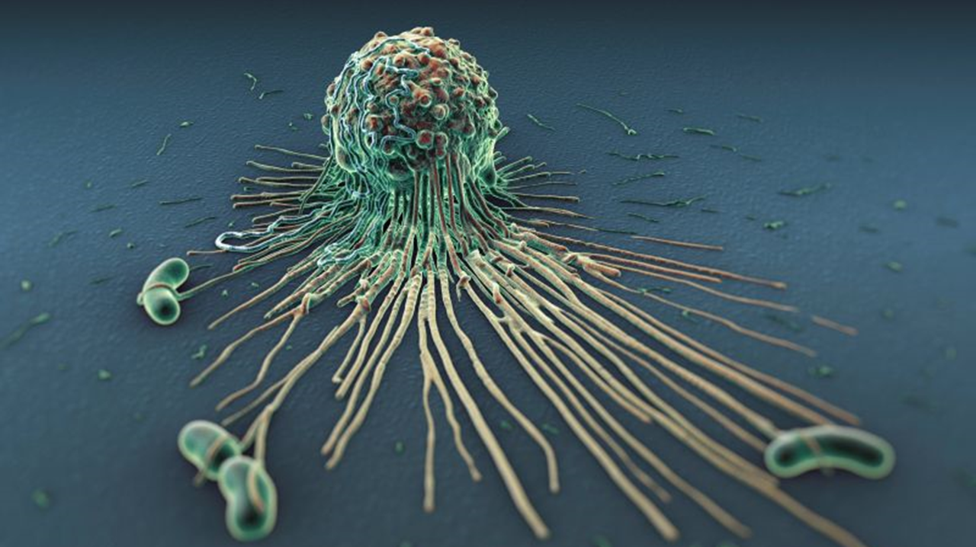
47.1 Nonspecific Defenses
Chapter 47: The body’s Defense Systems

Slide 2
Diseases that are caused by agents that have invaded the body are called __________ __________.

Slide 3
Student Objectives
Summarize
Summarize Koch’s postulates for identifying a disease-causing agent.
Describe
Describe how the skin and mucous membranes protect the body against pathogens.
Describe
Describe the steps of the inflammatory response.
Analyze
Analyze the roles of white blood cells in fighting pathogens.
Explain
Explain the functions of fever and proteins in fighting pathogens.

Slide 4
You wake up one morning with a stuffy nose, slight fever, and fatigue. Do you have a cold or the flu? Or are they the same?
Should you go to your doctor for an antibiotic? Why or why not?

Slide 5
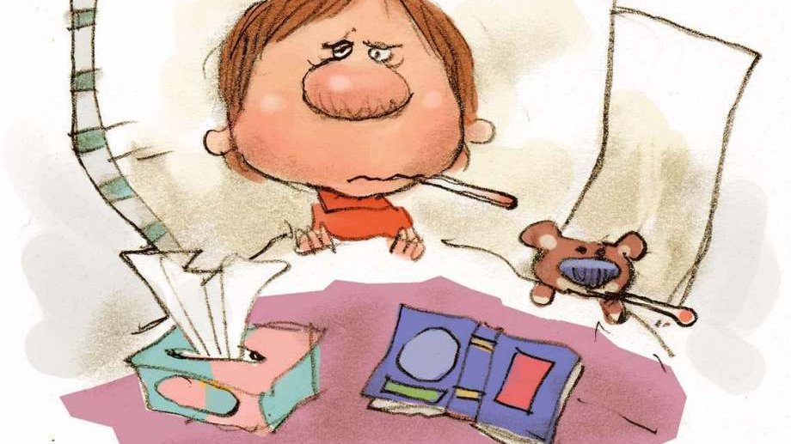

Slide 6
Give examples of pathogens that you know.

Slide 7
Identifying Pathogens
A _________ is any agent that causes disease.
Robert Koch (1843-1910) was the first person to establish a step-by-step procedure for identifying the particular pathogen that causes an infectious disease. He studied and isolated anthrax- a bacteria born disease which affects cattle.
Koch’s postulates are “_______” for determining the ______ __ __ ________.
Scientists have used Koch’s postulates to identify thousands of pathogens.
Pathogens can spread to human’s in five ways; ___, _____, _____, ____________, and _____ ___ _______.

Slide 8
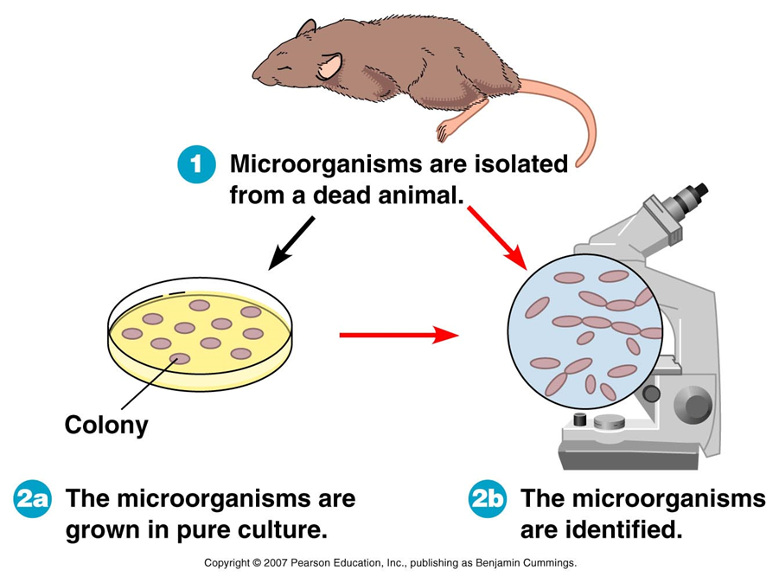

Slide 9
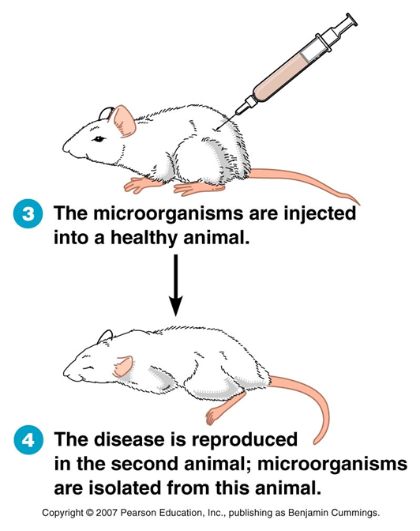

Slide 11
First line of Defense: Barriers
The body’s nonspecific defenses help protect the body against any pathogens.
Nonspecific defenses include the ____ and ______ __________.
The skin serves as a physical barrier to pathogens. In addition, the skin releases sweat, oil, and waxes.
Mucous membranes are epithelial tissues that protect the interior surfaces of the body. Mucous membranes serve as a _______ and secrete mucus, a sticky ______ that traps pathogens.

Slide 12
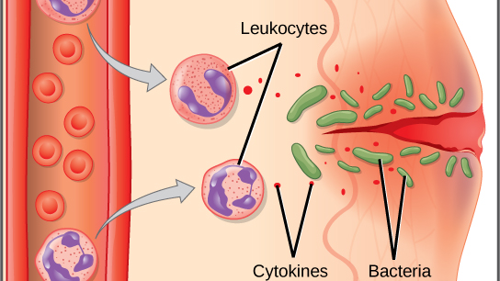
Second line of Defense: Nonspecific Immunity
If a pathogen gets past the skin and the mucous membranes, there is a second line of _______ _______ inside the body – nonspecific immunity.
Nonspecific immunity includes an _________ _______, the ________ response, and ____________.

Slide 13
Inflammatory Response
Any pathogen that gets past the skin or mucous membranes will stimulate the inflammatory response, a series of events that suppress infection and speed recovery.
1. __________ is an organic nitrogenous compound that increases blood flow to the injured area and increases the permeability of surrounding capillaries. The changes result in redness, swelling, warmth, and pain.
2.Fluids and WBCs (phagocytes) pass through capillary wall to the injured area.
3.Phagocytes ingest and destroy pathogens and foreign matter.

Slide 14
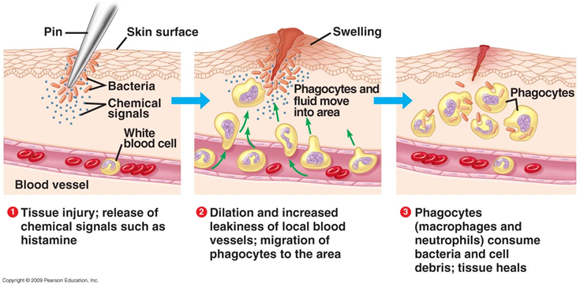

Slide 15
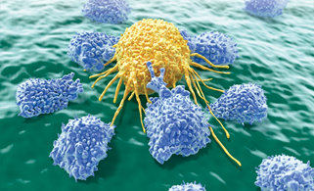
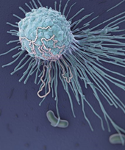
White Blood Cells
The neutrophil is the most abundant type of phagocyte in the body.
Neutrophils circulate through blood vessels, and they can squeeze through capillary walls to reach the infection site. They _______ pathogens they may encounter.
The macrophage _____ ______and ______ ______. Some are stationed in body tissues, while others seek out pathogens.
Natural killer cells are large white blood cells that attack _____________ _____. Natural killer cells are effective at killing cancer cells and virus-infected cells.

Slide 16
Temperature Response
When the body begins to fight pathogens, body temperature may increase several degrees.
A rise above the normal temperature (37 ◦C) is called a fever. A fever is a symptom of illness that the body is _________________________.
A moderate fever may slow bacterial and viral growth and promote white blood cell activity.

Slide 17
Proteins
Proteins also provide ________ __________.
About 20 different proteins make up the complement system.
_______ _________circulate in the blood and become active when they encounter certain pathogens.
Another nonspecific defense is interferon, a protein released by cells infected with viruses. ___________ causes nearby cells to make a protein that helps them resist viral infection.

Slide 18
Review Questions
Explain how Koch tested his hypothesis about the cause of anthrax.
How does the body’s first line of defense function?
What role does greater permeability of capillaries play in the inflammatory response?
How do natural killer cells differ from macrophages?
What is the role of interferon?
Should a fever always be treated? Why or why not?

Slide 19
https://www.youtube.com/watch?v=XP-WXLsnMjY

