Slide 1
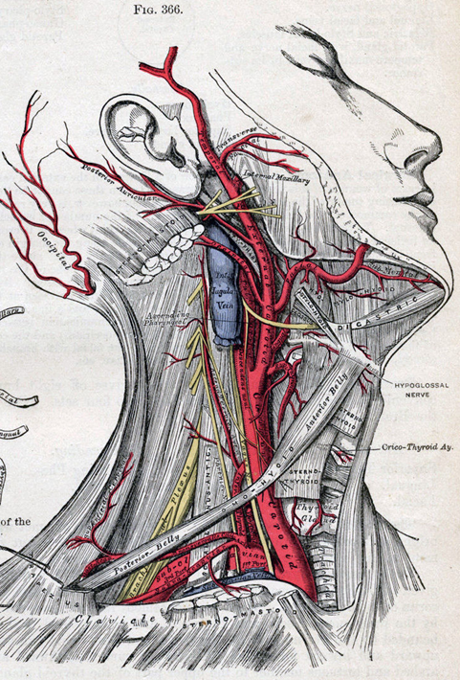
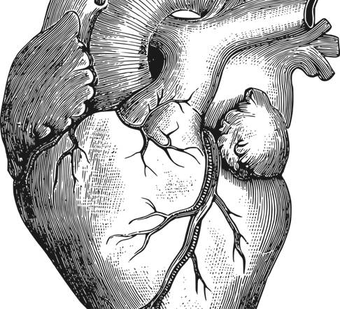
46.2 Blood
Unit 2: Circulatory and Respiratory System

Slide 2
Blood is a liquid connective tissue. It transports nutrients and oxygen to the cells and carries carbon dioxide and waste materials away from cells. Blood also transfers heat to the body surface and plays a major role in defending the body against disease.

Slide 3
Student objectives
List the components of blood.
Distinguish between red blood cells, white blood cells, and platelets in terms of their structure and function.
Summarize the process of blood clotting.
Explain what determines the compatibility of blood types for transfusion.

Slide 4
Composition of Blood
Blood is composed of a liquid (plasma), and blood solids (red blood cells, white blood cells, and platelets)
The liquid makes up about 55% of the blood.
A healthy human has about 4-5 L of blood in the body.

Slide 5
Plasma
Plasma is a sticky, straw-colored fluid that is about 90% water and includes metabolites, nutrients, wastes, salts, hormones, and proteins.
Proteins:
Formation blood clots
Albumin helps regulate osmotic pressure between plasma and blood cells/tissues
Antibodies fight disease

Slide 6
Red Blood Cells
Red Blood Cells, or Erythrocytes, transport oxygen to cells in all parts of the body.
Immature red blood cells produce large amounts of iron-containing protein called hemoglobin.
Hemoglobin is the molecule that transports O² and, to a lesser degree, CO².
RBC have no nucleus and are not much more than a membrane containing hemoglobin.
RBC live 120 to 130 days.
RBC 30 trillion in human body and 2 million die every second.

Slide 7
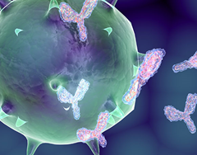
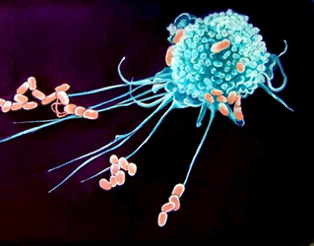
White Blood Cells
White Blood Cells, of Leukocytes, help defend the body against disease.
WBC are formed in red bone marrow, but mature in lymph nodes, tonsils, thymus, or spleen.
WBC are larger than RBC and significantly less plentiful. It might also live for years.
Phagocytes are WBCs that engulf invading microorganisms.
Another type of WBC produces antibodies.
Antibodies are proteins that help destroy substances, such as bacteria and viruses.

Slide 8
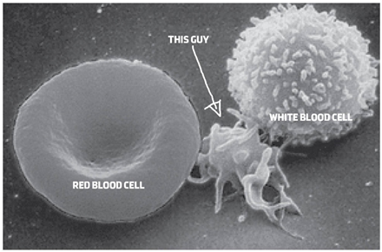
Platelets
Platelets (thrombocytes) are essential to the formation of a blood clot.
Fibrin is a protein that consists of long, sticky chains.
When blood vessels damage, platelets release a clotting protein (enzyme)-> a clotting reaction occurs -> fibrin net forms, trapping blood cells and platelets and results in a blood clot.
Hemophilia is a disorder caused by the absence of protein(s) for blood clotting.

Slide 9
Blood Types
Blood type is determined by the type of antigen present on the surface of the red blood cells.
An antigen is a substance that stimulates an immune response.
When foreign antigens enter the body, cells respond by producing antibodies.
When some blood types are mixed together the cells clump together; agglutinate. Reactions occur between the antigens on RBC and antibodies in the plasma.

Slide 10
A-B-0 System
The A-B-O system is a means of classifying blood by the antigens located on the surface of RBCs and the antibodies circulating in the plasma.

Slide 11
Rh system
An antigen that is sometimes present on the surface of RBCs is the Rh factor, named after the rhesus monkey in which it was first discovered.
The most serious problem with Rh incompatibility occurs during pregnancy.

Slide 12
Review Questions
Identify the four main components of blood.
How does the structure of red blood cells, white blood cells, and platelets relate to their function?
Identify the stages and structures involved in the clotting process.
What factors determine the compatibility of blood types for transfusion?
Which blood types, in terms of the A-B-O and Rh antigens, can be donated to somebody with type AB- blood?

