Slide 1
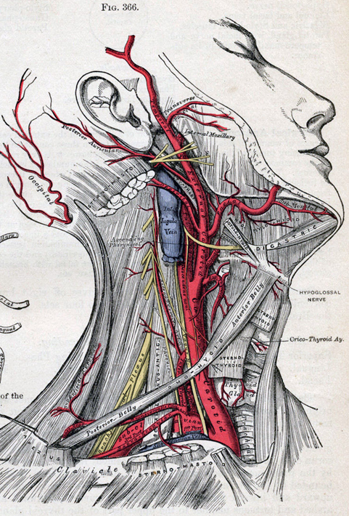
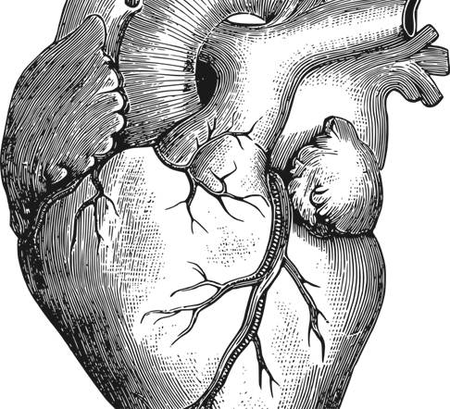
46.2 Blood
Unit 2: Circulatory and Respiratory System

Slide 2
Blood is a liquid connective tissue. It _____________ ________ and ________ to the cells and carries carbon dioxide and ______ materials away from cells. Blood also transfers _______ to the body surface and plays a major role in ________ the body against disease.

Slide 3
Student objectives
List the components of blood.
Distinguish between red blood cells, white blood cells, and platelets in terms of their structure and function.
Summarize the process of blood clotting.
Explain what determines the compatibility of blood types for transfusion.

Slide 4
Composition of Blood
Blood is composed of a ______ (plasma), and ______ ____ (red blood cells, white blood cells, and platelets)
The liquid makes up about 55% of the blood.
A healthy human has about ______ of blood in the body.

Slide 5
Plasma
Plasma is a sticky, straw-colored fluid that is about __________ and includes metabolites, nutrients, wastes, salts, hormones, and proteins.
Proteins:
Formation _____ ______
Albumin helps regulate ________ ________ between plasma and blood cells/tissues
__________ fight disease

Slide 6
Red Blood Cells
Red Blood Cells, or ___________, ________ ________ to cells in all parts of the body.
Immature red blood cells produce large amounts of iron-containing protein called ________.
RBC have ____________ and are not much more than a membrane containing hemoglobin.
RBC live 120 to 130 days.
RBC ___________ in human body and 2 million die every second.

Slide 7
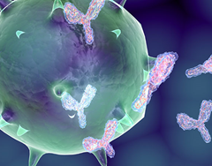
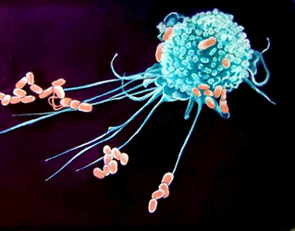
White Blood Cells
White Blood Cells, of Leukocytes, help defend the body against disease.
WBC are formed in red bone marrow, but mature in lymph nodes, tonsils, thymus, or spleen.
WBC are larger than RBC and significantly less plentiful. It might also live for years.
Phagocytes are WBCs that engulf invading microorganisms.
Another type of WBC produces antibodies.
Antibodies are proteins that help destroy substances, such as bacteria and viruses.

Slide 8
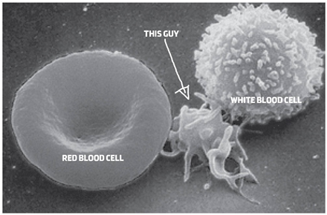
Platelets
Platelets are essential to the formation of a ____________.
Fibrin is a protein that consists of long, sticky chains.
When blood vessels damage, platelets release a clotting protein (enzyme)-> a clotting reaction occurs -> fibrin net forms, trapping blood cells and platelets and results in a blood clot.
___________ is a disorder caused by the absence of protein(s) for blood clotting.

Slide 9
Blood Types
Blood type is determined by the _____ ____ ______ present on the surface of the red blood cells.
An antigen is a substance that stimulates an ________ _________.
When foreign antigens enter the body, cells respond by producing ________.
When some blood types are mixed together the cells clump together; __________. Reactions occur between the antigens on RBC and antibodies in the plasma.

Slide 10
A-B-0 System
The A-B-O system is a means of ________ blood by the ________ located on the surface of RBCs and the ________ circulating in the ________.

Slide 11
Rh system
An antigen that is sometimes present on the surface of RBCs is the Rh factor, names after the ________ _______ in which it was first discovered.
The most serious problem with Rh incompatibility occurs during pregnancy.

Slide 12
Review Questions
Identify the four main components of blood.
How does the structure of red blood cells, white blood cells, and platelets relate to their function?
Identify the stages and structures involved in the clotting process.
What factors determine the compatibility of blood types for transfusion?
Which blood types, in terms of the A-B-O and Rh antigens, can be donated to somebody with type AB- blood?

