Slide 1
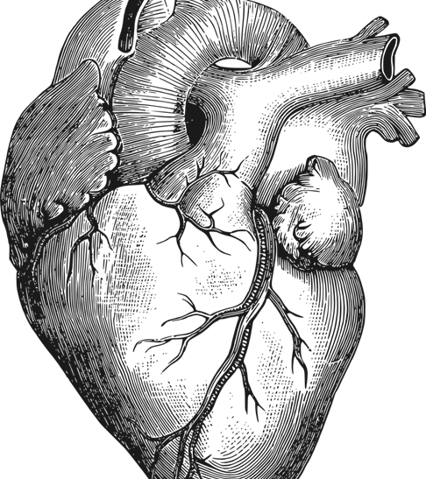
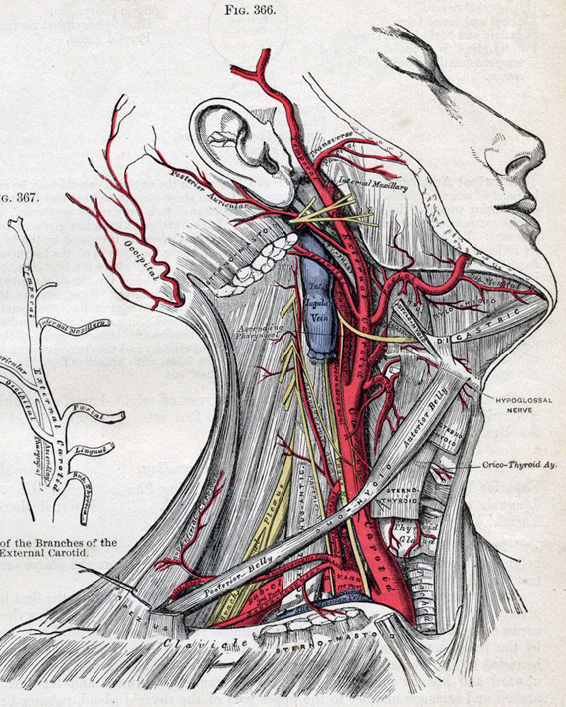
46.1 The Circulatory System
Unit 2: Circulatory and Respiratory System

Slide 2
What’s the role of the circulatory system? Which fluid besides blood moves through the circulatory system?

Slide 3
Student objectives
Describe and label the structure and function of the heart.
Trace the flow of blood through the heart and body.
Distinguish between arteries, veins, and capillaries in terms of their structure and function.
Distinguish between pulmonary circulation and systematic circulation.
Summarize the functions of the lymphatic system.

Slide 4
The Circulatory System
The blood, heart, and blood vessels form the cardiovascular system.
The lymph, lymph nodes, and lymph vessels form the lymphatic system.
The Circulatory system transports nutrients, hormones, and gases; gets rid of wastes; and helps maintain a constant body temperature.
https://www.youtube.com/watch?v=GVU_zANtroE

Slide 5
The Heart
The central organ of the cardiovascular system is the heart.
Beats 2.5 billion time in average life.
A mammalian heart has 4 chambers, 2 upper (atrium), 2 lower (ventricle).
A tough, saclike membrane called pericardium surrounds the heart and secretes fluid that reduces friction as the heart beats.
Valves are flaps of tissue that open only in one direction.

Slide 6
Anatomy of the Heart

Slide 7
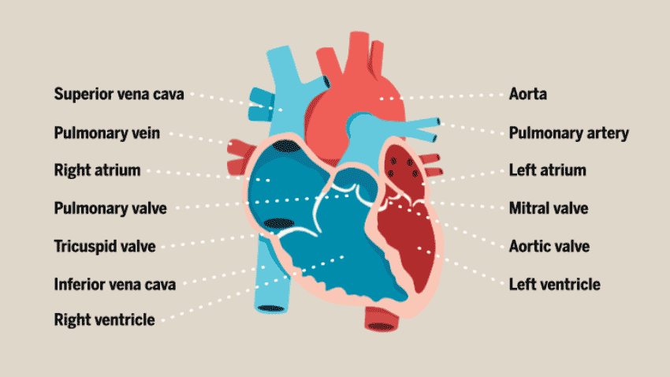

Slide 8
Circulation of the Heart
Deoxygenated blood enters the right atrium.
The right atrium sends deoxygenated blood into the right ventricle.
The muscles of the right ventricle contract and force the blood into the pulmonary arteries.
The pulmonary artery sends the blood to the lungs. In the lungs, the CO2 diffuses out and O2 diffuses into the blood.

Slide 9
Circulation of the Heart
The oxygenated blood returns to the left atrium of the heart.
The oxygenated blood is then pumped into the left ventricle.
Contraction of the muscular walls of the left ventricle forces the blood into a larger blood vessel called the aorta.
From the aorta, blood is transported to all parts of the body.
https://www.youtube.com/watch?v=ruM4Xxhx32U

Slide 10
Control of Heartbeat
The heart consists of muscle cells that contract in waves.
The sinoatrial (SA) node is a group of specialized heart-muscle cells locates in the right atrium. These muscles spontaneously initiate their own electrical impulse. And contract.
The electrical impulse initiated by the SA node subsequently reaches another specific area of the heart; atrioventricular (AV) node.
A person’s pulse is a series of pressure waves within an artery caused by contractions of their left ventricle.

Slide 11
Blood Vessels
The large muscular vessels that carry blood away from the heart are called arteries.
The force in the of blood in the arteries, from contraction of the heart, is called blood pressure.
Blood flows from aorta (biggest artery) to smaller arteries. Arteries divide into arterioles. Arterioles branch of into tiny vessels called capillaries.
Blood flows from capillaries that merge into larger vessels called venules. Several venules unite to form a vein.

Slide 13
Patterns of circulation
The heart and blood vessels form one continuous, closed system of circulation. There are two subsystems:
Pulmonary circulation: the blood travels between the heart and the lungs.
Systematic circulation: the blood travels between the heart and all other body tissues.

Slide 14
Lymphatic system
One function is the lymphatic system is to return fluids that have collected in the tissues to the bloodstream.
Excess fluid in the tissues moves into tiny vessels of the lymphatic system: this fluid is called lymph.
Lymph nodes filter the lymph, trapping foreign particles, microorganisms, and other tissue debris. Lymph nodes also store lymphocytes, white blood cells specialized to fight disease.

Slide 15
Review questions
Describe the structure of the heart.
Outline the path that blood follows through the heart and body, starting at the superior vena cava.
How are the structures of arteries, veins, and capillaries related to their function?
Compare oxygenation levels in pulmonary circulation and systematic circulation.
Explain how Lymph system works with the cardiovascular system.

