Slide 1
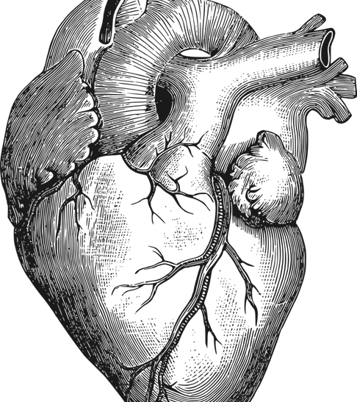
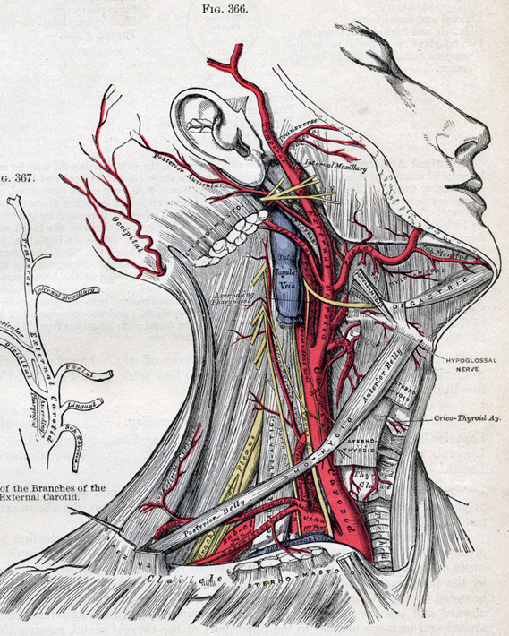
46.1 The Circulatory System
Unit 2: Circulatory and Respiratory System

Slide 2
What’s the role of the circulatory system? Which fluid besides blood moves through the circulatory system?

Slide 3
Student objectives
Describe and label the structure and function of the heart.
Trace the flow of blood through the heart and body.
Distinguish between arteries, veins, and capillaries in terms of their structure and function.
Distinguish between pulmonary circulation and systematic circulation.
Summarize the functions of the lymphatic system.

Slide 4
The Circulatory System
The _____, _____, and _____ _____ form the cardiovascular system.
The lymph, lymph nodes, and lymph vessels form the _______ ________.
The Circulatory system transports _______, _______, and _______; gets rid of _______; and helps maintain a constant body ____________.

Slide 5
The Heart
The _____ _______of the cardiovascular system is the heart.
Beats 2.5 billion time in average life.
A mammalian heart has 4 chambers, 2 upper (______), 2 lower (_________).
Valves are flaps of tissue that open only in _____ __________.

Slide 6
Anatomy of the Heart

Slide 7
Circulation of the Heart
__________ blood enters the ____ ____________.
The right atrium sends deoxygenated blood into the _____ _________.
The muscles of the right ventricle contract and force the blood into the __________ __________.
The pulmonary artery sends the blood to the _______. In the lungs, the CO2 diffuses out and O2 diffuses into the blood.

Slide 8
Circulation of the Heart
The _______ _________returns to the ____ ______of the heart.
The oxygenated blood is then pumped into the ____ __________.
Contraction of the muscular walls of the left ventricle forces the blood into a larger blood vessel called the _______.
From the aorta, blood is transported to all parts of the ______.

Slide 9
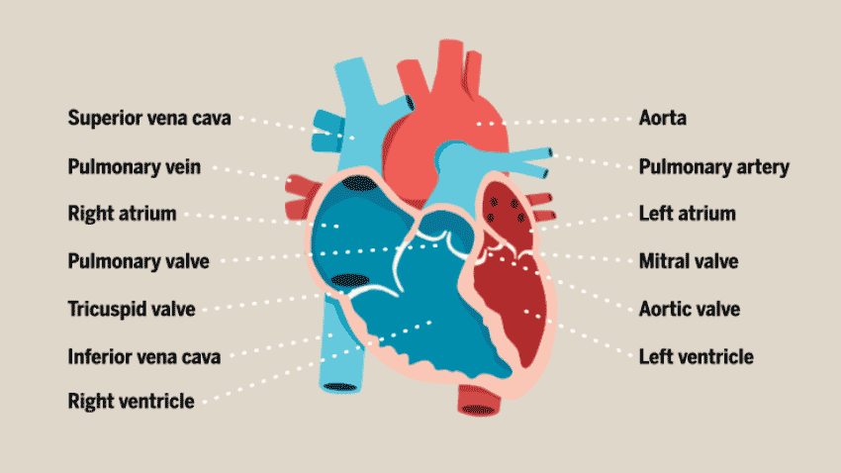

Slide 10
Control of Heartbeat
The heart consists of muscle cells that contract in ______.
The __________ (SA) node is a group of specialized heart-muscle cells locates in the ____ ________. These muscles spontaneously initiate their own electrical impulse. And contract.
The electrical impulse initiated by the SA node subsequently reaches another specific area of the heart; _________________ (AV) node.
A person’s pulse is a series of pressure waves within an artery caused by contractions of their left ventricle.

Slide 11
Blood Vessels
The large muscular vessels that carry blood away from the heart are called _______.
The _______ in the of blood in the arteries, from contraction of the heart, is called blood pressure.
Blood flows from aorta (biggest artery) to smaller arteries. Arteries divide into __________. Arterioles branch of into tiny vessels called ___________.
Blood flows from capillaries that merge into larger vessels called _________. Several venules unite to form a ________.

Slide 12
Patterns of circulation
The heart and blood vessels form one continuous, closed system of circulation. There are two subsystems:
Pulmonary circulation: the blood travels between the _____ and the _______.
Systematic circulation: the blood travels between the ______ and all other ______ ________.

Slide 13
Lymphatic system
One function is the lymphatic system is to return _______ that have collected in the tissues to the bloodstream.
Excess fluid in the tissues moves into tiny vessels of the lymphatic system: this fluid is called lymph.
Lymph nodes filter the lymph, trapping foreign particles, microorganisms, and other tissue debris. Lymph nodes also store ___________, white blood cells specialized to fight disease.

Slide 14
Review questions
Describe the structure of the heart.
Outline the path that blood follows through the heart and body, starting at the superior vena cava.
How are the structures of arteries, veins, and capillaries related to their function?
Compare oxygenation levels in pulmonary circulation and systematic circulation.
Explain how Lymph system works with the cardiovascular system.

