Slide 1
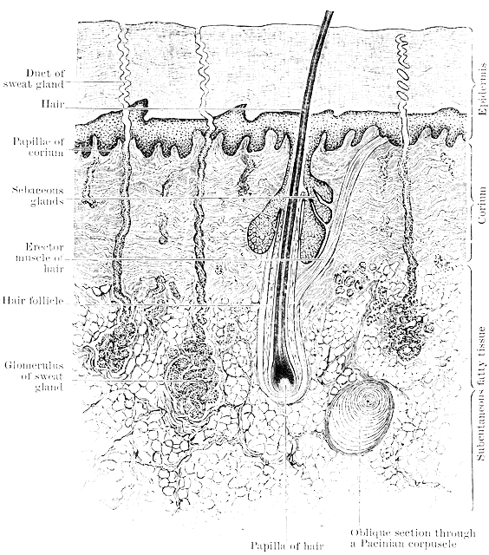
The Integumentary System - the hypodermis
T. Rick

Slide 2
- How do we destroy pathogens that entered our epidermis and dermis? - Why might our hair turn white when we are old?

Slide 3
Student objectives
Name the tissues that make up the subcutaneous tissue, and describe their functions.
Explain the effects of aging on the integumentary system.

Slide 4
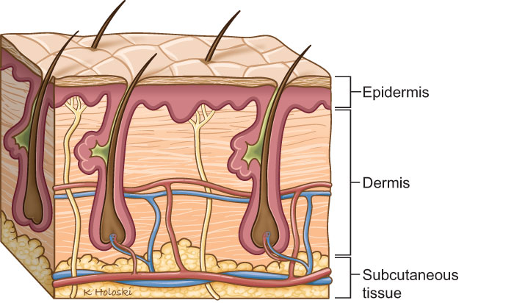
Hypodermis
The hypodermis, also called the subcutaneous tissue, connects the dermis to the underlying muscles.
It is made of loose connective tissue and adipose tissue.

Slide 5
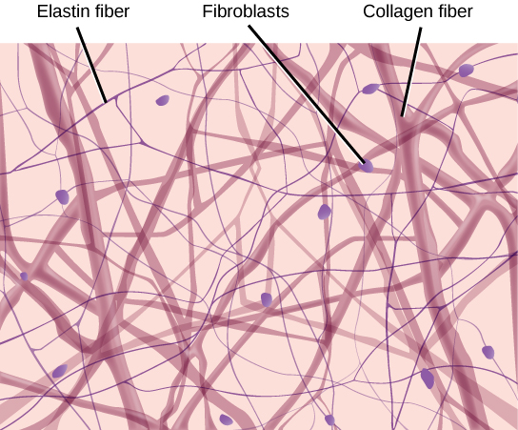
Loose connective tissue
The loose connective tissue contains collagen and elastin fibers and many white blood cells that have left capillaries to wander around in the tissue fluid between skin and muscles.
These migrating white blood cells destroy pathogens that enter the body through breaks in the skin.
Mast cells are specialized cells that bring out inflammation in a response to damage.

Slide 6
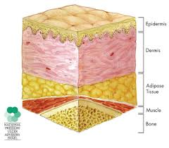
Adipose tissue
Adipose tissue are specialized to store fat, and our subcutaneous layer of fat stores excess nutrients as a potential energy source.
It also provides insulation from cold.

Slide 7
Aging and the integumentary system
The effects of age on the integumentary system are often quite visible.
Both layers of skin become thinner and more fragile as mitosis in epidermis slows and fibroblasts in the dermis die and are not replaced.
The skin becomes wrinkled as collagen and elastin fibers in the dermis deteriorate.
Sebaceous glands and sweat glands become less active; making skin dry, and temperature regulating more difficult.
Hair follicles become inactive making hair thinner, and melanocytes die and are not replaced; this makes hair become white.

Slide 8
Review questions
Name the tissues of which the subcutaneous tissue is made.
Describe the functions of these tissues.
What do mast cells do?
What are the effects of aging on the skin?
Why might the hair of an elderly turn white?

