Slide 1
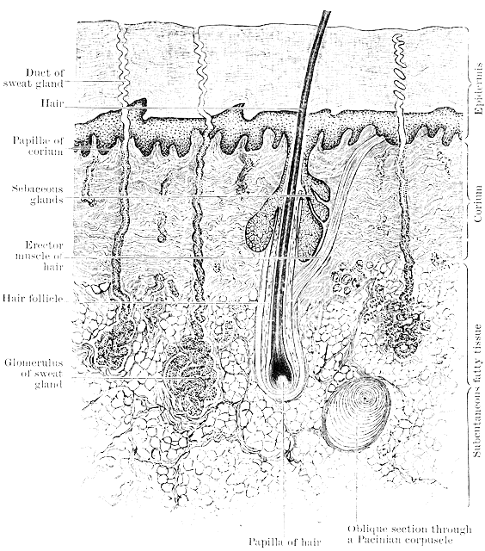
The Integumentary System - the epidermis
T. Rick

Slide 2
Why do we have skin? What are the 3 key roles of skin?

Slide 3
Student objectives
Name the top layer of the skin and the tissue of which it is made.
State the locations and describe the functions of the stratum germinativum and stratum corneum.
Describe the function of Langerhans cells.
Describe the function of melanocytes and melanin.

Slide 4
The Integumentary System
The integumentary system consists of the skin, its accessory structures such as hair and sweat glands, and the subcutaneous tissue below the skin.
The skin is made of several different tissue types and is considered an organ.

Slide 5
The Skin
There are 2 major layers in the skin:
Epidermis
Dermis

Slide 6
Epidermis
The epidermis is made of stratified squamous keratinizing epithelial tissue.
The most abundant cells are called keratinocytes, and there are no capillaries between them.
Epidermis has 5 sublayers (two of which are of most importance; the innermost and outermost layer)

Slide 7
Stratum Germinativum
The innermost layer, the stratum germinativum, may also be called the stratum basale.
In this layer mitosis takes place.
New cells are continuously being produced, pushing older cells toward the skin surface.
These cells produce the protein keratin, and as they get farther away from capillaries in the dermis they die.

Slide 8
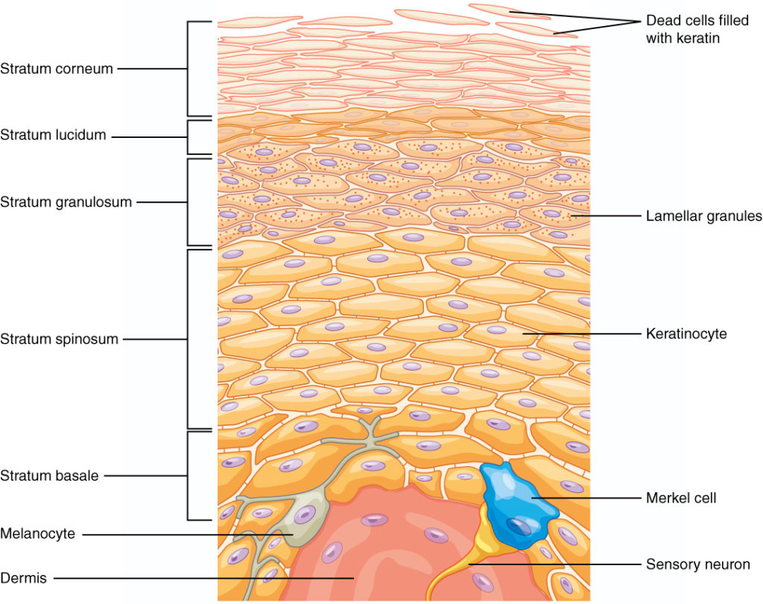
Cells of Stratum Germinativum
Keratinocytes; synthesize antimicrobial peptides called defensins; these are produced following any injury to the skin.
Merkel cells; these are receptors for the sense of touch.
Melanocytes
Langerhans cells

Slide 9
Langerhans cells
Within the epidermis are Langerhans cells, which are also called dendritic cells.
The cells originate in the red bone marrow, and are quite mobile.
They are able to phagocytize foreign material and migrate to lymph notes and present the pathogen to lymphocytes.
This triggers an immune response such as the production of antibodies.

Slide 10
Langerhans cells

Slide 11
Melanocytes
Melanocytes produce another protein, a pigment called melanin.
The activity of melanocytes is genetically regulated.
Melanin production is increased by exposure of the skin to ultraviolet rays.
Melanin gives the skin a darker color, which prevents exposure of the living stratum germinativum further exposure to ultraviolet rays.
Melanin also gives color to hair, though the protective function is confined to the hair of the head.

Slide 12
Melanocytes

Slide 13
“the Sunshine vitamin”
The living portion of the epidermis produces vitamin D.
The cells have a form of cholesterol that is changed to vitamin D on exposure to ultraviolet light.
Vitamin D is important for :
the absorption of calcium and phosphorus from food in the small intestine
Maintaining muscle strength
The functioning of insulin
Some immune responses
Protection for cancer

Slide 14
Stratum Corneum
The stratum corneum, the outer layer, consists of many layers of dead cells; all that is left is their keratin.
The protein keratin is relatively waterproof.
It prevents most evaporation of body water and also the entry of water.
The stratum corneum is also a barrier to pathogens and chemicals.
Flaking of dead cells removes micro-organisms, and the fatty acid in sebum help inhibit their growth.

Slide 15
Minor changes in the epidermis
A blister is a separation of layers of epidermis, or separation of the epidermis from the dermis, and tissue fluid is collected in the space.
If the skin is subjected to pressure, the rate of mitosis in the stratum germinativum will increase and create a thicker epidermis (callus).
Although calluses are more common on the palms and soles, they may occur on any part of the skin.

Slide 16
Review:
Name the parts of the integumentary system.
Name the major layers of the skin, the location of each.
What tissue is the epidermis made from?
Where does mitosis take place in the epidermis?
What protein do the new cells produce in the epidermis?
What is the function of Langerhans cells?
Describe the functions of the stratum corneum.

Slide 17
Next lesson we will explore the dermis and subcutaneous tissue!

