Slide 1
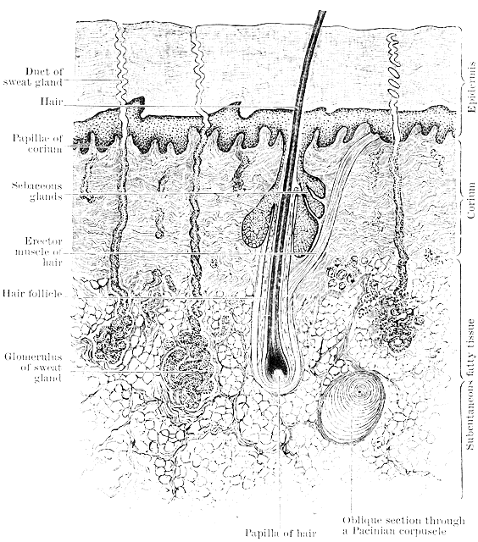
The Integumentary System - the dermis
T. Rick

Slide 2
How come your hair keeps growing back? Where do our hair and nails come from?

Slide 3
Student objectives
Define the dermis and the tissue of which it is made.
Describe the functions of hair and nails.
Name the cutaneous senses and explain their importance.
Describe functions of the secretions of sebaceous glands and the eccrine sweat glands.
Describe how the arterioles in the dermis respond to heat, cold, and stress.

Slide 4
Dermis
The dermis is made of irregular type of fibrous connective tissue.
The dermis contains accessory skin structures: hair and nail follicles, sensory receptors, and several types of glands.
Irregular means that the fibers are not parallel, but run in all directions.
Fibroblasts produce both collagen and elastin fibers.
Strength and elasticity are two characteristics of the dermis.

Slide 5
Papillary Junction
The uneven junction of the dermis with the epidermis is called papillary junction.
Capillaries are abundant here to nourish the dermis and epidermis.

Slide 6
Hair Follicles
Hair follicles are made of epidermal tissue, and the growth process of hair is very similar to the growth of the epidermis.
At the base is the hair root, which contains cells called the matrix, where mitosis takes place.
New cells produce keratin, get their color from melanin, then die and become part of the hair shaft, which is pushed towards the surface of the skin.
Hair growth averages 8-10 mm/month.

Slide 7
Functions of human hair
Eyelashes and eyebrows help to keep dust and perspiration out of eyes.
Hairs in nostrils help to keep dust out of nasal cavities.
Hair of the scalp provides insulation from cold on the head.
Attached to each hair follicle is a small, smooth muscle called pilomotor. It gives us ‘goosebumps’.

Slide 8
Nail Follicles
At the end of fingers and toes, nail follicles produce nails just as hair follicles produce hair.
Mitosis takes place in the nail root at the base of the nail, and the new cells produce keratin and then die.
The nail itself consists of keratinized dead cells, the flat nail bed is living epidermis and dermis.
Fingernails grow about 3mm/month.

Slide 9
Functions of nails
Nails protect the end of fingers and toes from mechanical injury and gives the fingers greater ability to pick up small objects.
Fingernails are also good for scratching:
Arthropod parasite, mosquito, tick, or flea.

Slide 10
Receptors
Receptors and sensations provide the central nervous system with information about the external environment and its effects on the skin.
Most sensory receptors for the cutaneous senses are found in the dermis.
Cutaneous senses are touch, heat, cold, and pain.
Free nerve endings feel pain, heat, or cold.
Encapsulated nerve endings feel touch and pressure.

Slide 11
Sensitivity
The sensitivity of an area of skin is determined by how many receptors are present.
Fingertips are very sensitive to touch because there are many receptors.

Slide 12
Glands
Glands are made of epithelial tissue:
Sebaceous Glands
Sweat Glands

Slide 13
Sebaceous Glands
The ducts of sebaceous glands open into hair follicles or directly to the skin surface.
They secrete sebum, a lipid substance (oil):
Inhibits the growth of bacteria on the skin surface
Prevents drying of skin and hair.
Adolescents may have problems of overactive sebaceous glands. Too much sebum traps bacteria in hair follicles and create small infections.

Slide 14
Sweat Glands
There are two types of sweat glands:
Apocrine glands: most numerous in underarm and genital areas. Sensitive to stress and emotional situations.
Eccrine glands: all over body, but numerous on forehead, upper lip, palms, and soles. Secretory portion of these glands is a coiled tube in the dermis. The duct to the skin’s surface is called a pore.

Slide 15
Sweat
The sweat produced by eccrine glands is important in the maintenance of normal body temperature.
A great deal of heat can be can be lost in evaporation of relatively small amount of water.
Loss of too much body water in sweat may cause dehydration.
Sodium Chloride is also lost in sweat, as are small amounts or urea (a nitrogenous waste product of amino acid metabolism).

Slide 16
Blood Vessels
Besides the capillaries in the dermis, arterioles are of great importance.
Arterioles are small arteries, and the smooth muscle in their walls permits them to constrict (close) or dilate (open) to maintain body temperature.
When arterioles dilate (vasodilation), blood flow increases in dermis and releases heat through skin.
When arterioles contract (vasoconstriction), blood flow is decreased keeping heat inside body.
Vasoconstriction may occur during stressful situations, because of ‘fight or flight response’.

Slide 17
Review
Define the dermis and the tissue of which it is made.
Where, on the body, does human hair have important functions? Describe these functions.
Describe the functions of nails.
Name the cutaneous senses and explain their importance.
Explain the functions of sebum.
How do the arterioles in the dermis respond to heat, cold, and stress?

