Slide 1
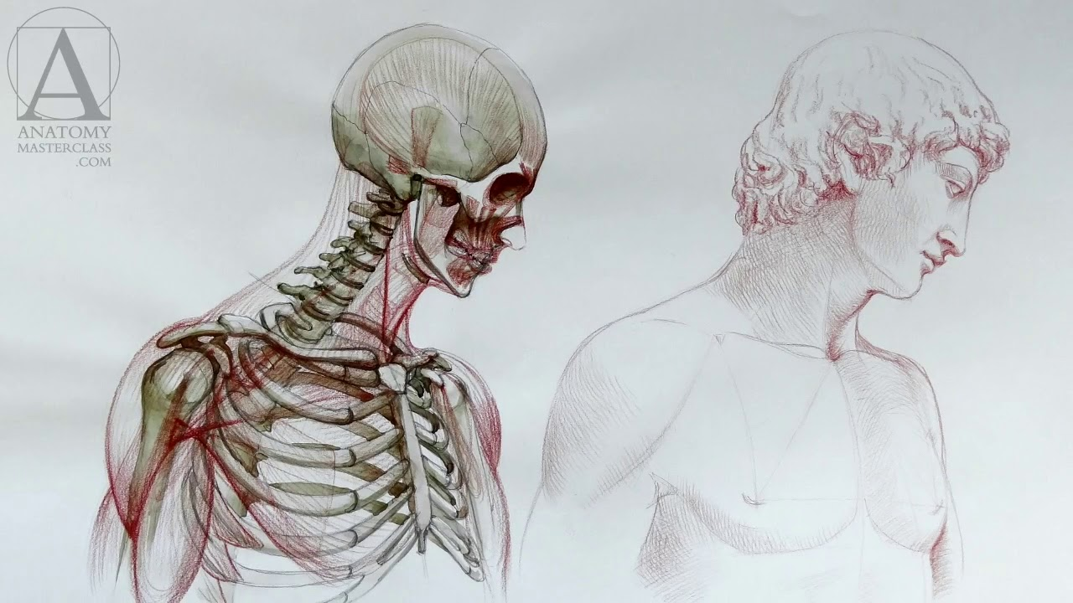
Anatomy and Physiology
Cell Tissues

Slide 2
Why do we breathe? Think of all the reasons why we need a respiratory system.

Slide 3
Why do we breathe?
Exchange of gases into the blood and tissues. Diffusion of Oxygen into blood from the lungs and then into the tissues. Diffusion of wastes such as Carbon Dioxide from tissues into blood and out of blood into the lungs.
Cellular Respiration requires oxygen in order to produce useable energy in order to carry out cellular processes and to prevent the build up of lactic acid via anaerobic respiration.

Slide 4
Definition Anatomy and Physiology
Anatomy:
The structure and relationships between body parts.
Physiology:
The study of how those parts come together to function, and keep that body alive.

Slide 5
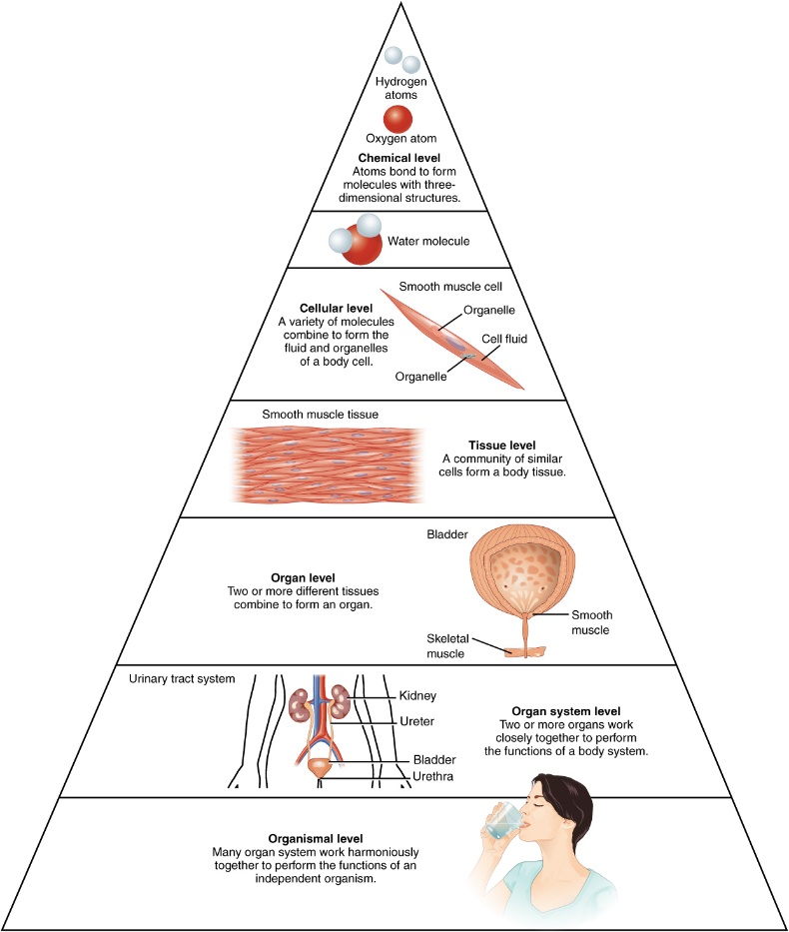
Basic architecture of human body
subatomic particles
atoms
molecules
organelles
cells
tissues
organs
organ systems
organisms
biosphere

Slide 6
The Levels of Organization
A cell is the smallest independently functioning unit of a living organism.
All living structures of human anatomy contain cells, and almost all functions of human physiology are performed in cells or are initiated by cells.
A tissue is a group of many similar cells that work together to perform a specific function.
An organ is an anatomically distinct structure of the body composed of two or more tissue types. Each organ performs one or more specific physiological functions.
An organ system is a group of organs that work together to perform major functions or meet physiological needs of the body.

Slide 7
Tissues
The term tissue is used to describe a group of cells found together in the body.
Microscopic observation reveals that the cells in a tissue share morphological features and are arranged in an orderly pattern that achieves the tissue’s functions.
From the evolutionary perspective, tissues appear in more complex organisms. For example, multicellular protists, ancient eukaryotes, do not have cells organized into tissues.

Slide 8
4 types of Tissues
Muscle tissue
Epithelial tissue
Connective tissue
Nervous tissue

Slide 9
Muscle Tissue
3 types of muscle tissue:
Skeletal: Attached to bones
Cardiac: Heart
Smooth: Organs and blood vessels

Slide 10
A. Skeletal Muscle Tissue
Skeletal muscle, which is also called straited – striped – muscle, is muscle that is usually attached to bones by tendons and allows us to consciously control our movements.

Slide 11
B. Cardiac Muscle Tissue
Cardiac muscle is found in the walls of our heart.
Like skeletal muscle it is striated or striped.
It is not under voluntary control.

Slide 12
C. Smooth Muscle Tissue
Smooth muscle is found in the walls of blood vessels, as well as in the walls of the digestive tract, and other internal structures.
Smooth muscle is not striated – striped – and it’s involuntary, not under conscious control.

Slide 15
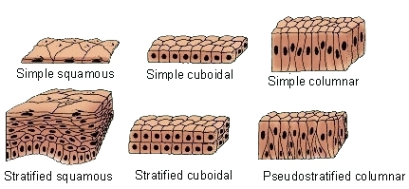
Epithelial Tissue
3 types of epithelial tissue
Squamous
Cuboidal
Columnar
Descriptive layers
Simple – one layer
Stratified – more than one layer

Slide 16
Connective Tissue
6 Types:
Loose connective tissue
Dense connective tissue
Adipose
Blood
Cartilage
Bone

Slide 17
Loose connective tissue
Loose connective tissue has a sampling of all of the components of a connective tissue.
Loose connective tissue is the most common type of connective tissue in vertebrates.
It holds organs in place and attaches epithelial tissue to other underlying tissues.
Loose connective tissue is found around every blood vessel and helps to keep the vessel in place.
The tissue is also found around and between most body organs. In summary, areolar tissue is tough, yet flexible, and comprises membranes.

Slide 18
Dense connective tissue
Dense connective tissues contain large amounts of collagen fibers and few cells or matrix material.
The fibers can be arranged irregularly or regularly with the strands lined up in parallel.
Regular fibrous connective tissue is found in tendons (which connect muscles to bones) and ligaments (which connect bones to bones).

Slide 19
Adipose
Adipose tissue, or fat tissue, is made up of cells called adipocytes that collect and store fat in the form of triglycerides, for energy metabolism.
Adipose tissues additionally serve as insulation to help maintain body temperatures, allowing animals to be endothermic, and they function as cushioning against damage to body organs.

Slide 20
Blood
Blood is considered a connective tissue because it has a matrix.
The living cell types are red blood cells (RBC), also called erythrocytes, and white blood cells (WBC), also called leukocytes. The fluid portion of whole blood, its matrix, is commonly called plasma.

Slide 21
Cartilage
Cartilage is a resilient and smooth elastic tissue.
The human skeleton is a cartilaginous skeleton during a specific pre-birth developmental stage.
Cartilage is commonly found in the ribs, nose, larynx and trachea.

Slide 22
Bone
Bone is a hard and dense connective tissue.
Bone tissue is a mineralized tissue of two types, cortical bone and cancellous bone.
Other types of tissue found in bones include bone marrow, endosteum, periosteum, nerves, blood vessels and cartilage.

Slide 23
Nervous Tissue
Nervous tissues are made of cells specialized to receive and transmit electrical impulses from specific areas of the body and to send them to specific locations in the body.
The main cell of the nervous system is the neuron.

