Slide 1
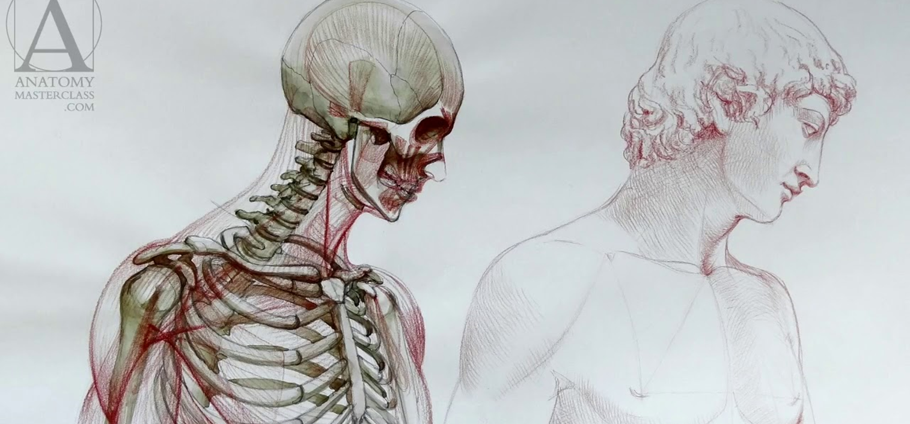
45.1 The Human Body Plan
Unit 2: Circulatory and Respiratory Systems

Slide 2
Why do we breathe? Think of all the reasons why we need a respiratory system.

Slide 3
Why do we breathe?
1.Exchange of gases into the blood and tissues. Diffusion of Oxygen into blood from the lungs and then into the tissues. Diffusion of wastes such as Carbon Dioxide from tissues into blood and out of blood into the lungs.
2.Cellular Respiration requires oxygen in order to produce useable energy in order to carry out cellular processes and to prevent the buildup of lactic acid via anaerobic respiration.

Slide 4
Student Objectives
Differentiate between anatomy and physiology.
Relate to all levels or organization in biology.
Explain how tissues, organs, and organ systems are organized.
Describe the four types of tissues that make up the human body.
Differentiate between the 3 types of muscle tissue.
Relate to the different types of epithelial tissue.
Differentiate between the 6 different connective tissues.
Summarize the functions of primary organ systems in the human body.
Identify the five human body cavities and the organs that each contains.

Slide 5
Anatomy and Physiology
Anatomy:
The structure and relationships between body parts.
Physiology:
The study of how those parts come together to function and keep that body alive.

Slide 6
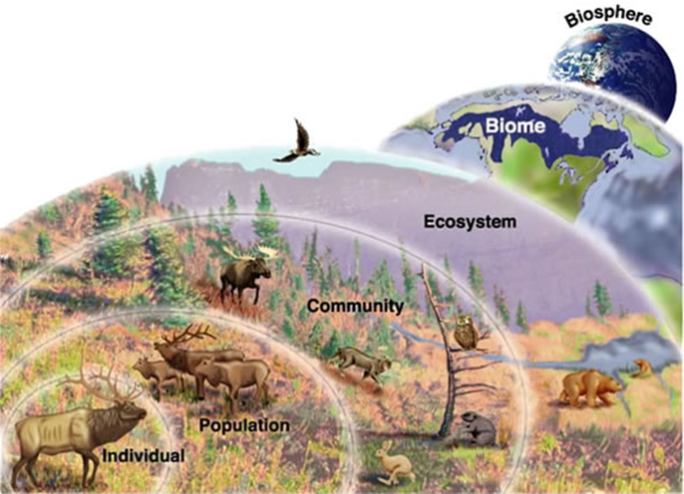
Basic Architecture of Human body and Ecology
subatomic particles
atoms
molecules
organelles
cells
tissues
organs
organ systems
Organism
Individual (organism)
Population
Community
Ecosystem
Biome
Biosphere

Slide 7
The Levels of Organization
A cell is the smallest independently functioning unit of a living organism.
All living structures of human anatomy contain cells, and almost all functions of human physiology are performed in cells or are initiated by cells.
A tissue is a group of many similar cells that work together to perform a specific function.
An organ is an anatomically distinct structure of the body composed of two or more tissue types. Each organ performs one or more specific physiological functions.
An organ system is a group of organs that work together to perform major functions or meet physiological needs of the body.

Slide 8
Tissues
The term tissue is used to describe a group of cells found together in the body.
Microscopic observation reveals that the cells in a tissue share morphological features and are arranged in an orderly pattern that achieves the tissue’s functions.
From the evolutionary perspective, tissues appear in more complex organisms. For example, multicellular protists, ancient eukaryotes, do not have cells organized into tissues.

Slide 9
4 types of Tissues
Muscle tissue
Epithelial tissue
Connective tissue
Nervous tissue

Slide 10
1. Muscle Tissue
3 types of muscle tissue:
A.Skeletal: Attached to bones
B.Cardiac: Heart
C.Smooth: Organs and blood vessels

Slide 11
A. Skeletal Muscle Tissue
Skeletal muscle, which is also called straited – striped – muscle, is muscle that is usually attached to bones by tendons and allows us to consciously control our movements.

Slide 12
B. Cardiac Muscle Tissue
Cardiac muscle is found in the walls of our heart.
Like skeletal muscle it is striated or striped.
It is not under voluntary control.

Slide 13
C. Smooth Muscle Tissue
Smooth muscle is found in the walls of blood vessels, as well as in the walls of the digestive tract, and other internal structures.
Smooth muscle is not striated – striped – and it’s involuntary, not under conscious control.

Slide 14
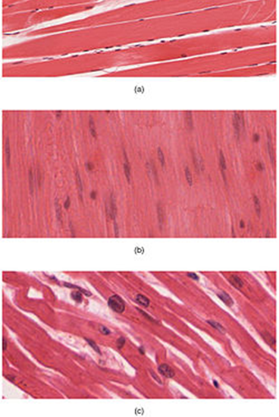
Overview Muscle Tissues

Slide 15
2. Epithelial Tissue
Epithelial tissues are widespread throughout the body. They form the covering of all body surfaces, line body cavities and hollow organs, and are the major tissue in glands. They perform a variety of functions that include protection, secretion, absorption, excretion, filtration, diffusion, and sensory reception.
3 types of epithelial tissue:
Squamous
Cuboidal
Columnar
Descriptive layers:
Simple – one layer
Stratified – more than one layer

Slide 16
3. Connective Tissue
6 Types:
Loose connective tissue
Dense connective tissue
Adipose
Blood
Cartilage
Bone

Slide 17
A. Loose connective tissue
Loose connective tissue has a sampling of all the components of a connective tissue.
Loose connective tissue is the most common type of connective tissue in vertebrates.
It holds organs in place and attaches epithelial tissue to other underlying tissues.
Loose connective tissue is found around every blood vessel and helps to keep the vessel in place.
The tissue is also found around and between most body organs. In summary, areolar tissue is tough, yet flexible, and comprises membranes.

Slide 18
B. Dense connective tissue
Dense connective tissues contain large amounts of collagen fibers and few cells or matrix material.
The fibers can be arranged irregularly or regularly with the strands lined up in parallel.
Regular fibrous connective tissue is found in tendons (which connect muscles to bones) and ligaments (which connect bones to bones).

Slide 19
C. Adipose
Adipose tissue, or fat tissue, is made up of cells called adipocytes that collect and store fat in the form of triglycerides, for energy metabolism.
Adipose tissues additionally serve as insulation to help maintain body temperatures, allowing animals to be endothermic, and they function as cushioning against damage to body organs.

Slide 20
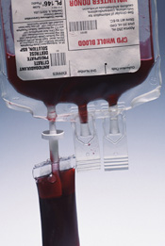
D. Blood
Blood is considered a connective tissue because it has a matrix.
The living cell types are red blood cells (RBC), also called erythrocytes, and white blood cells (WBC), also called leukocytes. The fluid portion of whole blood, its matrix, is commonly called plasma.

Slide 21
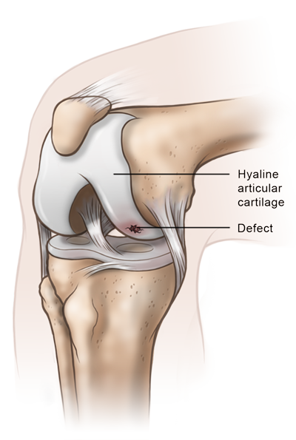
E. Cartilage
Cartilage is a resilient and smooth elastic tissue.
The human skeleton is a cartilaginous skeleton during a specific pre-birth developmental stage.
Cartilage is commonly found in the ribs, nose, larynx and trachea.

Slide 22
F. Bone
Bone is a hard and dense connective tissue.
Bone tissue is a mineralized tissue of two types, cortical bone and cancellous bone.
Other types of tissue found in bones include bone marrow, endosteum, periosteum, nerves, blood vessels and cartilage.

Slide 23
4. Nervous Tissue
Nervous tissues are made of cells specialized to receive and transmit electrical impulses from specific areas of the body and to send them to specific locations in the body.
The main cell of the nervous system is the neuron.

Slide 24
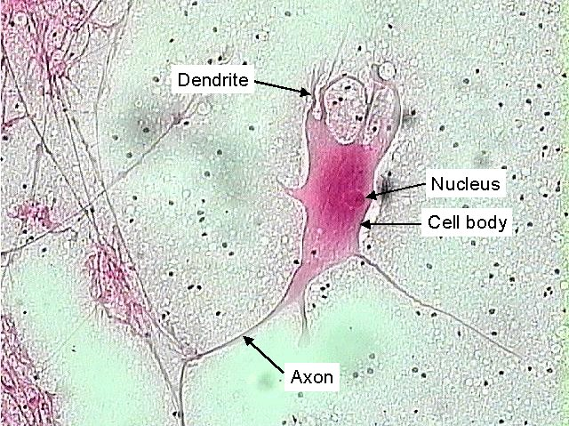

Slide 25
Body Cavities
5 Cavities and their contents:
Cranial- houses the brain
Spinal- houses the spinal cord
Thoracic- houses the heart, esophagus, and the respiratory system
Abdominal- houses the digestive system
Pelvic- houses the reproductive system

Slide 26
Review Questions
Name four types of tissues in the human body, and give an example of each.
Explain the differnce between muscle tissue and nervous tissue.
How are tissues, organs, and organ systems organized in the body.
How do the organ systems function together in the human body?
Identify the organs each body cavity contains.

