Slide 1
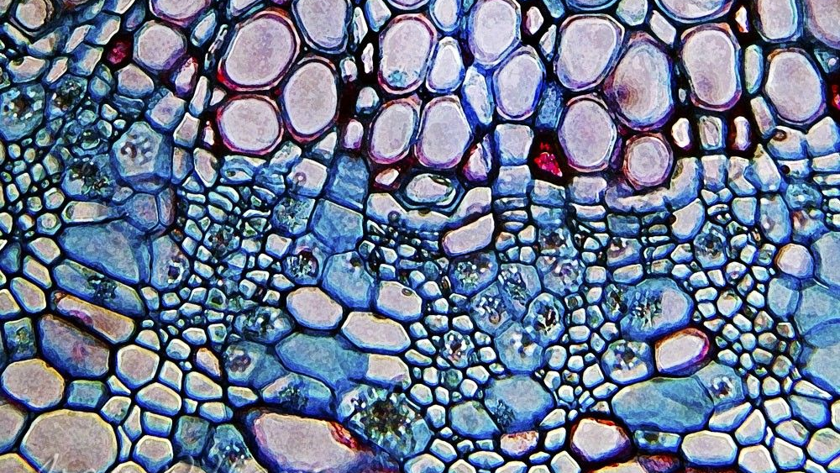
4.3 Unique Features of Plant Cells
UNIT 4: CELL STRUCTURE AND FUNCTION

Slide 2
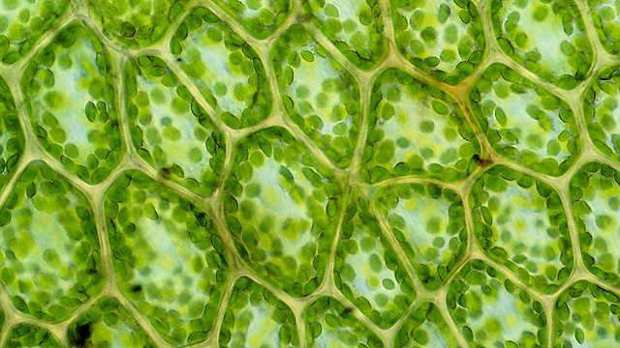
Plant cells have three kind of features that are not found in animal cells and that are extremely important to plant survival: ________, ________ ________, and __________.

Slide 3
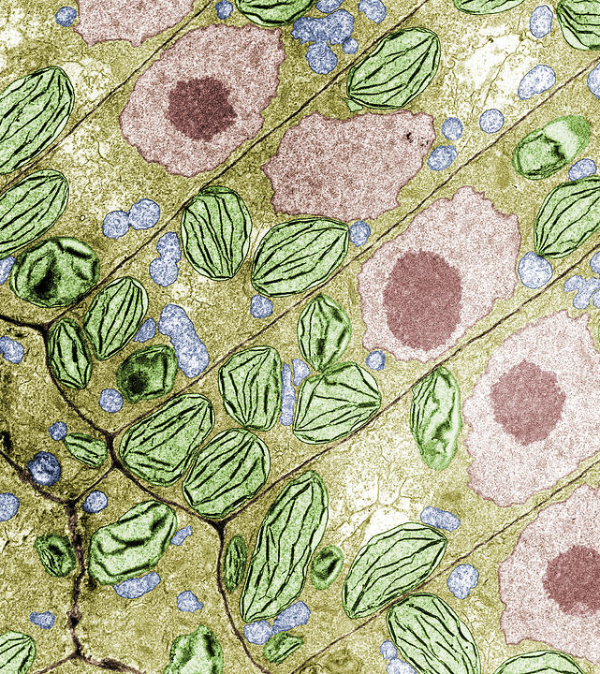
Student Objectives
List three structures that are present in plant cells but not in animal cells.
Compare the plasma membrane, the primary cell wall, and the secondary cell wall.
Explain the role of the central vacuole.
Describe the roles of plastids in the life of a plant.
Identify features that distinguish prokaryotes, eukaryote, plant cells, and animal cells.

Slide 4
Plant Cells
Besides the organelles discussed previous lesson, plant cells have three other kinds of structures that are very important to the cell.
A plant’s _________ is very different from an animal.
Plant cells take carbon dioxide gas from the air, and in a process called _________, they convert carbon dioxide and water into _________.

Slide 5
Cell Wall
The cell wall is a rigid layer that lies outside the cell’s ______ _________.
Plant cell walls contain a carbohydrate called _________.
Cellulose is made directly on the surface of the plasma membrane, guided by microtubules inside plasma membrane.
Other material of cell wall is made in ______ and moved in vesicles of _____ to the cell’s surface.

Slide 6
Secondary Cell Walls
Some plants also produce a _________ _____ _____.
When a cell stops growing a secondary cell wall between the plasma membrane and primary cell wall might be secreted.
The secondary cell wall is very ______ and can no longer expand.
______ in tables and chairs is made of billions of secondary cell walls. The cells inside the walls have died and disintegrated.

Slide 7
Central Vacuole
The Central Vacuole is a ____, _________ organelle that stores not only water but also enzymes, metabolic wastes, and other materials.
Smaller vacuoles form together to form the central vacuole.
It can take up to 90% of the cell and stand up straight. When there is not plenty of water the cells shrink and the plant wilts.

Slide 8
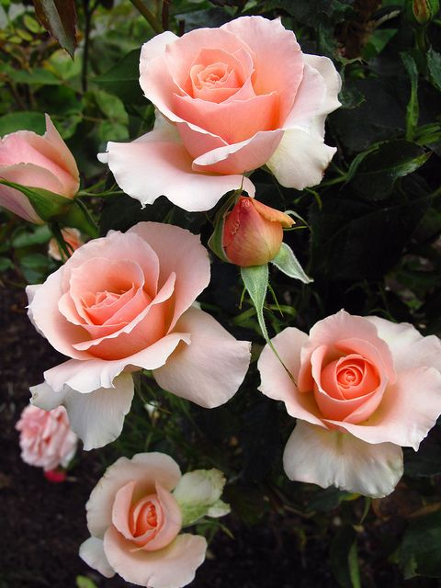
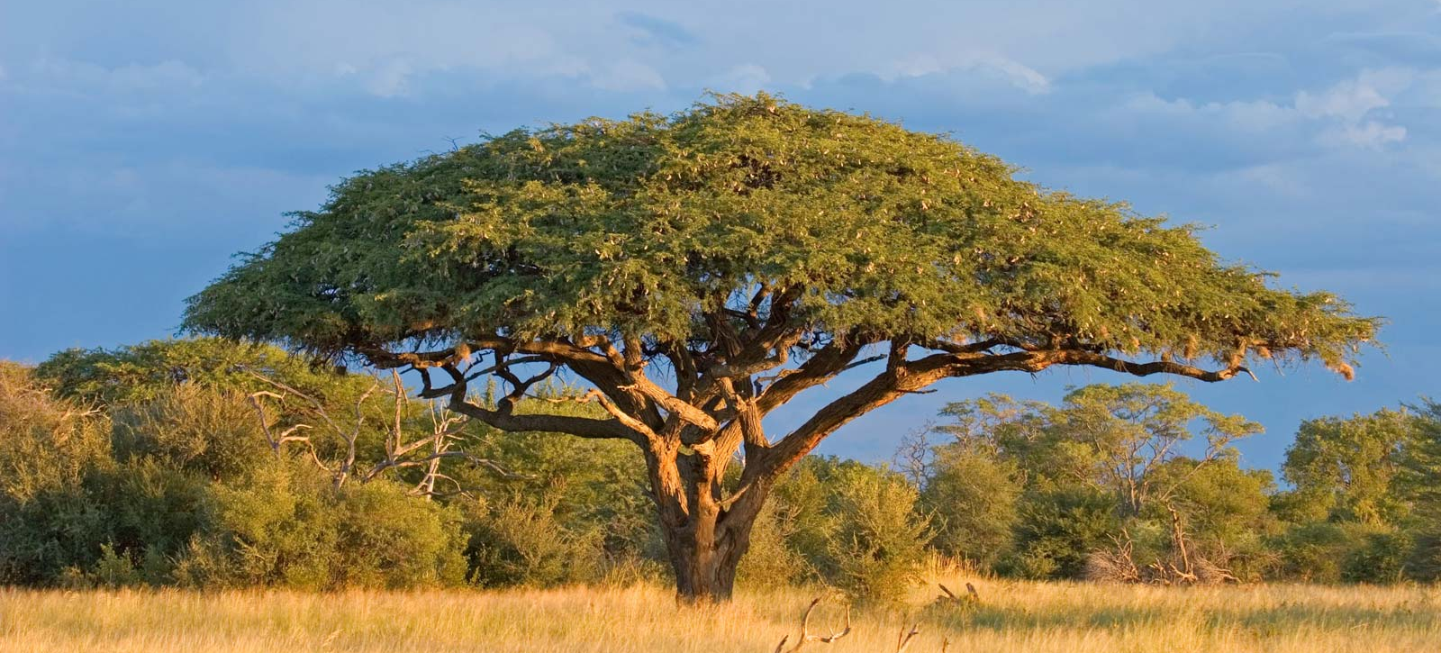
Other Vacuoles
Some vacuoles store _____ materials.
Acacia trees store poison.
Tobacco plants store nicotine.
Some vacuoles store pigments for color like rose petals.

Slide 9
Plastids
Plastids are organelles that, like mitochondria, are surrounded by a double membrane and contain their own DNA.
_____________
_____________
_____________

Slide 10
Chromoplasts
Chromoplasts are plastids that contain colorful pigments and may or may not take part in photosynthesis and can synthesize ATP.
chromoplasts with orange pigment carotene in carrot plants.
chromoplasts in petal cells contain red, purple, yellow, or white pigment.

Slide 11
Leucoplasts
Leucoplasts are a _______ organelle found in plant cells, used for the storage of _____ or _____.

Slide 12
Comparing Cells
All cells have common features: _____________, _____________, _____________, and _____________.
Prokaryotes lack ______ and ________-bound organelles.
Plant cells have three unique features from animal cells:
_____________
_____________
_____________

Slide 13
Review questions
Identify three unique features of plant cells.
List the difference between the plasma membrane, the primary cell wall, and the secondary cell wall.
Identify three functions of the plastids.
Name three things that may be stored in vacuoles.
Describe the features that distinguish prokaryotes from eukaryotes and plant cells from animal cells.
Tobacco plant cells contain a toxic chemical. Why don’t tobacco plants poison themselves? Explain.

