Slide 1
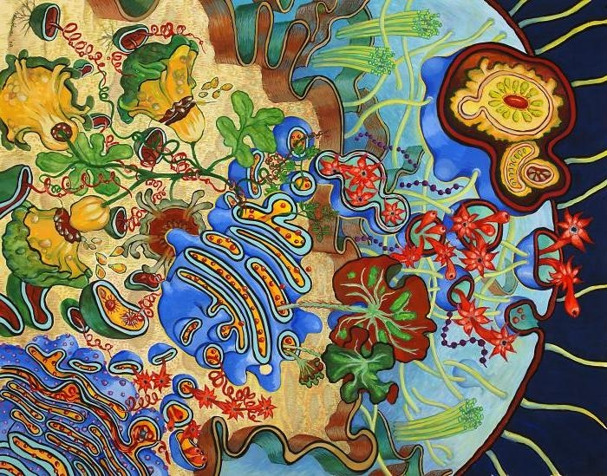
Chapter 4: Cell structure and Function
Unique Features of Plant Cells

Slide 2
Plant cells have three kind of features that are not found in animal cells and that are extremely important to plant survival: plastids, central vacuoles, and cell walls.

Slide 3
Student objectives:
List three structures that are present in plant cells but not in animal cells.
Compare the plasma membrane, the primary cell wall, and the secondary cell wall.
Explain the role of the central vacuole.
Describe the roles of plastids in the life of a plant.
Identify features that distinguish prokaryotes, eukaryote, plant cells, and animal cells.

Slide 4
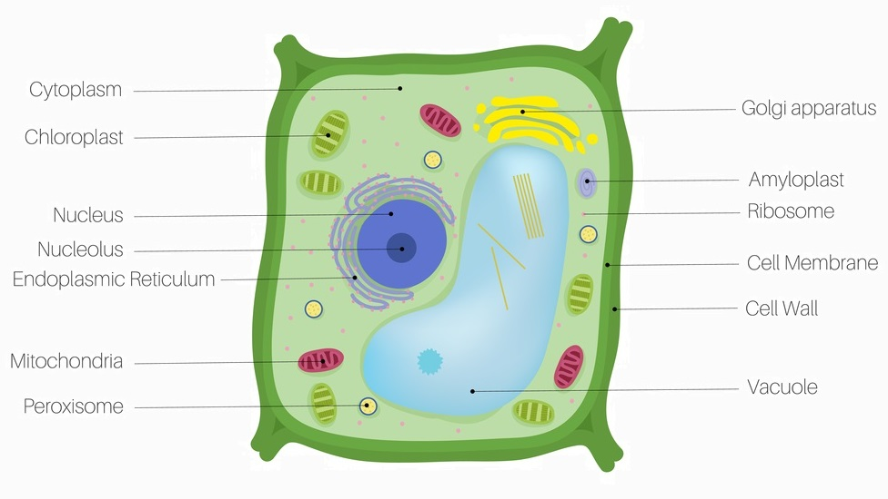
Plant Cells
Besides the organelles discussed previous lesson, plant cells have three other kinds of structures that are very important to the cell.
A plant’s lifestyle is very different from an animal’s.
Plant cells take carbon dioxide gas from the air, and in a process called photosynthesis, they convert carbon dioxide and water into sugars.

Slide 5
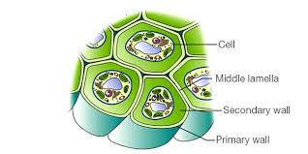
Cell Wall
The Cell wall is a rigid layer that lies outside the cell’s plasma membrane.
Plant cell walls contain a carbohydrate called cellulose.
Cellulose is made directly on the surface of the plasma membrane, guided by microtubules inside plasma membrane.
Other material of cell wall is made in ER and moved in vesicles of Golgi to the cell’s surface.

Slide 6
Secondary Cell Walls
Some plants also produce a secondary cell wall.
When a cell stops growing a secondary cell wall between the plasma membrane and primary cell wall might be secreted.
The secondary cell wall is very strong and can no longer expand.
Wood in tables and chairs is made of billion of secondary cell walls. The cells inside the walls have died and disintegrated.

Slide 7
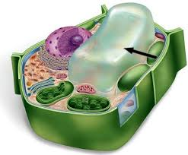
Central Vacuole
The Central Vacuole is a large, fluid-filled organelle that stores not only water but also enzymes, metabolic wastes, and other materials.
Smaller vacuoles form together to form the central vacuole.
It can take up to 90% of the cell and stand up straight. When there is not plenty of water the cells shrink and the plant wilts.

Slide 8
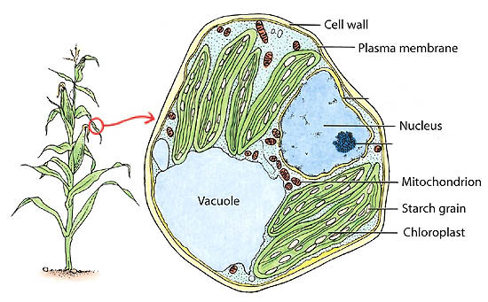
Other Vacuoles
Some vacuoles store toxic materials.
Acacia trees store poison
Tobacco plants store nicotine
Some vacuoles store pigments for color like rose petals.

Slide 9
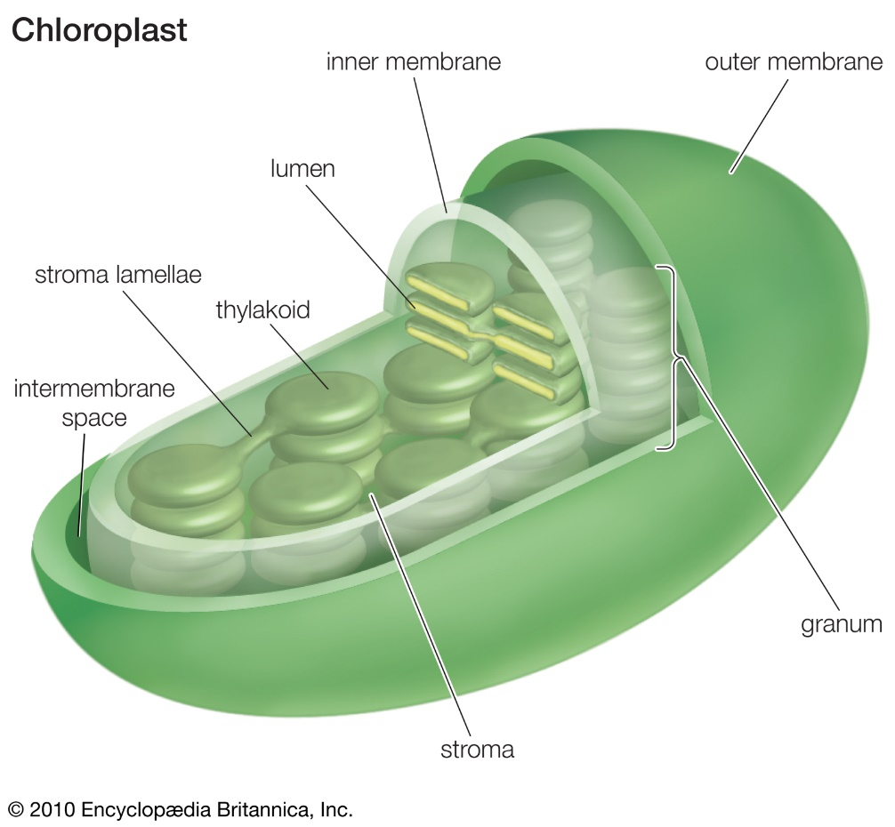
Plastids
Plastids are organelles that, like mitochondria, are surrounded by a double membrane and contain their own DNA.
Chloroplasts
Chromoplasts
Leucoplasts

Slide 10
Chloroplasts
Chloroplasts use light energy to make carbohydrates from carbon dioxide and water.
Each chloroplast consists of flattened, membranous sacs called thylakoids.
Thylakoids contain the green pigment chlorophyll, the main molecule that absorbs light and captures light energy for the cell.

Slide 11
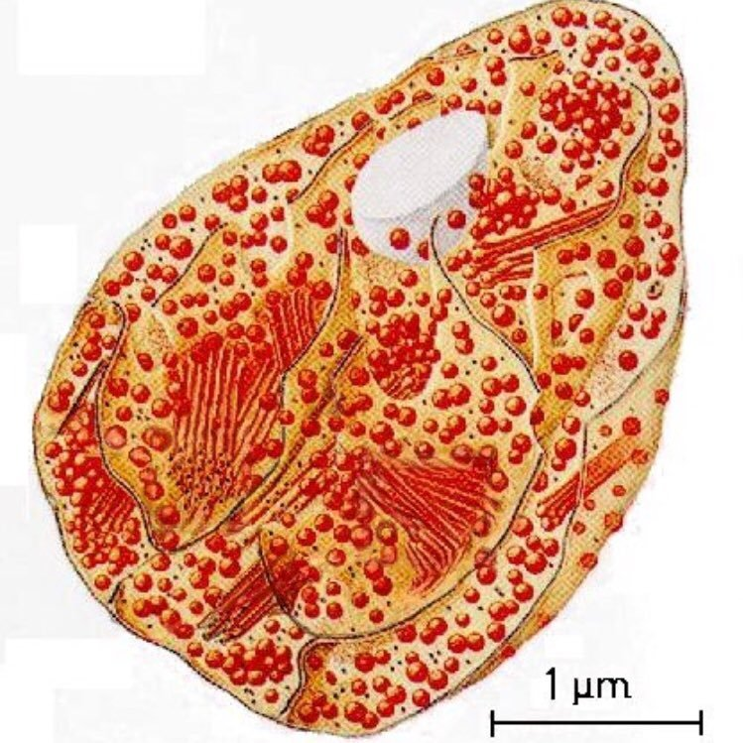
Chromoplasts
Chromoplasts are plastids that contain colorful pigments and may of may not take part in photosynthesis.
chromoplasts with orange pigment carotene in carrot plants
chromoplasts in petal cells contain red, purple, yellow, or white pigment.

Slide 12
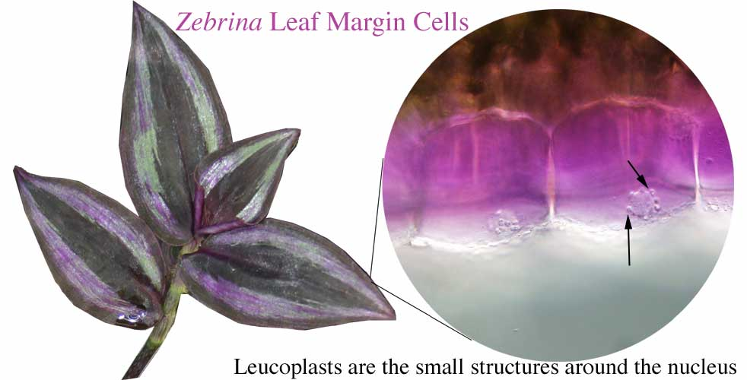
Leucoplasts
Leucoplasts are a colorless organelle found in plant cells, used for the storage of starch or oil.

Slide 13
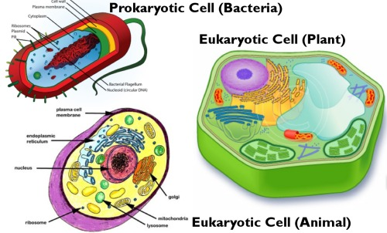
Comparing Cells
All cells have common features: cell membrane, cytoplasm, genetic material, and ribosomes.
Prokaryotes lack nucleus and membrane-bound organelles.
Plant cells have three unique features from animal cell’s: cell wall, central vacuole, and plastids.

Slide 14
Review Questions
Identify three unique features of plant cells.
List the difference between the plasma membrane, the primary cell wall, and the secondary cell wall.
Identify three functions of the plastids.
Name three things that may be stored in vacuoles.
Describe the features that distinguish prokaryotes from eukaryotes and plant cells from animal cells.
Tobacco plant cells contain a toxic chemical. Why don’t tobacco plants poison themselves? Explain.

