Slide 1
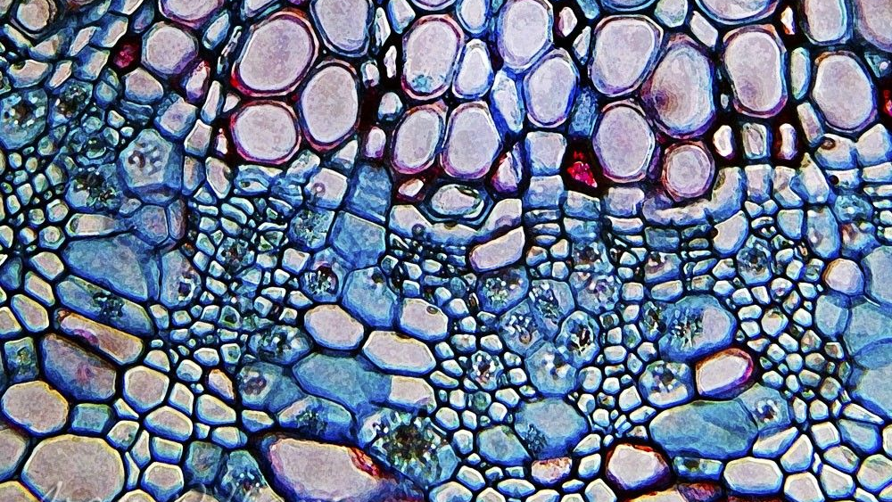
4.3 Cell Organelles and Features
UNIT 4: CELL STRUCTURE AND FUNCTION

Slide 2
What structures do we have in a cell?

Slide 3
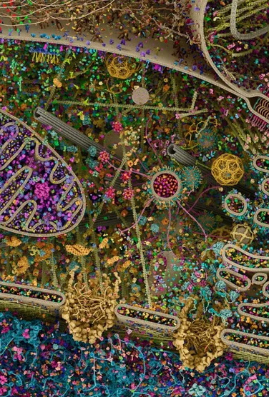
Student Objectives
Describe the structure and function of a cell’s plasma membrane.
Summarize the role of the nucleus.
List major organelles found in cytosol, and describe their roles.
Identify the characteristics of mitochondria.
Describe the structure and function of the cytoskeleton.

Slide 4
Organelles and Features
Plasma Membrane
Nucleus
Mitochondria
Ribosomes
Endoplasmic Reticulum
Golgi Apparatus
Vesicles
Cytoskeleton
Cilia and Flagella

Slide 5
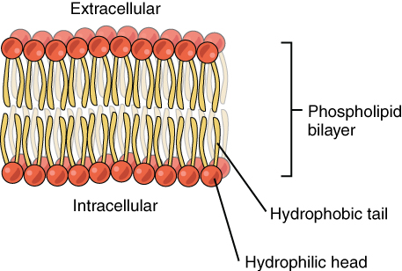
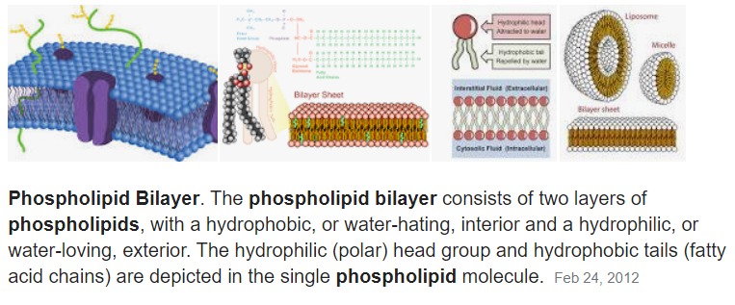
Example: Plasma membrane

Slide 6
Plasma membrane

Slide 7
Nucleus

Slide 8
Mitochondria

Slide 9
Ribosomes

Slide 10
Endoplasmic Reticulum

Slide 11
Golgi Apparatus

Slide 12
Vesicles

Slide 13
Cytoskeleton

Slide 14
Cilia and Flagella

Slide 15
Review questions
What’s DNA?
What is the function of the nucleus?
Identify two characteristics that make mitochondria different from other organelles.
List three types of cytoskeletons.

