Slide 1
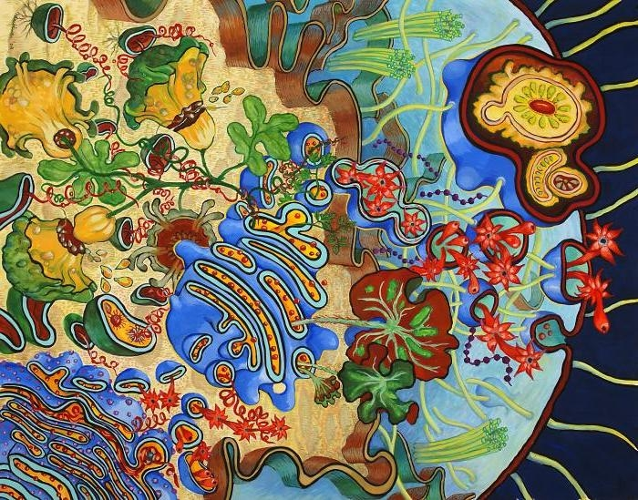
Chapter 4: Cell structure and Function
Cell Organelles and Features

Slide 2
What structures do we have in a cell?

Slide 3
Student objectives:
Describe the structure and function of a cell’s plasma membrane.
Summarize the role of the nucleus.
List major organelles found in the cytosol, and describe their roles.
Identify the characteristics of mitochondria.
Describe the structure and function of the cytoskeleton.

Slide 4
Plasma Membrane
The plasma membrane (cell membrane) allows only certain molecules to enter or leave the cell.
It separates internal metabolic reactions from the external environment.
It allows the cell to excrete wastes and to interact with its environment.

Slide 5
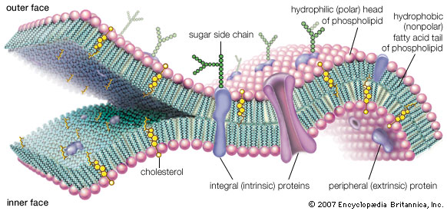
Membrane Lipids
The plasma membrane is primarily made of phospholipids.
Phospholipids have polar hydrophilic phosphate head and two nonpolar hydrophobic fatty acid tails.
They line up in a phospholipid bilayer.
Cell membranes also contain sterols (other lipids such as cholesterol).

Slide 6
Membrane Proteins
Plasma membranes also contains integral proteins in the lipid bilayer.
Receptor proteins
Transport proteins

Slide 7
Fluid mosaic model
A cell’s membrane is very dynamic.
The fluid mosaic model states that the phospholipid bilayer behaves more life a fluid than a solid.
Membrane lipids and proteins can move laterally within the bilayer.

Slide 8
Nucleus
The nucleus is filled with a jellylike liquid called the nucleoplasm, which holds contents of the nucleus and is similar to the cytoplasm.
The nucleus houses and protects the cell’s genetic information (DNA).
When a cell is not dividing it is in a threadlike form called chromatin.
When a cell is about to divide, the chromatins condenses to form chromosomes.
The nucleus is where DNA is transcribed into ribonucleic acid (RNA).

Slide 9
Nuclear Envelope
The nucleus is surrounded by a double membrane called the nuclear envelope.
It is made of two phospholipid bilayers.
RNA can enter and leave the nuclear envelope via nuclear pores.

Slide 10
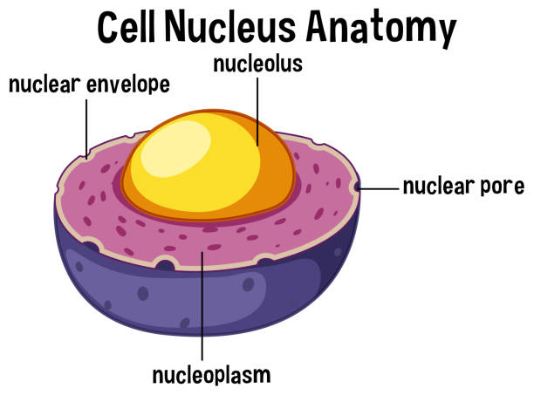
Nucleolus
Most nuclei contain at least one denser area, called the nucleolus.
The nucleolus is the site where DNA is concentrated when it is making ribosomal RNA.
Ribosomes are organelles made of protein and RNA that direct protein synthesis in the cytoplasm.

Slide 11
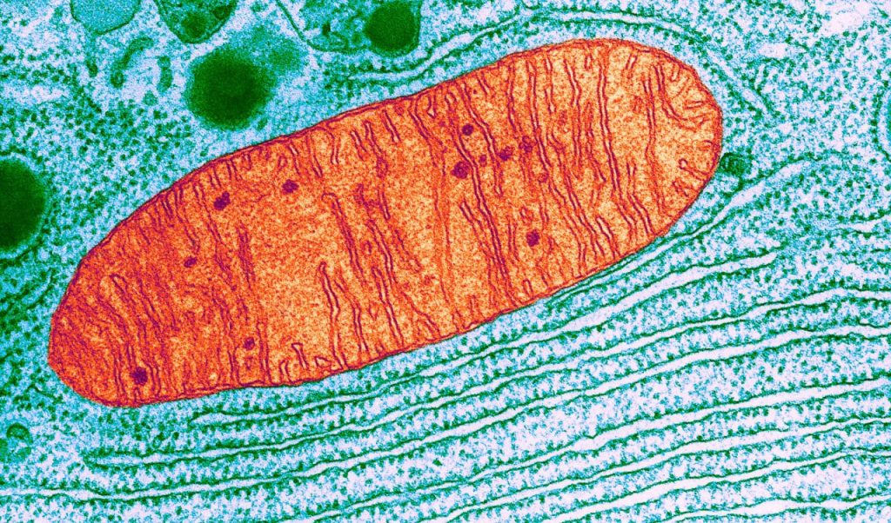
Mitochondria
Mitochondria are tiny organelles that transfer energy from organic molecules to adenosine triphosphate (ATP).
ATP powers the cell’s chemical reactions.
A mitochondrion has an inner and outer phospholipid membrane.
Mitochondria have their own DNA and reproduce only by division of preexisting mitochondria.
Scientists think that mitochondria originated from prokaryotic cells that were incorporated into ancient eukaryotic cells.

Slide 12
Ribosomes
Ribosomes are small, toughly spherical organelles that are responsible for building protein.
Ribosomes do not have a membrane.
They are made of protein and RNA molecules.

Slide 13
Endoplasmic reticulum
The endoplasmic reticulum (ER) is a system of membranous tubes and sacs.
The ER functions primarily as a intracellular highway.
There are two types of ER:
Rough ER: covered with ribosomes and produces phospholipids and proteins.
Smooth ER: lacks ribosomes and produces lipids.

Slide 14
Golgi Apparatus
The Golgi apparatus is a system of flattened, membranous sacs. The sacs receive newly made proteins and lipids and transport the substances.

Slide 15
Vesicles
Vesicles have a single membrane and transport and/or digest wastes within the cell.
Lysosomes are vesicles that contain digestive enzymes (for large molecules, bacteria, and cells).

Slide 16
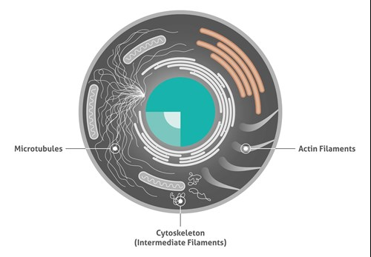
Cytoskeleton
The cytoskeleton is a network of thin tubules and filaments that crisscrosses the cytosol.
They give shape and act as internal tracks.
Microtubules: hollow tubes made of a protein called tubulin.
Microfilaments: long threads of protein actin for cell movement of white blood cells and for muscle contraction.
Intermediate filaments: rods that anchor the nucleus and some other organelles to their place.

Slide 17
Cilia and Flagella
Cilia and Flagella are hair like structures that extend from the surface of the cell, where they assist in movement.

Slide 18
Review questions
What’s DNA?
What is the function of the nucleus?
Identify two characteristics that make mitochondria different from other organelles.
List three types of cytoskeletons.

