Slide 1
Chapter 4: Cell structure and Function
Introduction to cells

Slide 2
Cells come in a variety of shapes and sizes that suit their diverse function. There are at least 200 types of cells.

Slide 3
Student objectives:
Explain the relationship between cell shape and cell function.
Identify the factor that limits cell size.
Describe the three basic parts of a cell.
Compare prokaryotic cells and eukaryotic cells.
Analyze the relationship among cells, tissues, organs, organ systems, and organisms.

Slide 4
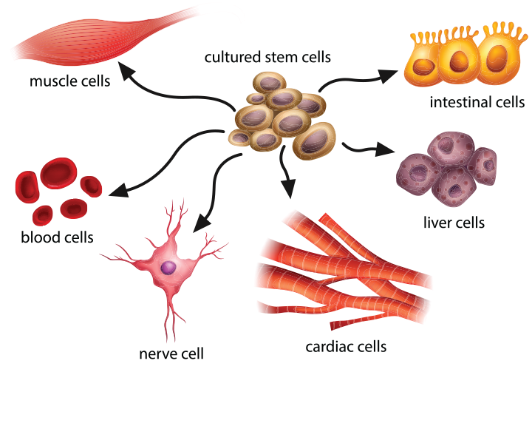
Cell Diversity
Cells of different organisms and even cells within the same organism are very diverse in terms of shape, size, and internal organization.

Slide 5
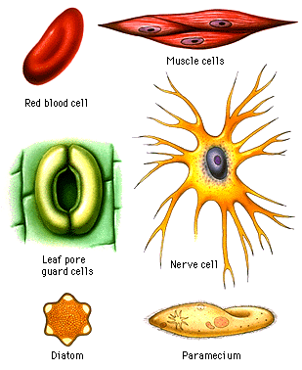
Cell Shape
The diversity of cell shapes reflects the different functions of cells.
A cell’s shape can be simple or complex depending on the function of the cell.
Each cell has a shape that has evolved to allow the cell to perform its function effectively.

Slide 6
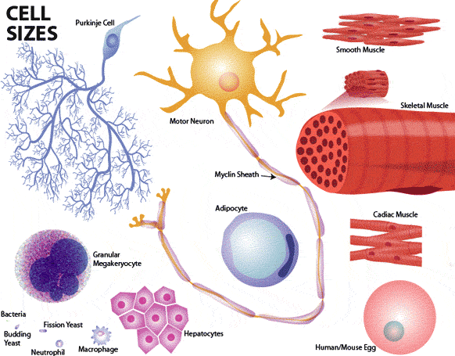
Cell size
Cells can have very different sizes.
The size of a cell is limited by the relationship of the cells outer surface area to its volume, or its surface area-to-volume ratio.

Slide 7
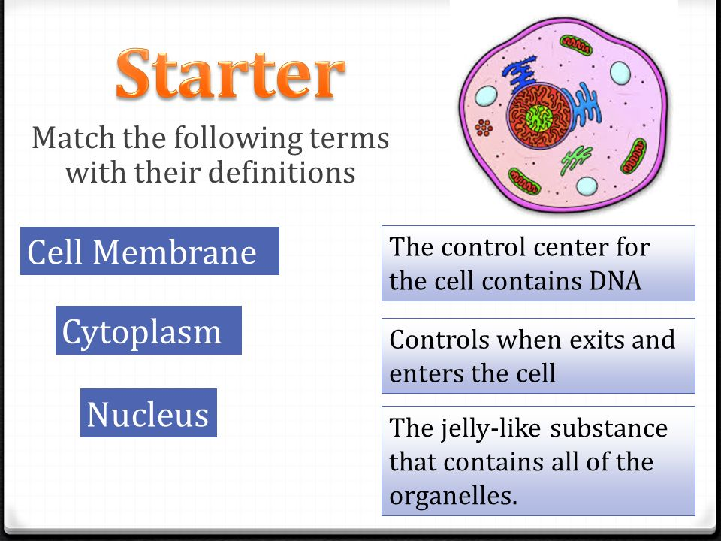
Basic parts of a Cell
3 basic features are common to all cell types:
  Plasma membrane
  Cytoplasm
  Control center

Slide 8
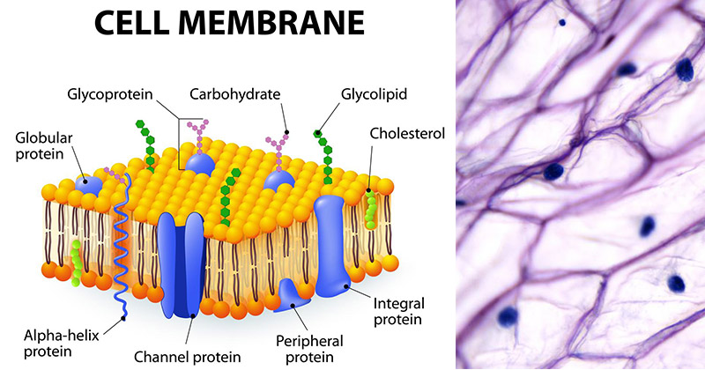
Plasma membrane
The plasma membrane is the cell’s outer boundary.
It covers the cell and acts as a barrier between the cell and the outside.

Slide 9
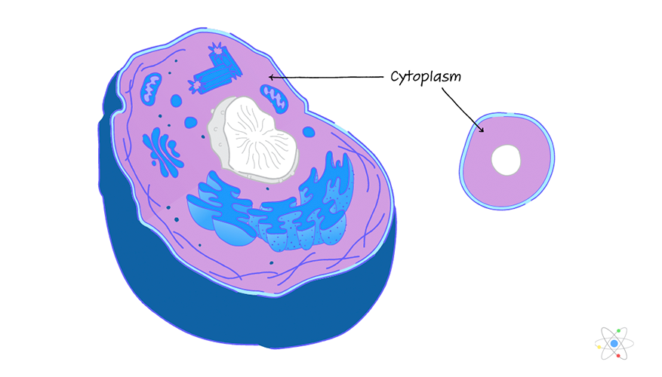
Cytoplasm
All the fluid, the cytoskeleton, and all of the organelles (except nucleus) are called the cytoplasm.
Cytosol is the part of the cytoplasm that includes molecules and small particles, but without the membrane-bound organelles.

Slide 10
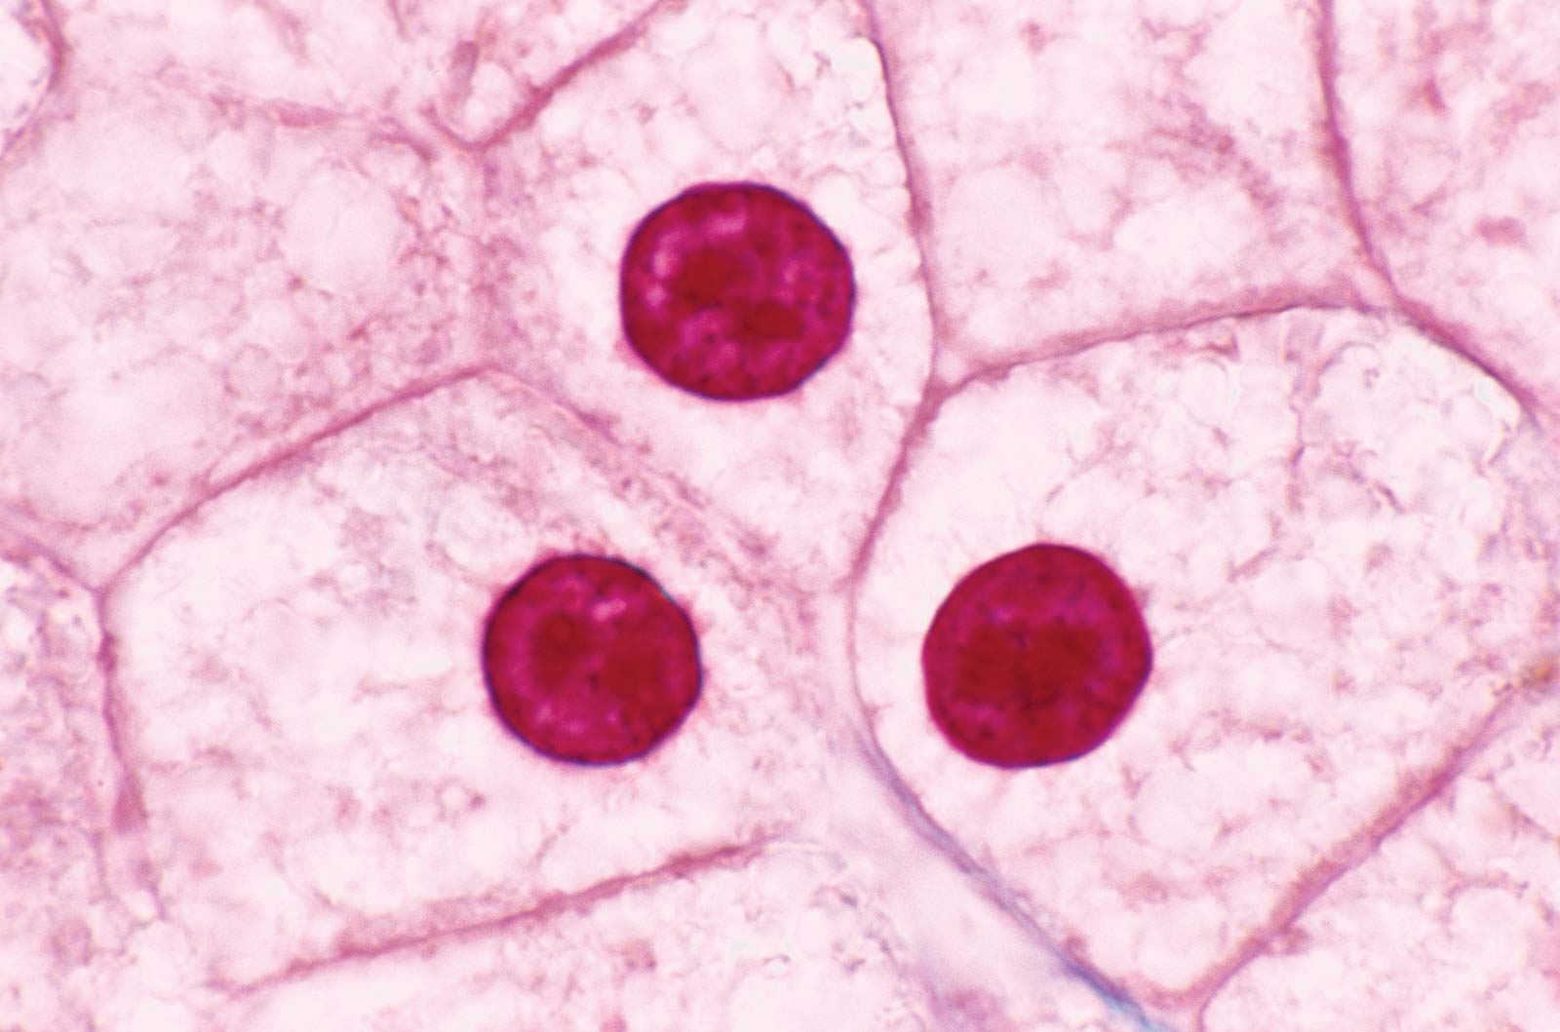
Control Center
The nucleus is a membrane bound organelle that carries the coded information in the form of DNA.
Some cells have the DNA float freely within the cell.

Slide 11
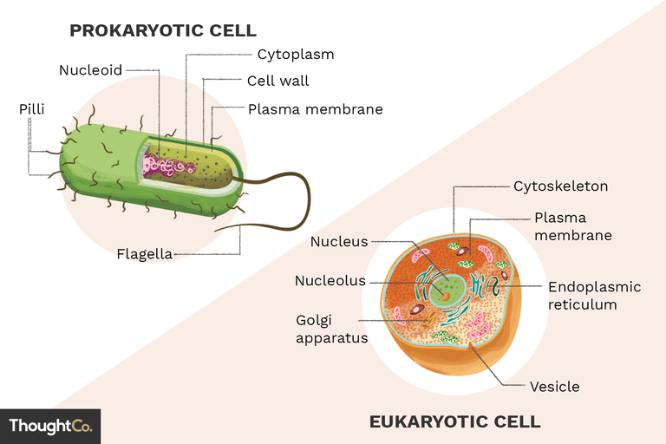
Two basic types of Cells
The earliest cells on Earth were simple cells similar to some present-day bacteria.
As cell evolved, they differentiated into two major types:
  Prokaryotes
  Eukaryotes

Slide 12
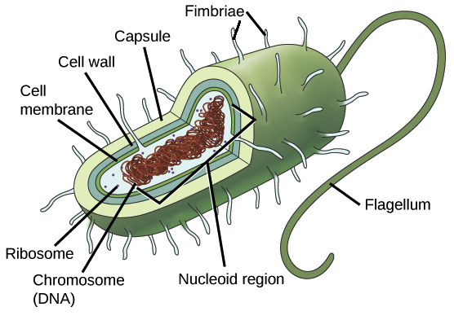
Prokaryotes
Prokaryotes are organisms that lack a membrane-bound nucleus and membrane-bound organelles.
Their DNA is often concentrated in a part of the cell called nucleoid.
Prokaryotes have two domains: Bacteria and Archaea

Slide 13
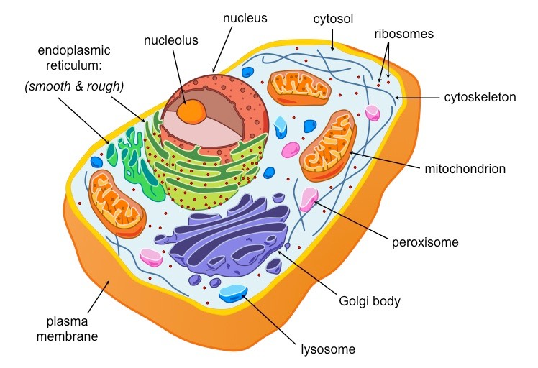
Eukaryotes
Organisms made up of one or more cells that have a nucleus and membrane-bound organelles called Eukaryotes.
Eukaryotic cells have a variety of subcellular structures called organelles, well-defined, intracellular bodies that perform specific functions for the cell. Many organelles are surrounded by a membrane.

Slide 14
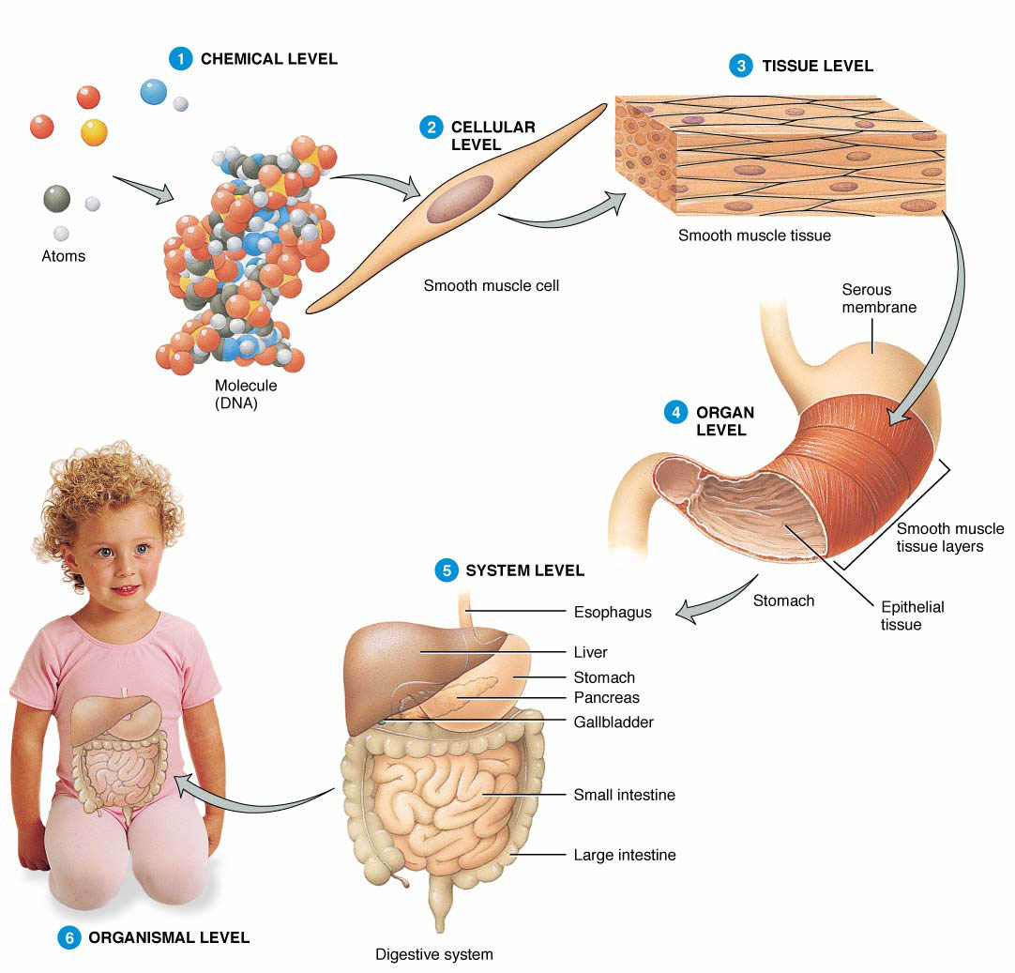
Cellular organization
Over time cells began to work together:
  Colonies: A colonial organism is a collection of genetically identical cells that live together in a connected group.
  Organism: Cells take specific roles within an organism. Tissues are the groups of similar cells that carry out a specific task. Organs are groups of tissue working together. An organ system is a group of organs that accomplish related tasks.

Slide 15
Review questions
Describe the relationship between a cell’s shape and its function.
Explain the factor that limits cell size.
Identify three parts of a cell.
Summarize the difference between prokaryotic and eukaryotic cells.
List four levels of organization that combine to form an organism.

