Slide 1
Chapter 4: Cell structure and Function
The history of cell biology

Slide 2
Both living and nonliving things are made of atoms, molecules, and compounds. How are living and nonliving things different?

Slide 3
Student objectives:
Name the scientists who first observed living and nonliving cells.
Summarize the research that led to the development of the cell theory.
State the three principles of the cell theory.
Explain why the cell is considered to be the basic unit of life.

Slide 4
The Discovery of Cells
All living things are made up of one or more cells.
A cell is the smallest unit that can carry on all of the processes of life.
When scientists were first able to use microscopes, they discovered these objects too small to be seen with the naked eye.

Slide 5
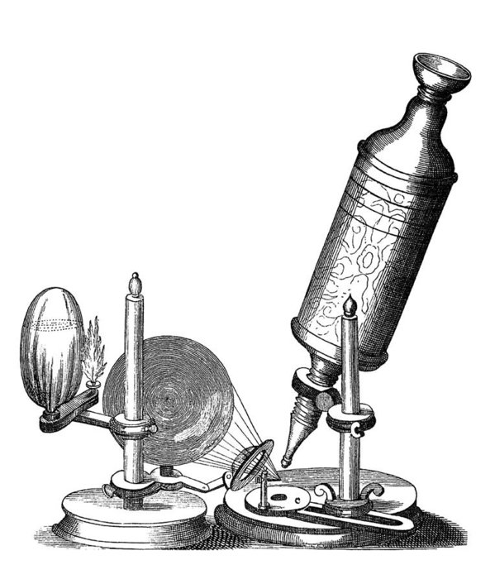
Hooke
In 1665, English scientist Robert Hooke studies nature by using an early microscope.
It used optical lenses to magnify objects by bending light rays.
Cells were little boxes where the monks lived, and he called cells after this.

Slide 6
Leeuwenhoek
The first person to observe living cells was a Dutch trader named Anton van Leeuwenhoek.
His microscope was 10 times better compared to Hooke’s.

Slide 7
The Cell Theory
Only 150 years later, other scientists discovered that plants and animals are made of cells.
Cell Theory:
All living things are composed of one or more cells.
Cells are the basic units of structure and function in an organism.
Cells come only from the reproduction of existing cells.

Slide 8
Developments in cell theory
The discovery of cells and the development of the cell theory happened at the beginning of a revolutionary time in the history of science.

Slide 9
Review questions
Describe the major contributions of Hooke and Leeuwenhoek.
State the three fundamental parts of the cell theory.

