Slide 1
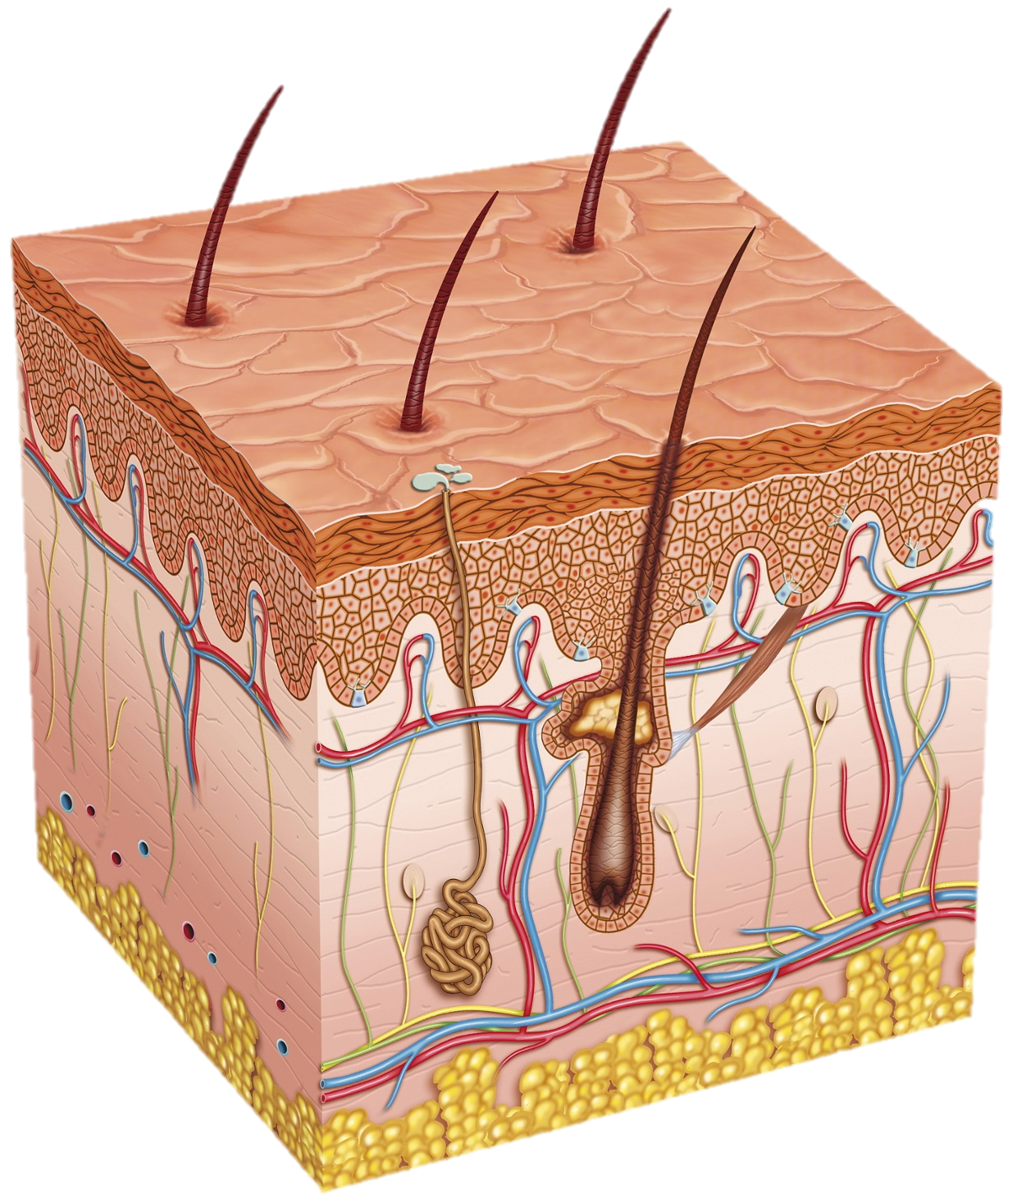
Integumentary System
-- Definition & Organs, Function, Tissue & Cavities --
By Piwat Suppawittaya 511 No. 9
Kittipat Chua-anusorn 511 No. 20

Slide 2
Definition & Organs
a system comprised of organs that are the outermost protective covering of the animal body, the skin, and its various derivatives
Cutaneous Membrane
Epidermis
Dermis
Subcutaneous Membrane
Accessory Structures
Hair
Exocrine Glands
Nails
Fun fact!
the largest system of the body
16 % of the body weight
1.5 – 2m² in area

Slide 3
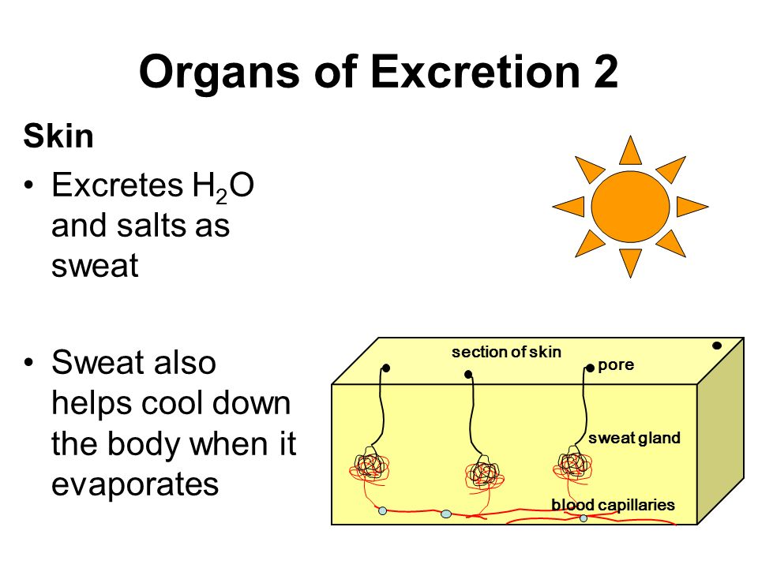
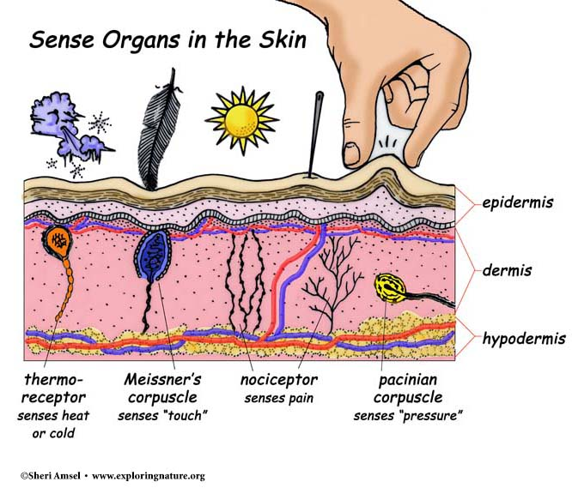
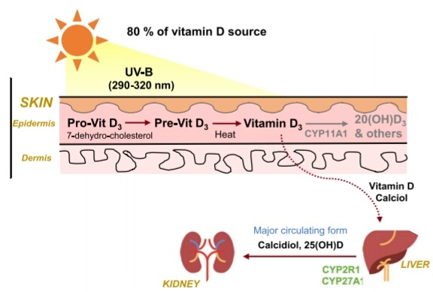
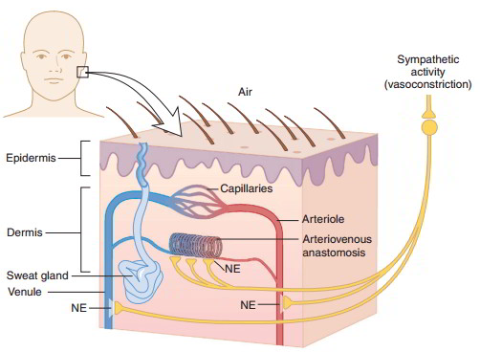
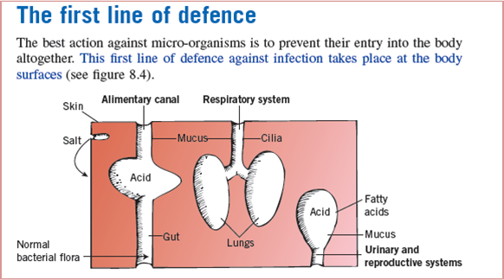
Functions of Integumentary System
Sensory Receptors
Vitamin D Production
Excretion
Fun Fact!
Every month you have a whole new layer of skin.
You will shed 40lbs of skin in a lifetime.
Body Temperature Regulation
Protection

Slide 4
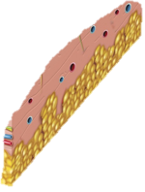
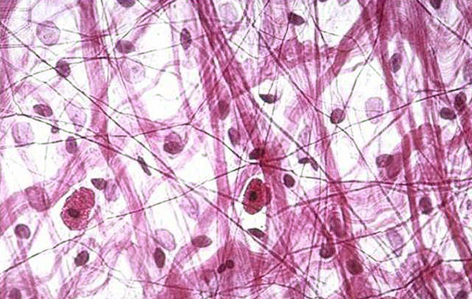
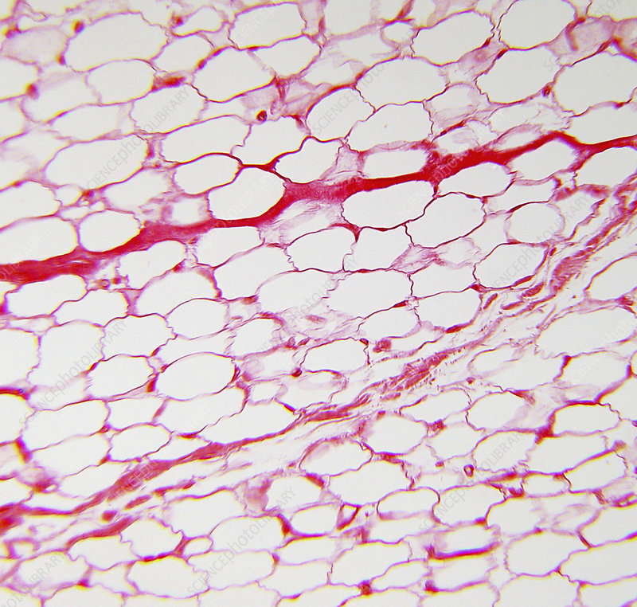
v
Types of Tissues in Skin
Subcutaneous Membrane / Hypodermis
Loose Connective Tissue
connect the skin to underlying tissues such as muscles
Adipose
How about Cavities?
maintain body temperature
function as a barrier to decrease the external force towards the body
As the integumentary is situated on the surface of human’s body, it is not related to any cavities of the body.

Slide 5
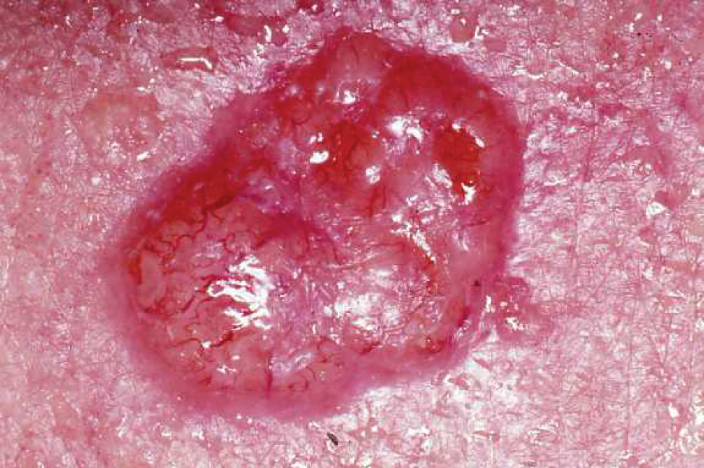
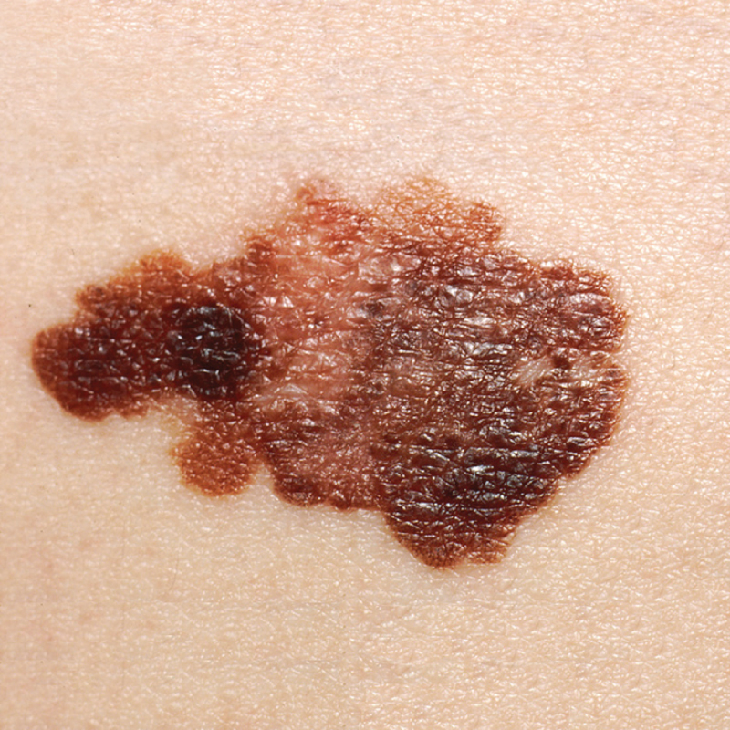
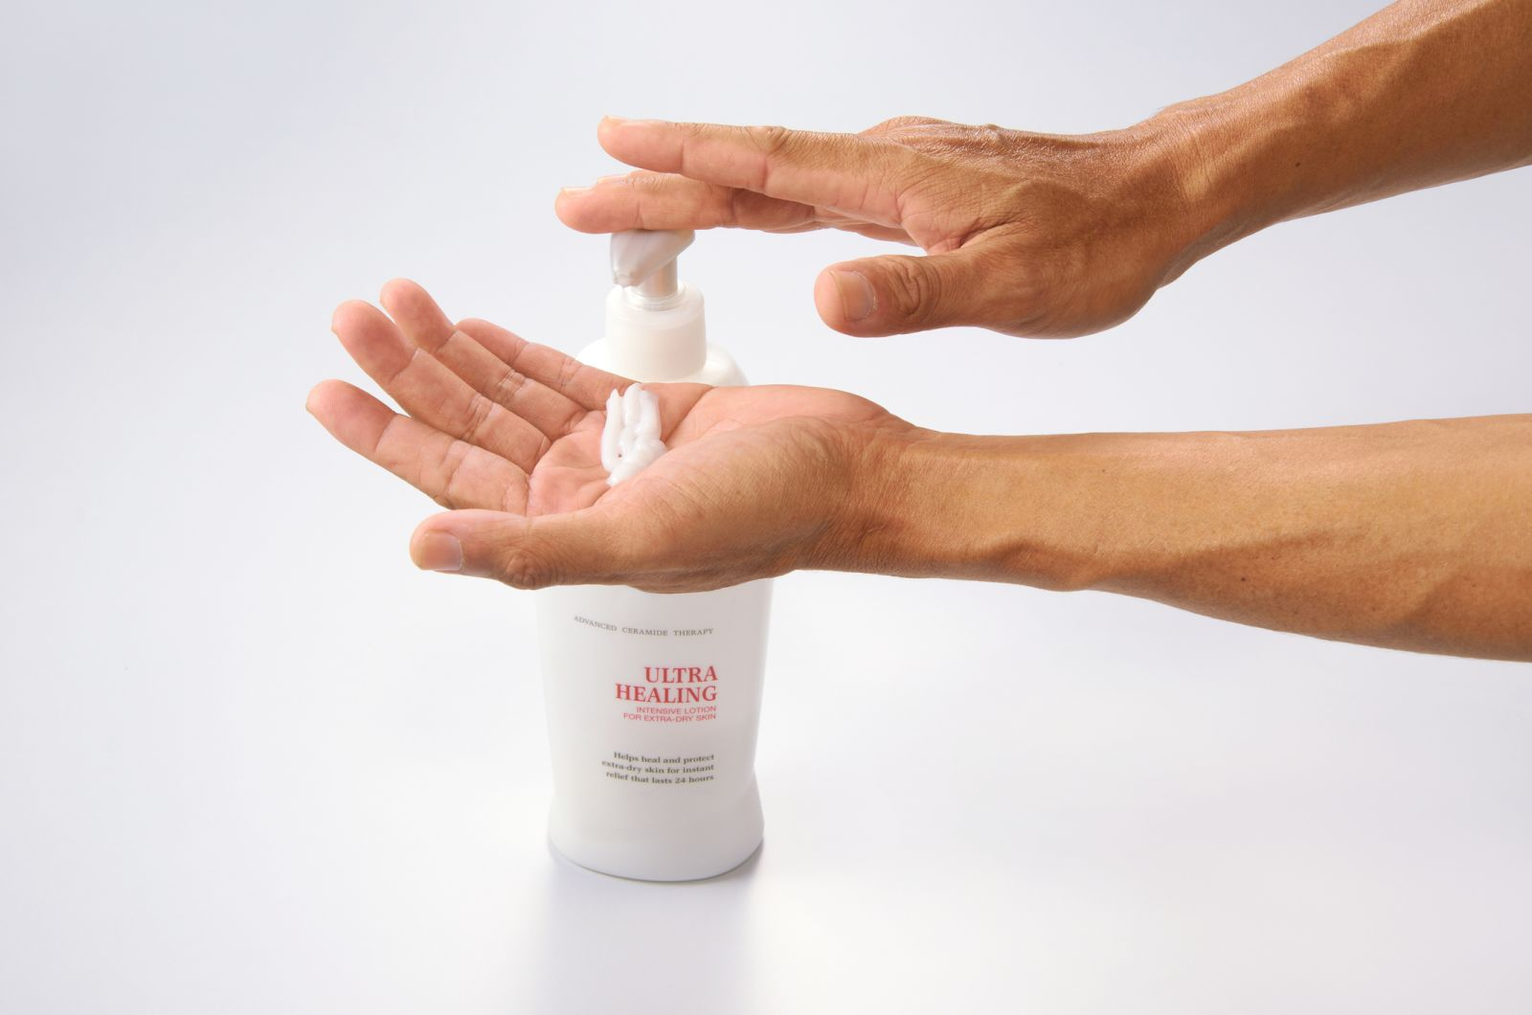
Suggestions of Daily Life Activities
Integumentary System
susceptible to a variety of diseases, disorders, and injuries
range from annoying but relatively benign bacterial or fungal infections that are categorized as disorders, to skin cancer and severe burns, which can be fatal
Ways to Maintain Healthy Integumentary System
Protect yourself from the sun
Use sunscreen
Seek shade
Wear protective clothing
Don't smoke
Eat a healthy diet
Manage stress
Treat your skin gently
Limit bath time
Avoid strong soaps
Shave carefully
Pat dry
Moisturize dry skin

Slide 6
References
https://courses.lumenlearning.com/wm-biology2/chapter/integumentary-system/
https://www.innerbody.com/anatomy/integumentary#continued
https://courses.lumenlearning.com/boundless-ap/chapter/functions-of-the-integumentary-system/
https://www.slideshare.net/itutor/the-integumentary-system-21210498
https://www.earthslab.com/physiology/thermoregulation-temperature-
regulation-skin-hypothermia-hyperthermia/
https://slideplayer.com/slide/9818148/
https://immunityproject.weebly.com/first-line-of-defence.html
https://www.quora.com/How-exactly-does-the-sun-provide-us-with-Vitamin-D
https://www.earthslab.com/physiology/structures-locations-functions-sensory-receptors/
https://sites.google.com/site/integumentarysystem305/10-interesting-facts
https://www.sciencephoto.com/media/120798/view/adipose-tissue-in-skin-hypodermis-lm
https://twsmassage.wordpress.com/2016/06/13/types-and-functions-of-connective-tissue-proper/
https://opentextbc.ca/anatomyandphysiology/chapter/5-4-diseases-disorders-and-injuries-of-the-integumentary-system/
https://www.mayoclinic.org/healthy-lifestyle/adult-health/in-depth/skin-care/art-20048237
https://opentextbc.ca/anatomyandphysiology/chapter/5-4-diseases-disorders-and-injuries-of-the-integumentary-system/

