Slide 1
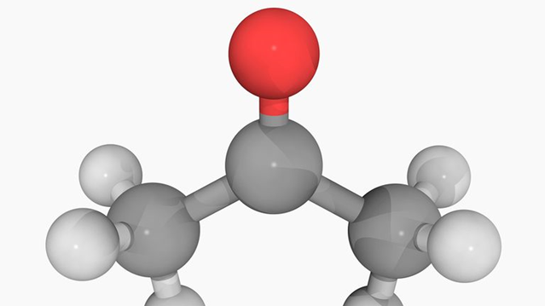
3.1 Carbon Compounds
Unit 3: Biochemistry

Slide 2
Four main classes of organic compounds are essential to the life processes; carbohydrates, lipids, proteins, and nucleic acids.

Slide 3
Student Objectives
Distinguish between monosaccharides, disaccharides, and polysaccharides.
Explain the relationship between amino acids and protein structure.
Describe the induced fit model of enzyme action.
Compare the structure and function of each of the different types of lipids.
Compare the nucleic acids DNA and RNA.

Slide 4
Carbohydrates
_____________ are organic compounds composed of carbon, hydrogen, and oxygen in a ratio 1:2:1.
Some carbohydrates serve as a source of ________, others as structural materials.
Carbohydrates exist as monosaccharides, disaccharides, and polysaccharides.

Slide 5
Monosaccharides
A ___________ of a carbohydrate is called monosaccharide.
Also called a simple sugar.
Formula: (CH2O)n
‘n’ can be any whole number between 3 to 8.
The most common monosaccharide are glucose (energy source for cells), fructose (found in fruits), and galactose (found in milk).
Compounds with single chemical formula but different structural forms are called __________.

Slide 6
Disaccharides
In living things, two monosaccharides can combine in a condensation reaction to form double sugars, or disaccharide.
Fructose and glucose can combine to form the disaccharide _________.

Slide 7
Polysaccharides
A polysaccharide is a ________ molecule composed to three or more monosaccharides.
Animals store glycose in the form of polysaccharide ____________.
Glycogen consists of hundreds of glucose molecules together.
Liver and muscles store glycogen and are ready to be used for quick energy.

Slide 8
Proteins
Proteins are organic compounds composed mainly of carbon, hydrogen, oxygen, and nitrogen.
Protein monomers are called _______ _________.
Hair, horns, skin, muscles and many enzymes are made of proteins.

Slide 9
Amino Acids
There are 20 different amino acids, and all share a basic structure.
Amino acid: a central carbon (4 bonds), a single hydrogen atom, carboxyl group (-COOH), an amino group (-NH2), and a side chain (R group).
The main difference among different amino acids is in their R groups, and give proteins their different shapes for different activities.

Slide 11
Dipeptides
Two amino acids bond to form a dipeptide.
In this condensation reaction, the two amino acids form a covalent bond, called a peptide bond and release a water molecule.

Slide 12
Polypeptides
Amino acids often form very long chains called polypeptides.

Slide 13
Enzymes
Enzymes – RNA or protein molecules that act as biological ____________ – are essential for the functioning of any cell.
Many enzymes are ___________.
Enzyme reaction depend on a physical fit between the enzyme molecule and its specific substrate, the reactant being catalyzed.
The active site is a shape that allows the substrate to fit into the enzyme.
This way less energy is needed to start the reaction.

Slide 14
Lipids
Lipids are large, nonpolar organic molecules.
They do _____ __________ in water.
Lipids include _____________, phospholipids, steroids, waxes, and pigments.
Lipids have higher ratio of carbon and hydrogen atoms to oxygen atoms compared to carbohydrates, therefore they can store more energy.

Slide 15
Fatty acids
Fatty acids are unbranched carbon chains that make up most lipids.
A fatty acid contains a long carbon chain (from 12 to 18 carbons) with a carboxyl group, -COOH, attached to the end.
Carboxyl is polar, thus _____________, attracted to water.
Hydrocarbon is nonpolar, _______________, does not interact with water.
When all carbon atoms are bonded to four atoms, they are saturated.
When carbon hasn’t bonded with the maximum atoms it’s considered unsaturated.

Slide 16
Triglycerides
A triglyceride is composed of three molecules of fatty acid joined to one molecule of the alcohol glycerol.
Saturated triglycerides are composed of saturated fatty acids: butter and fats in red meat.
Unsaturated triglycerides are composed of unsaturated fatty acids: plant seeds.

Slide 17
Phospholipids
Phospholipids have two fatty acids attached to a glycerol molecule.
The _____ _________is made of two layers of phospholipids, called lipid bilayer.
The inability to dissolve in water allows the membrane to form a barrier between the inside and outside of the cell.

Slide 18
Waxes
A wax type is a type of structural lipid consisting of a long fatty-acid chain.
Waxes are __________, and in plants, form a protective coating on the outer surfaces.
In animals we have earwax to protect our ears from microorganisms.

Slide 19
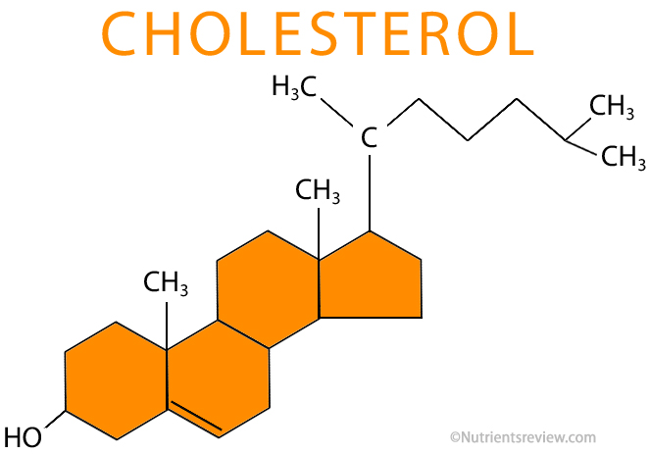
Steroids
Steroid molecules are composed of four fused carbon rings with various groups attached to them.
Many animal hormones are steroid compounds.
Cholesterol is needed by the body for nerve and other cells to function normally.

Slide 20
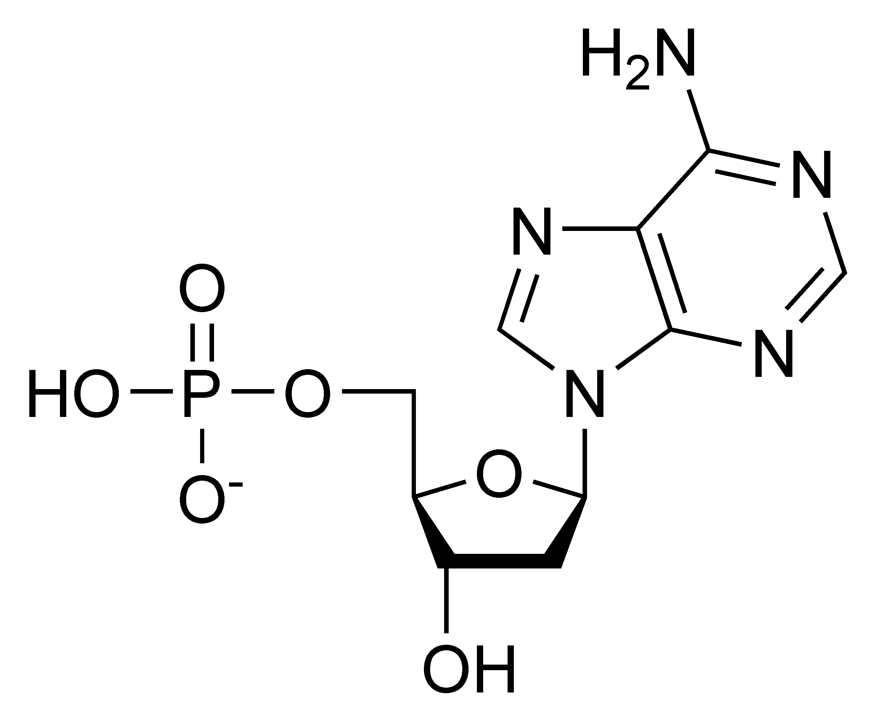
Nucleic Acids
Nucleic acids are very large and complex organic molecules that store and transfer important information in the cell.
_____________ ____ (DNA), contain information that determines the characteristics of an organism and directs cell activities.
_____________ ____(RNA), stores and transfers information from DNA that is essential for the manufacturing of proteins.
The monomer of nucleic acids is called nucleotide: a phosphate group, five-carbon sugar, and a ring based nitrogenous base.

Slide 21
Review Questions
Compare the structure of monosaccharides, disaccharides, and polysaccharides.
How are proteins constructed from amino-acids?
How do amino acids differ from one another?
Describe the model of enzyme action.
Why do phospholipids orient in a bilayer when in a watery environment, such as a cell?
Describe how three major types of lipids differ in structure from one another.
What are the functions of the two types of nucleic acids?

