Slide 1
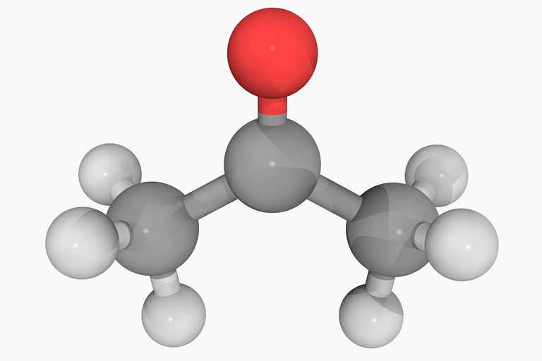
Biochemistry
Carbon compounds

Slide 2
Although water is the primary medium for life on Earth, most of the molecules from which living organisms are made are based on the element of carbon.

Slide 3
Student Objectives
Distinguish between organic and inorganic molecules.
Explain the importance of carbon bonding in biological molecules.
Identify functional groups in biological molecules.
Summarize how large carbon molecules are synthesized and broken down.
Describe how the breaking down of ATP supplies energy to drive chemical reactions.

Slide 4
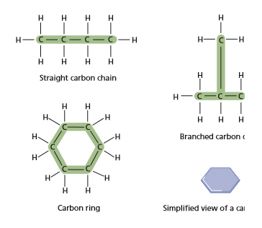
Carbon Bonding
Organic compounds are made primarily of carbon atoms.
Inorganic compounds, with a few exceptions, do not contain carbon compounds.
A carbon atom has four electrons in its outermost energy level. Most atoms become stable when their outermost energy levels contain eight electrons.
A carbon forms four covalent bonds with the atoms of other elements.
Carbon also readily bonds with other carbon atoms.
This tendency of carbon to bond with itself results in an enormous variety of organic compounds.

Slide 5
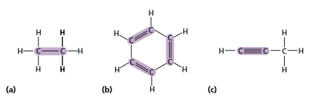
Carbon bonding
A bond formed when two atoms share one pair of electrons is called a single bond.
A carbon atom can also share two or even three pairs of electrons with another atom.
In a double bond – represented by two lines – atoms share two pairs of electrons.

Slide 6
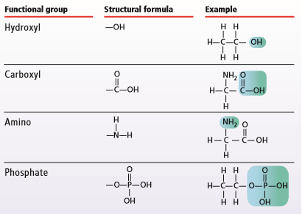
Functional groups
Functional groups influence the characteristics of the molecules they compose and the chemical reactions the molecules undergo.
Hydroxyl
Carboxyl
Amino
Phosphate

Slide 7
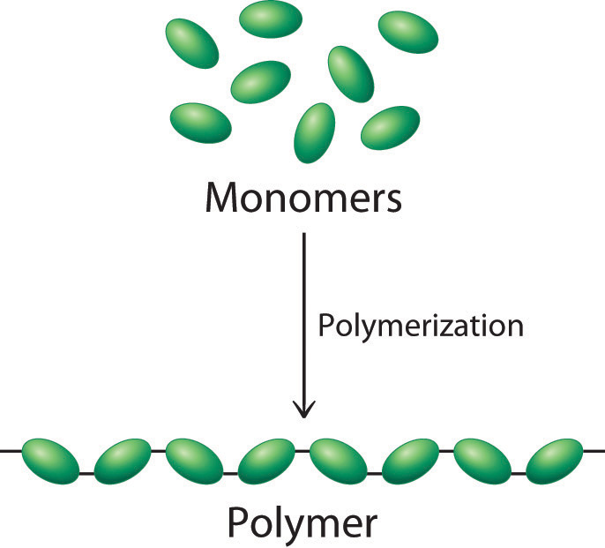
Large carbon molecules
Monomer are smaller simpler molecules.
A polymer is a molecule that consist of repeated, linked units.
The units may be identical or structurally related to each other.
Large polymers are called macromolecules. (carbohydrates, lipids, proteins, and nucleic acids)

Slide 8
Condensation reaction
Monomers link to form polymers through a chemical reaction called condensation reaction.
Each time a monomer is added to a polymer, a water molecule is released.
H+ and OH- are released to then combine to produce a water molecule H2O.
In a hydrolysis reaction, water is used to break down a polymer.

Slide 9
Energy Currency
Life processes require a constant supply of energy.
Adenosine triphosphate (ATP).
The covalent bonds between the phosphate groups are more unstable than the other bonds in the ATP molecule because the phosphate groups are close together and have negative charges.
When a bond between the phosphate groups is broken, energy is released.

Slide 10
Review
How do organic and inorganic compounds differ?
How do carbon bonding properties contribute to the existence of a wide variety of biological molecules?
Name four types of functional groups.
What role do functional groups play in the molecules in which they are found?
How are monomers, polymers, and macromolecules related to each other?
How is a polymer broken down?
Why is ATP referred to as the ‘energy currency’ in living things?

