Slide 1
2.3 Water and Solutions
Unit 2: Chemistry of Life

Slide 2
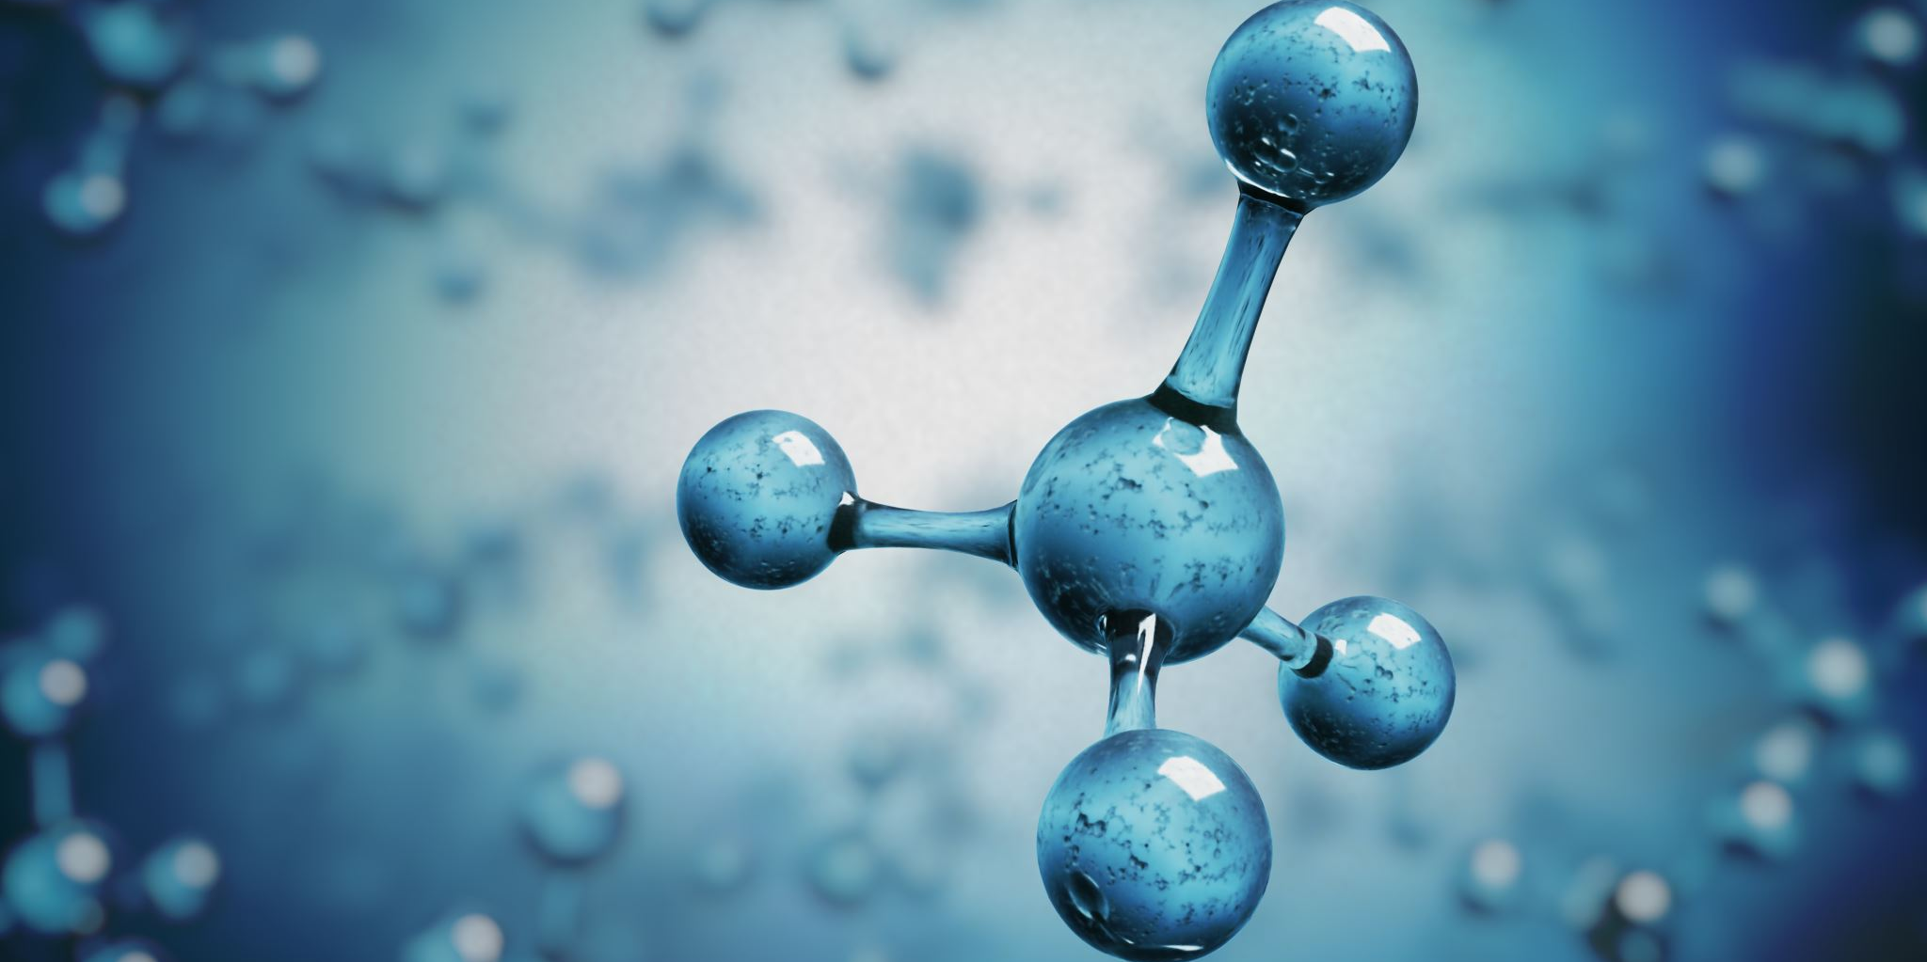
Jellyfish and humans seem unlike each other, yet the bodies of both are made of cells that consist mostly water. The chemical reactions of all organisms take place in the aqueous environment of the cell. Water has several unique properties that make it one of the most important compounds found in organisms.

Slide 3
Student Objectives
Describe
Describe the structure of a water molecule.
Explain
Explain how water's polar nature affects its ability to dissolve substances.
Outline
Outline the relationship between hydrogen bonding and the different properties of water.
Identify
Identify the roles of solutes and solvents in solutions.
Differentiate
Differentiate between acids and bases.

Slide 4
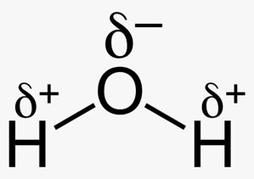

Slide 5
Polarity
In the water molecule (H20), hydrogen and oxygen atoms share electrons to form covalent bonds.
Water is called a polar compound because of its uneven distribution of charge.

Slide 6
Solubility of Water
The polar nature of water allows it to dissolve polar substances, such as sugars, ionic compounds, and some proteins.
Ions are essential to bodily functions.

Slide 7
Hydrogen Bonding
The polar nature of water also causes water molecules to attract each other.
A hydrogen bond is the force of attraction between a hydrogen molecule with a partial positive charge and another atom or molecule with a partial charge of full negative charge.

Slide 8
Hydrogen bonding in water
Hydrogen bonding accounts for some properties of water:
Cohesion and adhesion
Heat absorption
Cool surfaces with evaporation
Density of ice
Ability to dissolve many substances

Slide 9
Cohesion
An attractive force that holds molecules of a single substance together is known as cohesion.
Upward movement of water in plants
Surface tension

Slide 10
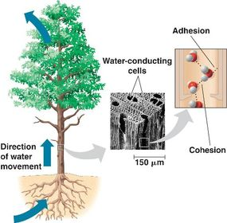
Adhesion
Adhesion is the attractive force between two particles of different substances.
A capillarity is the attraction between molecules that result in the rise of surface of a liquid when in contact with a solid.

Slide 11
Temperature Moderation
Water has high heat capacity, which means that water can absorb or release relatively large amounts of energy in the form of heat with only a slight change in temperature.
Energy is absorbed breaking hydrogen bonds.
Energy is released creating hydrogen bonds.

Slide 12
Density of Ice
Solid water (ice) is less dense than liquid water.
Ice crystals have large amounts of open space.
Because ice floats on water, ice insulates the water below from cold air.

Slide 13
Solutions
A solution is a mixture in which one or more substances are uniformly distributed in another substance.
Solutions can be mixtures of liquids, solids, or gases.
A solute is a substance dissolved in the solvent.
A solvent is the substance in which the solute is dissolved.

Slide 15
Proportion in Solutions
The concentration of a solution is the amounts of solute dissolved in a fixed amount of the solution.
A saturated solution is one in which no more solute can dissolve.

Slide 16
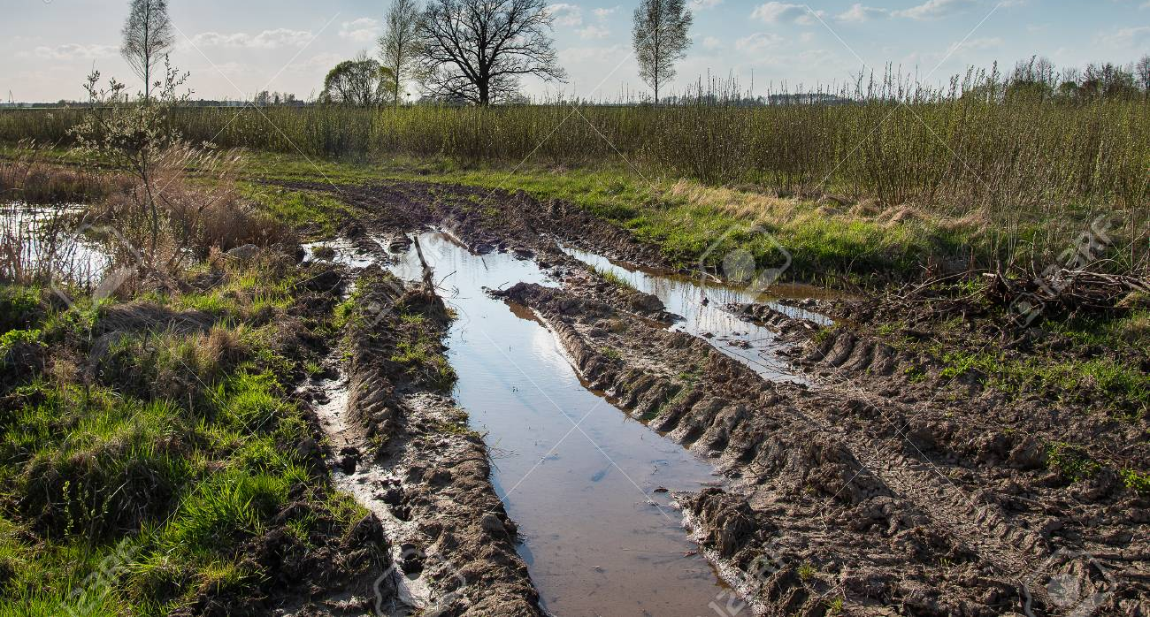
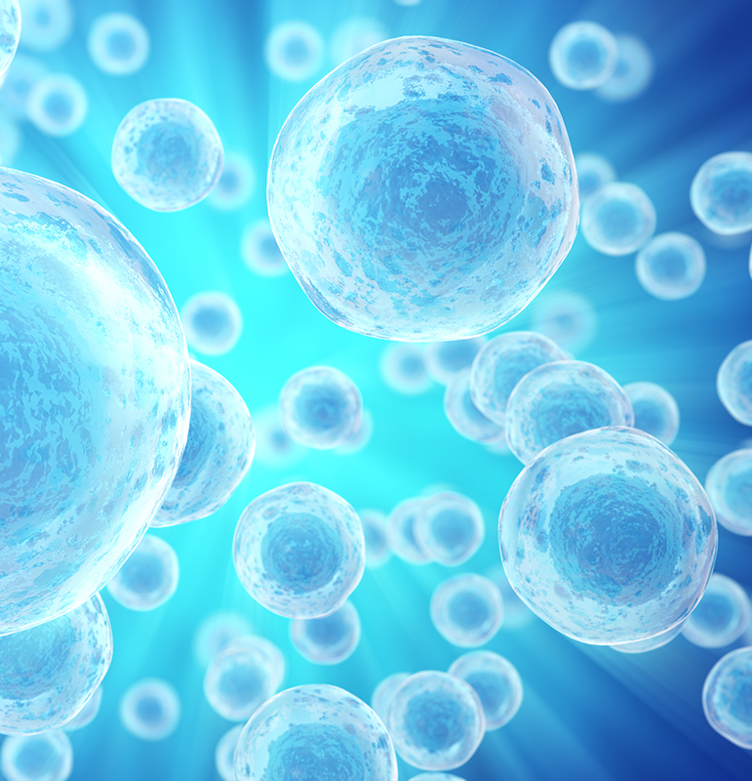
Aqueous Solutions
Solution in which water is the solvent are universally important in living things.
Marine microorganisms
Nutrients in soil for plants
Intracellular fluids in cells

Slide 17
Review Questions
Polarity
Illustrate the structure of a water molecule by drawing a space-filling model.
Why is water called a polar molecule?
Hydrogen Bonding
Identify the properties of water that are important for life to be able to exist.
Identify the solute and solvent in a hot chocolate solution that is made up of chocolate syrup and warm milk.
What is the relationship between hydrogen bonds and the forces of cohesion, adhesion and capillarity?

Slide 18
Acids and Bases
Most of the important aspects of a living system is the degree if its acidity or alkalinity. What do we mean when we use the terms acid and base?

Slide 20
Ionization of Water
One molecule of water disassociates another water molecule into two ions of opposite charge.
The OH- ion is known as the hydroxide ion.
The free H+ ion can now react with another water molecule.
The H3O+ ion is the hydronium ion.

Slide 21
Acids and Bases
Acidity or alkalinity is a measure of the relative amounts of hydronium ions and hydroxide ions dissolved in a solution.
If hydronium and hydroxide ions are equal the solution is neutral.

Slide 22
Acids
If the number of hydronium ions in a solution is greater than the number of hydroxide ions, the solution is an acid.
Sour taste
Corrosiveness

Slide 23
Bases
A base is a solution that contains more hydroxide ions than hydronium ions.
Alkaline refers to bases.
Bitter taste
Feel slippery

Slide 24
pH
The pH scale is a scale for comparing the relative concentrations if hydronium and hydroxide ions in a solution.

Slide 25
Buffers
The control of pH is important for living systems.
Stomach acid and Urine
Intestinal fluid and blood
Enzymes can function only within a very narrow pH range.
Buffers are chemical substances that neutralize small amounts of either an acid or a base added to a solution.

Slide 26
Review Questions
Solutions
What is H30+?
Classify and acid and a base in regard to H30+.
Why does pure water have a neutral pH?
Outline a reason why the control of pH is important in living systems.

