Slide 1
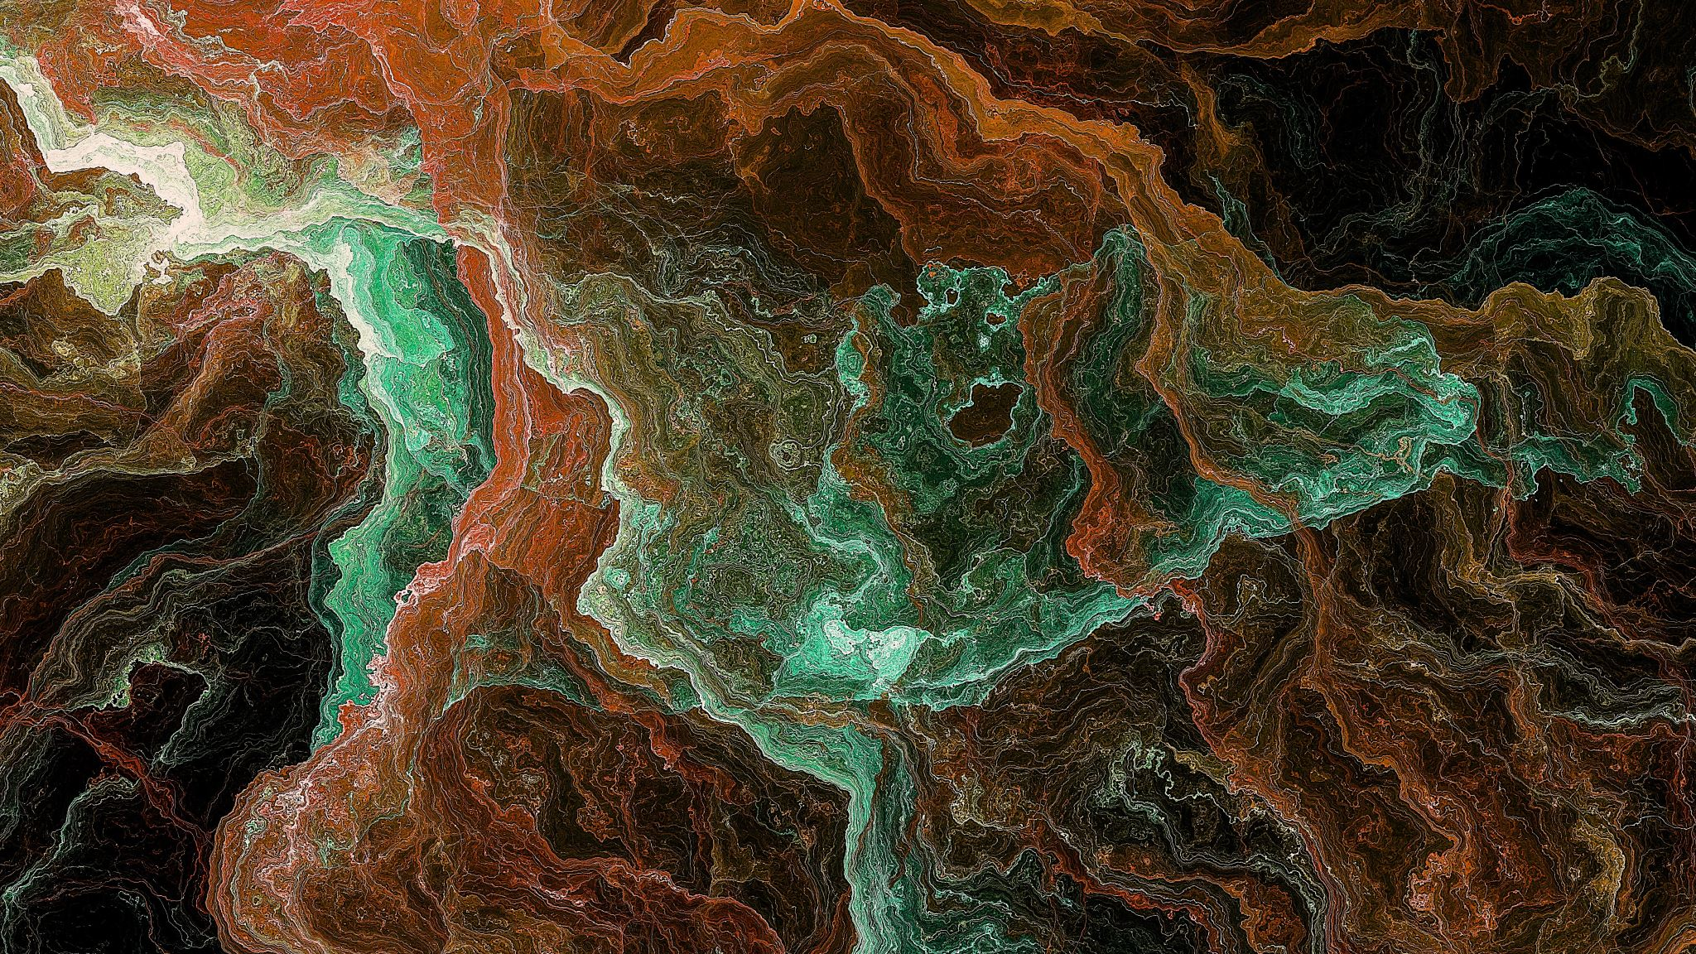
2.2 Energy
Chapter 2: Chemistry of Life

Slide 2
All living things use energy. The amount of energy in the universe remains the same over time, but energy can change from one form to another.

Slide 3
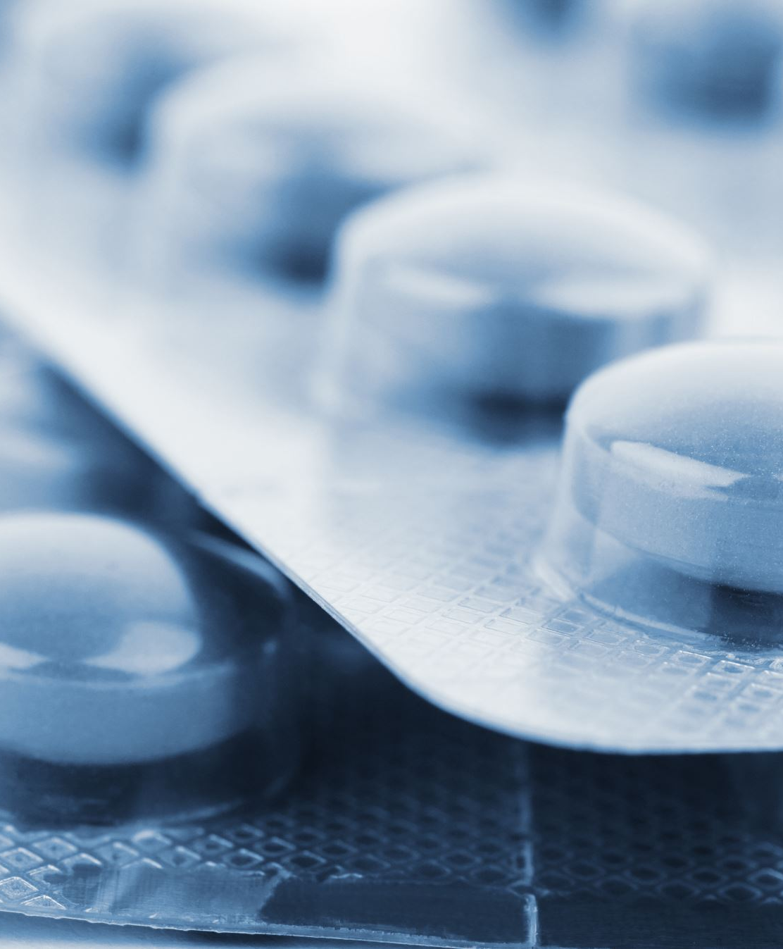
Student Objectives
Describe the physical properties of each state of matter.
Describe the role of reactants and products in chemical reactions.
Explain the relationship between enzymes and activation energy.
Explain how oxidation and reduction reaction are linked.

Slide 4
Energy and Matter
Energy is the ability to do work.
Energy comes in various forms and can convert to another form.
Some forms of energy are important to biological systems:
Chemical energy
Thermal energy
Electrical energy
Mechanical energy

Slide 6
States of Matter
All the atoms in any substance are in constant motion.
The motion and spacing between atoms or molecules of a substance determine the substance's state; solid, liquid, gas.
Water is an exception to this.
Thermal energy must be added to the substance to cause a change in states.
https://www.youtube.com/watch?v=hkBrw2fG75U&list=PLidqqIGKox7WeOKVGHxcd69kKqtwrKl8W&index=20

Slide 7
Energy and Chemical Reactions
In a chemical reaction, one or more substances change to produce one or more different substances.
Energy is absorbed or released
1000's chemical reactions each day in organisms
Complex or simple

Slide 8
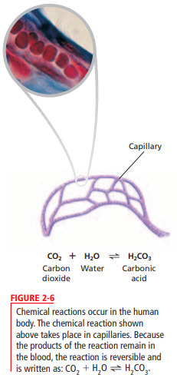

Slide 9
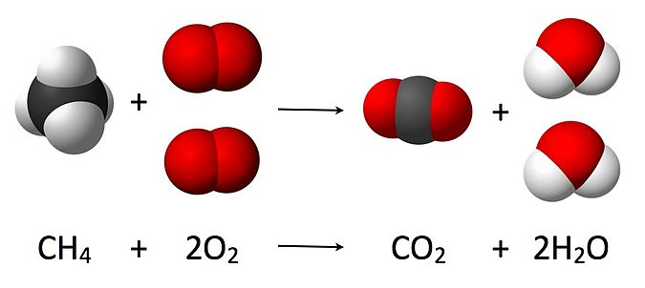
Chemical Reaction
Reactants: In chemical reactions the bonds present in reactants are broken and new compounds are formed.
New compounds formed from chemical reactions are called products.
Two-direction arrow: Some chemical reactions can happen either direction.

Slide 10
Metabolism
The energy your body needs is provided by sugars, proteins, and fats found in foods.
Chemical reactions break down food into CO2, H2O, and other products.
Energy is released for use by your body to build and maintain body cells, tissues and organs.
Metabolism are all the chemical reactions that occur in an organism.

Slide 11
Activation Energy
For most chemical reactions to begin, energy must be added to the reactants.
The amounts if energy needed to start the reaction is the activation energy.
Certain chemical substances, catalysts, reduce the amount of activation energy that is needed for a reaction to take place.
In living things, enzymes act as catalysts.
An enzyme is a protein or RNA molecule that speeds up metabolic reactions without being permanently changed or destroyed.

Slide 12
Oxidation-Reduction Reactions
Redox reactions (oxidation-reduction reactions) are reactions in which electrons are transferred between atoms.
In an oxidation reaction, a reactant loses one or more electrons, becoming positive in charge.
In a reduction reaction, a reactant gains one or more electrons, becoming more negative in charge.
An oxidation reaction occurs, and the electron given up by one substance is then accepted by another substance in a reduction reaction.
https://www.youtube.com/watch?v=jyvcVjrZnJA

Slide 13
Review Questions
Energy and Matter _states of Matter
Name and describe the physical properties of the three states of matter. Give information about their atoms as well.
Give a name to the different processes of matter changing between state phases. i.e. solid to a liquid is called…?
Is it possible for matter to skip phases or does matter always follow the same state phase changes? Explain and give support.
Is energy matter? Explain.
Energy and Chemical Reactions
Explain the roles of reactants and products in in a chemical reaction.
Describe the effect of an enzyme on activation energy in a chemical reaction.
Enzymes are biological catalysts. Explain their role in living organisms.
Why does a reduction reaction always accompany an oxidation reaction?
Living things need a constant supply of energy. Explain why this is true.
Why do you suppose a reduction reaction is referred to as such, “reduction”?

