Slide 1
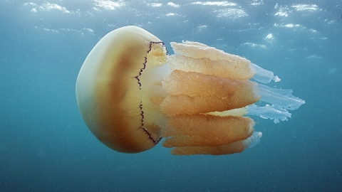
2.1 Composition of Matter
Chapter 2: Chemistry of Life

Slide 2
Earth supports an enormous variety of organisms. The structure and function of living things are governed by the laws of chemistry.

Slide 3
All organisms are made of the same basic material: carbon, hydrogen, oxygen, and nitrogen. Jellyfish are made of cells that are composed primarily of water. The chemical reactions of life occur in the aqueous environment of the cell.

Slide 4
Student Objectives
Define
Define the term matter.
Explain
Explain the relationship between elements and atoms.
Draw and label
Draw and label a model of the structure of an atom.
Explain
Explain how compounds affect an atom’s stability.
Contrast
Contrast covalent and ionic bonds.

Slide 5
Matter
Everything in the universe is made of matter.
Matter is anything that occupies space and has mass.
Mass is the quantity of matter an object has.
Mass and weight are not the same.
Chemical changes in matter are essential to all life processes.

Slide 6
Elements
Elements are substances that cannot be broken down chemically into simpler kinds of matter.
100 elements have been identified, fewer than 30 are important for living things.
More than 90% of the mass of all kinds of organisms is composed of combinations of just 4 elements: oxygen, carbon, hydrogen, and nitrogen.

Slide 7
Atoms
The simplest particle of an element that retains all the properties of that element is the atom.
Atoms are composed of protons, neutrons and electrons.
Protons and neutrons make up the nucleus of the atom.
Electrons move about the nucleus in orbitals.

Slide 8
Periodic Table
Each element has a different chemical symbol.
The number of protons in an atom is called the atomic number of the element.
The mass number of an atom is equal to the total number of protons and neutrons of the atom.

Slide 9
Electrons
The number of positively charged protons is balanced by an equal number of small, negatively charged particles called electrons.
An orbital is a three-dimensional region around a nucleus that indicates the probable location of the electron.
Electrons in orbital that are farther away from the nucleus have greater energy than electrons that are in orbitals closer to the nucleus.
Orbitals correspond to specific energy levels.

Slide 10
Isotopes
All atoms of an element have the same number of protons.
Atom of the same element that have a different number of neutrons are called isotopes.
Additional neutrons change the mass of the element.
Most elements are made up of a mixture of isotopes.
The average atomic mass of an element considers the relative amounts of each isotope in the element, and this average is the mass found in the periodic table.

Slide 11
Compounds
Compounds are made up of atoms of two or more elements in fixed proportions.
The physical and chemical properties differ between the compounds that compose them.
Noble or inert gases are elements that consist of maximum number of electrons in their orbit of highest energy levels. They do not react to other elements under normal conditions.

Slide 12
Chemical Bonds
Most atoms are not stable in their natural state, so they tend to react with other atoms in different ways to become more stable.
Carbon, nitrogen, and oxygen atoms have unfilled orbitals that correspond to other highest energy levels.
Like these elements, most elements tend to interact with other atoms to form chemical bonds.
Chemical bonds are the attractive forces that hold atoms together.

Slide 13
Covalent Bonds
A covalent bond forms when two atoms share one or more pairs of electrons.
A molecule is the simplest part of a substance that retains all the properties of that substance and can exist in a free state.

Slide 14
Ionic Bonds
An atom or molecule with an electrical charge is called ion.
Positive and negative electrical charges attract each other, this attraction is called ionic bond.

Slide 15
Review Questions
What is matter?
What is the relationship between elements and atoms
Describe the arrangement within energy levels of the six electrons of an atom of Carbon.
How are isotopes of the same element alike?
How can we predict which elements are reactive or unreactive under normal conditions?
Explain why the term weight and mass should not be used interchangeably.
What are the properties of Covalent Bonds?
What are the properties of ionic bonds?
How are these two bonds different?
Classify each of the following as an element or compound: HCl, CO2, Cl, Li, H2O, FeO
Given that elements are pure substances; how many types of atoms make up the structure of a single element. Explain and give an example?

