Slide 1
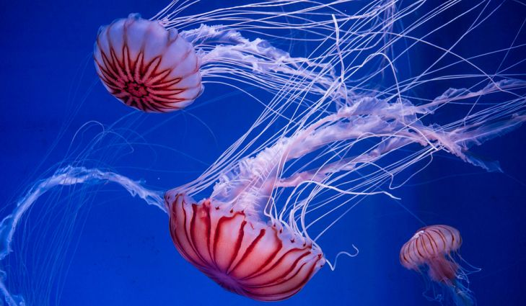
Chapter 2: Chemistry of life!
T. Rick

Slide 2
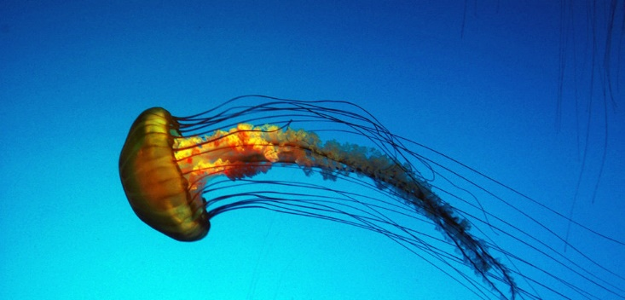
Chemistry of life
All living things are made of the same basic materials; carbon, hydrogen, oxygen and nitrogen. Living things, such as this jellyfish, are made of cells that are composed primarily of water.
The chemical reactions of life occur in the aqueous environment of the cell.

Slide 3
Composition of Matter
Come up with a definition of matter.
Matter → anything that has mass and takes up space!
Determine which of the following would be classified as matter:
WHALE, MILK, HEAT, DINOSAUR, GRASS, LOVE, BLOOD, SUN, BOOK, YOU, GRAVITY

Slide 4
Matter can be classified as either a substance or mixture

Slide 5
Substance: type of matter with a fixed structure that cannot be separated by physical means
2 examples →
elements & compounds

Slide 6
SUBSTANCE
Element: substance made up of the same atoms combined
examples→
gold, helium, aluminum

Slide 7
SUBSTANCE
Compound: substance made up of 2 or more different atoms that are combined
examples→
Water (H₂0), carbon dioxide (CO₂)

Slide 8
Mixture: type of matter made up of 2 or more substances that can be separated by physical means;
2 examples →
heterogeneous & homogeneous

Slide 9
MIXTURE
Heterogeneous: mixture in which 2 or more materials are not evenly mixed together
examples→
Pizza, fruit salad, chex mix

Slide 10
MIXTURE
Homogeneous: mixture in which 2 or more materials are evenly mixed together
examples→
vinegar, milk

Slide 11
Classifying Matter
- SUBSTANCES
-TAKES UP SPACE
-MATTER
-HETEROGENEOUS
-COMPOUNDS
-HAS MASS
-ROCKY ROAD ICE-CREAM
-MIXTURES
-HOMOGENEOUS
ELEMENTS
CO₂
milk
gold

Slide 12
Determine whether the following is a element (E), compound (C), homogeneous mixture (HO), or heterogeneous mixture (HE)
Chocolate chip cookie
Water (H₂0)
Milk
Pile of leaves
Oxygen (O₂)

Slide 13
Group Work
You will find definitions for the vocabulary words listed on page 31, 35, and 39 of the textbook.
I will assign each group to be responsible for teaching the class about a different topic.
You need to be able to put these concepts and definitions into your own words to give a clear understanding and show your comprehension of the material.

