Slide 1
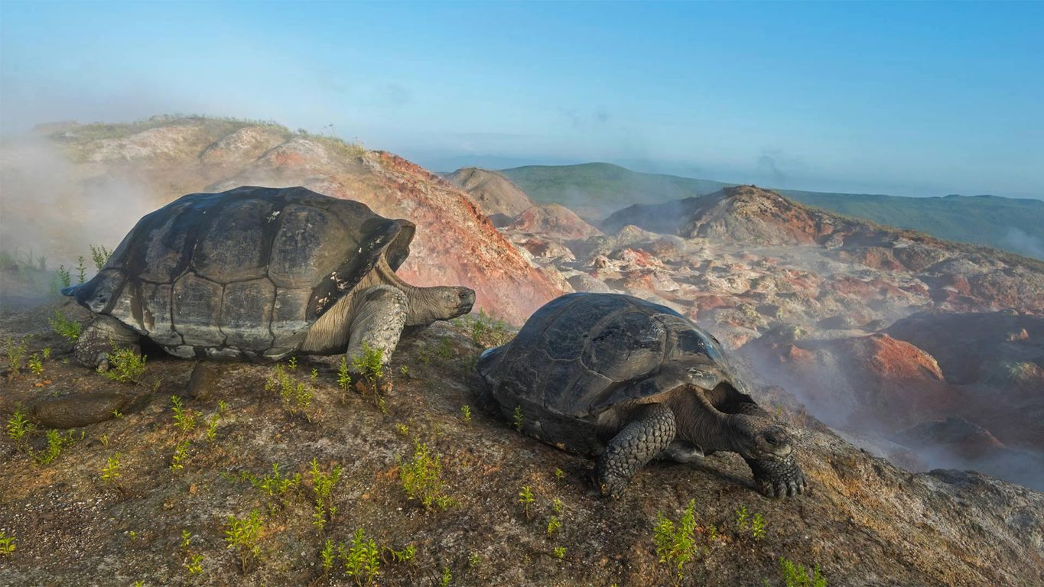
15.3 Evolution in Action
Chapter 15: Theory of Evolution

Slide 2
Student Objectives
Describe how convergent evolution can result among different species.
Explain how divergent evolution can lead to species diversity.
Compare artificial selection and natural selection.
Explain how organisms can undergo coevolution.

Slide 3
Evolution is a continued process. Evolution is going on today in populations of living species and can be observed, recorded, and tested. Interaction between species, including humans, affect their undergoing evolution.

Slide 4
CASE STUDY: Caribbean Anole Lizards
Often, when scientists compare groups of species, the scientists find patterns that are best explained as evolution in progress.
Each species of Anole lizards in Caribbean islands have body types correlating with their habitat.
Tree trunks: stocky bodies, long legs
Slender twigs: thin bodies, short legs and tails, large toe pads
Grass: slender body, very long tails
There are six body types that are adapted to their environment in a unique way.

Slide 5
Two hypotheses:
Distinct species of anoles with the same body types occur on different islands.
Two hypotheses:
An ancestral anole species specialized for living in twigs originally lived on one island and later migrated to other islands.
Each species evolved independently in each island from distinct ancestor anole species.

Slide 6
Testing DNA
Biologists tested these hypotheses by comparing DNA from various species to look for closely related species.
Twig-dwelling species evolved independently on each island.
The process by which different species evolve similar traits is called convergent evolution.

Slide 7
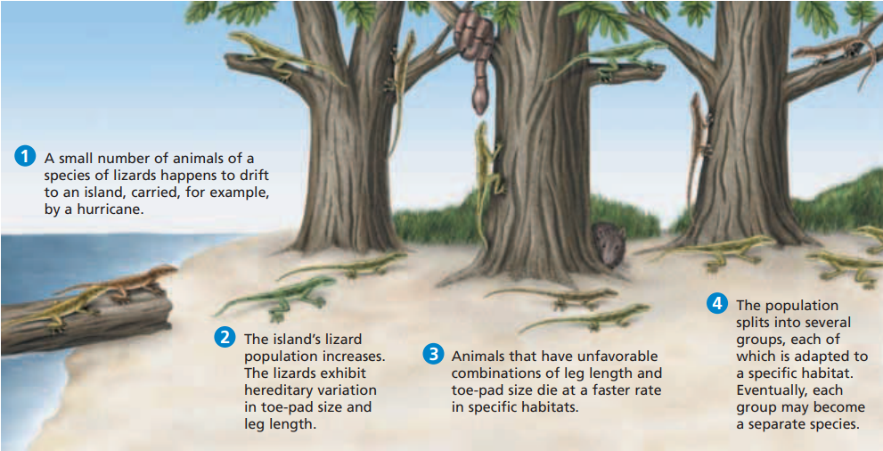
Divergence and Radiation
Divergent evolution is a process in which the descendants of a single ancestor diversify into species that each fit different parts of the environment.
Adaptive radiation happens when a new population in a new environment undergoes divergent evolution until the population fills many parts of the environment

Slide 8
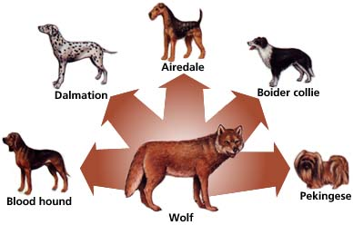
Artificial Selection
Darwin started his famous book with a chapter on artificial selection.
Artificial selection occurs when a human-breeder chooses individuals that will parent the next generation.
Oat plants
Dogs

Slide 9
Coevolution
It is important to keep in mind that evolution is ongoing and that in a given environment, many species may be evolving at once.
When two or more species have evolved adaptations to each other’s influence, the situation is called coevolution.
Many flowering plants need specific insects or birds to carry pollen to other plants.
Some microbes live with certain animals.

Slide 10
Humans and coevolution
Humans are also involved in many cases of coevolution.
Humans have developed and used antibiotics to kill disease-causing bacteria, and many populations of bacteria have evolved adaptations to resist the antibiotics (resistance).
The evolution of resistance to pesticides is observed among populations of insects in agricultural settings.

Slide 11
Review questions
Explain how the anole lizard species on the Caribbean Islands demonstrate both convergent and divergent evolution.
What are the key differences and similarities between natural selection and artificial selection?
Propose a reason why some Caribbean islands lack lizard species.

