Slide 1
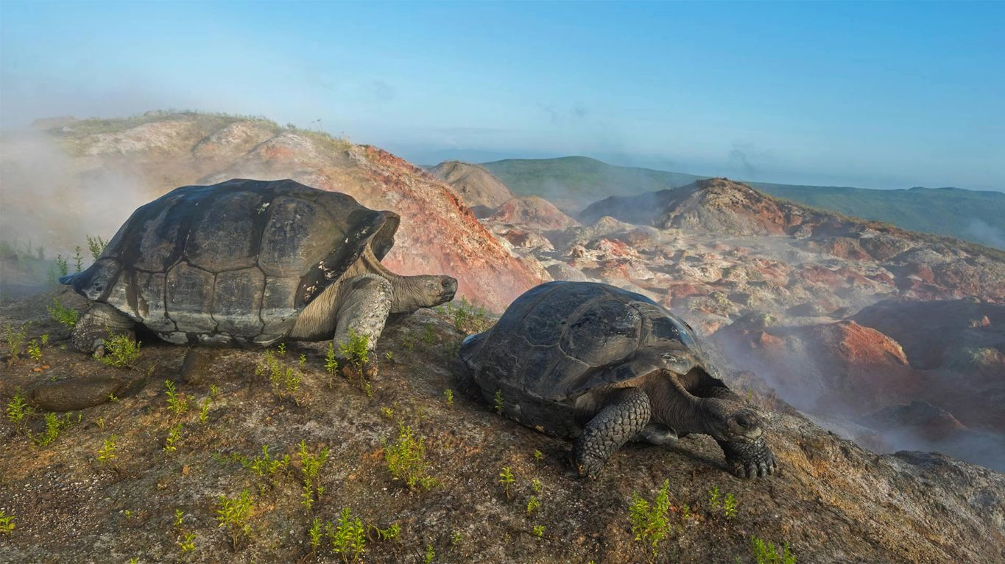
15.2 Evidence of Evolution
Chapter 15: Theory of Evolution

Slide 2
Student Objectives
Relate several inferences about the history of life that are supported by evidence from fossils and rocks.
Explain how biogeography provides evidence that species evolve adaptations to their environment.
Explain how the anatomy and development of organisms provide evidence of shared ancestry.
Compare the use of biological molecules with other types of analysis of evolutionary relationships.
Describe the ongoing development of evolutionary theory.

Slide 3
Many kinds of evidence give insight into the history of life on Earth and the patterns of change among organisms. Fossils that are different from organisms living today are strong evidence that organisms on Earth can change over time.

Slide 4
The Fossil Record
A fossil is the remains or traces of an organism that died long ago.
Fossils of many kinds of organisms can be formed under a number of different conditions.
Some fossils are of organisms tat have become extinct, meaning the species is no longer alive.

Slide 5
The Age of Fossils
1669, Nicolaus Streno proposed the principle of superposition. The principle that the rock strata at if a location have not been disturbed, the lowest stratum was formed before the strata above it.
Geologists started to put a timeline together known as the geologic time scale.
Today, geologists often can tell a fossil’s relative age – its age compared to that of other fossils, by referring to the geologic time scale and to records of known fossils.
Absolute age of rock is measured by techniques such as radiometric dating.

Slide 6
Fossils and Organisms
Not all organisms have left fossil evidence.
Nevertheless, Earth is rich with fossil evidence of organisms that lived in the past.

Slide 7
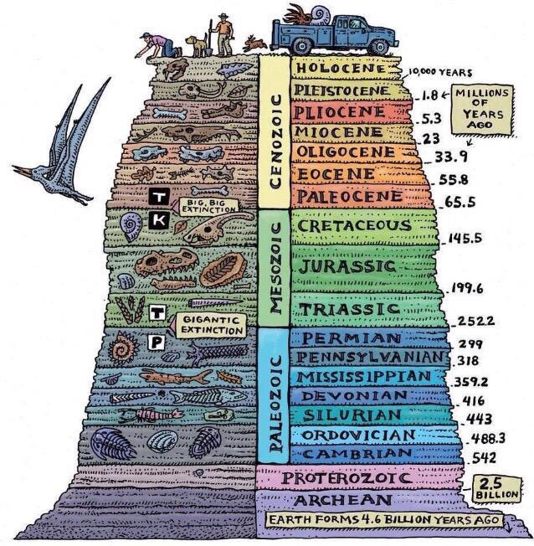
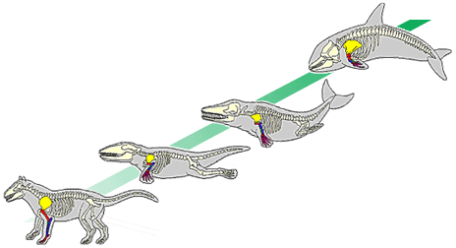
The Distribution of Fossils
Inferences from the fossil record:
Different organisms lived at different times
Today’s organisms are different from those of the past.
Fossils found in adjacent strata are more like each other that fossils found in deeper or higher strata.
By comparing fossils from around the planet, we can infer when and where different organisms existed.
Species have differed in a gradual sequence of forms over time (transitional species).

Slide 8
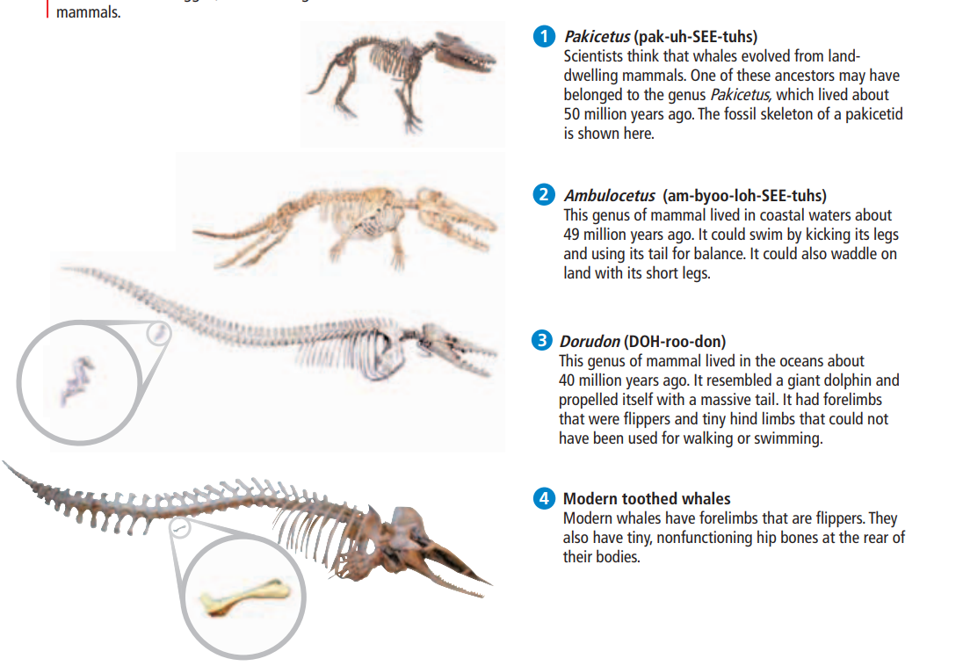
Pakicetus and toothed whale

Slide 9
Biogeography
Biogeography is the study of the locations of organisms around the world.
Darwin and Wallace observed animals that seemed closely related yet were adapted to different environments in nearby regions.
However, they also observed animals that seems unrelated that had similar adaptations to similar environments in regions that are far apart.
Descent with modification could explain this.

Slide 10
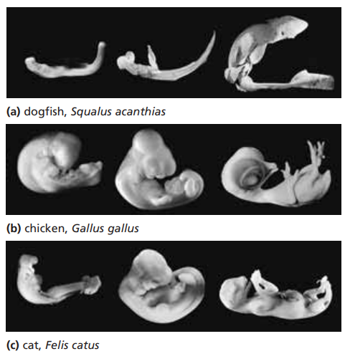
Anatomy and Embryology
Descent with modification also predicts the findings of embryology and anatomy.
Homologous structures as anatomical structures that occur in different species and that originated by heredity from a structure in the most recent common ancestor of the species.
Analogous structures have closely related functions but do not derive from the same ancestral structure.
Vestigial structures seem to serve no function but that resemble structures with functional roles in related organisms.

Slide 11
Biological Molecules
Biologists compare the DNA, RNA, proteins, and other biological molecules from many different organisms.
They look at similarities and differences among the data of each species.
The greater the similarities between any given species, the more closely the species are relates through a common ancestor.

Slide 12
Development Theory
Modern synthesis of evolutionary theory integrates the theory of natural selection and genetics.
Phylogeny is the relationship of ancestor among groups of organisms.

Slide 13
Review questions
Relate several inferences about history of life that are supported by geologic evidence.
What evidence supports the hypothesis that whales evolved from land-dwelling mammals?
Compare the concepts of homologous structures, analogous structures, and vestigial structures.
Explain the evidence of evolution presented by the mammals of Australia.
Compare the use of biological molecules to other types of analysis of phylogeny.
Does natural selection act on vestigial structures? Support your answer.

