Slide 1
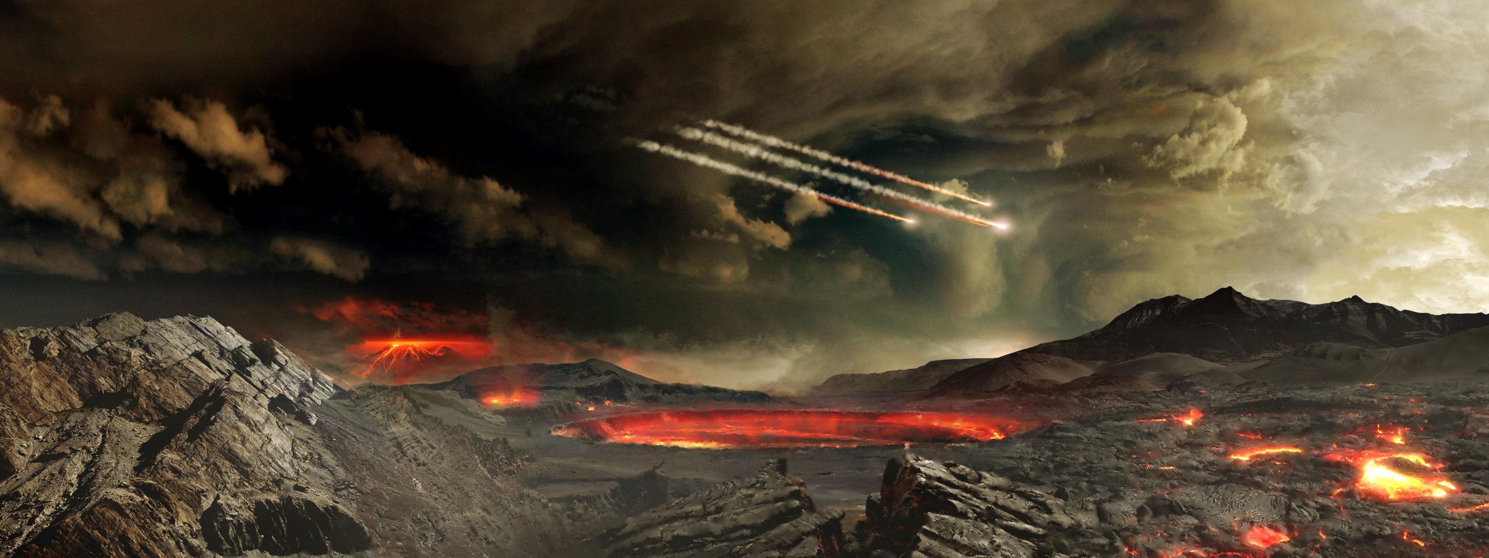
14.3 The First Life Forms
Chapter 14: History of Life

Slide 2
Student Objectives
Explain the importance of the chemistry of RNA in relation to the origin of life.
List three inferred characteristics that describe the first forms of cellular life on Earth.
Compare the two types of autotrophy used by early cells.
Relate the development of photosynthesis to the development of aerobic respiration in early cells.
Explain the theory of endosymbiosis.

Slide 3
Scientists continue to investigate many competing hypotheses about possible transitions from simple organic molecules to cellular life. - How could molecules be organized into self-replicating systems? - Where does heredity come from?

Slide 4
The Origin of Heredity
Hereditary information affects phenotype of cells.
Hereditary information contained in a DNA molecule is first transcribed into an RNA message, and then the RNA message is translated into a protein.
DNA serves as the template for RNA, which in turn serves as the template for specific proteins.
RNA molecules take on a greater variety of shapes that DNA molecules do.

Slide 5
The Roles of RNA
Ribozyme is a RNA molecule that can act as a catalyst and promote a specific chemical reaction.
Because self-replicating RNA molecules have been created in the laboratory, there is support for the hypothesis that life could have started with self-replicating RNA molecules.
RNA roles:
DNA replication
Protein synthesis
Other basic chemistry

Slide 6
Hypotheses of modern cellular life
There are several competing hypotheses about how RNA or other simple replicating systems could have evolved into modern cellular life.
Certain kinds of minerals formed a template in which organic molecules could line up and form polymers.
Self-replicating RNA started to evolve inside cell-like structures such as microspheres and coacervates.

Slide 7
The first Cells
First, many scientists think that little or no oxygen gas existed on early Earth.
Second, the oldest fossils that are thought to be cells are similar to prokaryotes.
Finally, first cells might have developed in an environment with organic molecules for food.
The first cells were probably anaerobic, heterotrophic prokaryotes.
When most organic molecules were removed, autotrophs would get an advantage.

Slide 8
Chemosynthesis
The archaea are a related group of unicellular organisms, many of which thrive under extremely harsh environmental conditions.
Many species of archaea are autotrophs that obtain energy by chemosynthesis.
In the process of chemosynthesis, CO₂ serves as a carbon source for the assembly of organic molecules. Energy is obtained from the oxidation of various inorganic substances, such as sulfur.

Slide 9
Photosynthesis and Aerobic Respiration
Some forms of life had become photosynthetic by 3.5 billion years ago.
Most of the oldest known fossils of cells are similar to modern cyanobacteria – a group of photosynthetic, unicellular prokaryotes.
Fossils of stromatolites are as old as 3.5 billion years are known.

Slide 10
Oxygen
Oxygen was damaging to many early unicellular organisms. Oxygen could destroy some coenzymes essential to cell function.
Oxygen can bond to other compounds. This bonding was the first steps in aerobic respiration.
It took billions of years for oxygen gas levels to reach today’s levels.
When O₂ is hit by wavelengths of sunlight in splits in two. O molecules react with O₂ and form O₃, ozone.
Ozone is poisonous, but absorbs much of the ultraviolet radiation from the Sun.
Ultraviolet radiation damages DNA, and without the protection of the ozone layer, life could not have come to exist on land.

Slide 11
The First Eukaryotic Cells
Eukaryotic cells:
Larger than prokaryotes
DNA is organized in chromosomes in a nucleus
Have cytoskeleton and membrane-bound organelles
Eukaryotes evolved from a mutually beneficial relationship between primitive eukaryotes and the prokaryote it engulfed.
Aerobic prokaryotes engulfed by eukaryotic cells evolved into mitochondria, which perform aerobic respiration.
Engulfed photosynthetic cyanobacteria evolved into chloroplasts.

Slide 12
Review questions
How does RNA differ from DNA?
Describe three major scientific inferences about the first living cells on Earth?
What traits make archaebacterial likely relatives of Earth’s earliest organisms?
Explain the difference between chemosynthesis and photosynthesis.
Explain the theory of endosymbiosis.
What evidence supports the hypothesis that mitochondria were once free-living prokaryotic cells?
How did anaerobic cells influence the development of aerobic cells?
Some forms of air pollution reduce the thickness of Earth’s ozone layer. How might this change affect modern life?

