Slide 1
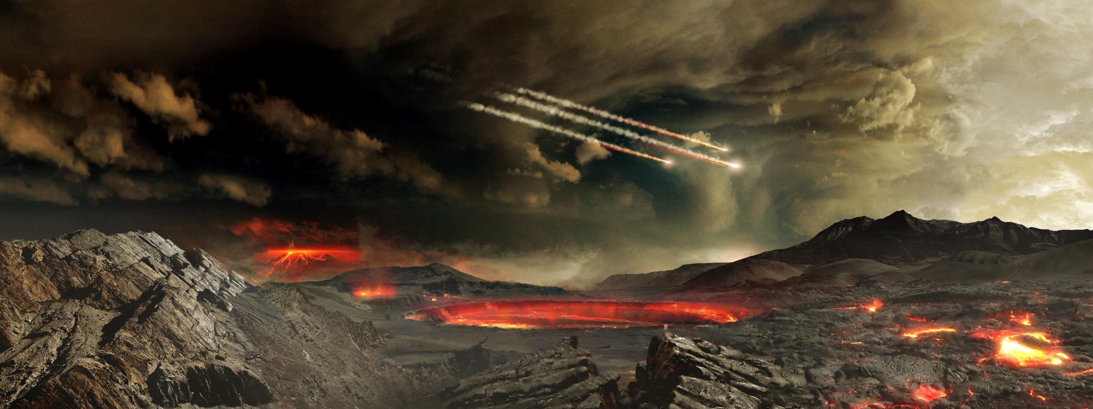
14.2 Earth’s History
Chapter 14: History of Life

Slide 2
Student Objectives
Outline the modern scientific understanding of the formation of Earth.
Summarize the concept of half-life.
Describe the production of organic compounds in the Miller-Urey apparatus.
Summarize the possible importance of cell-like structures produced in the laboratory.

Slide 3
If spontaneous generation does not happen on Earth today… How did cell-based life arise in the first place?

Slide 4
The formation of Earth
5 billion years ago our Solar system was a swirling mass of gas and dust.
Most of its material was pulled together by gravity and formed the Sun.
Scientists think that the planets formed by repeated collisions of space debris surrounding the Sun.
During a 400 year-million period, Earth grew larger as gravity pulled more debris. The collisions released a great deal of thermal heat.

Slide 6
Earth’s Age
The estimate of Earth’s age, 4.7 billion years, is about 700,000 times longer as the period recorded history.
Early estimates of Earth’s age were made from studying layers of sedimentary rock in Earth’s crust.
The age of Earth is nowadays much more accurately measured with modern methods.

Slide 7
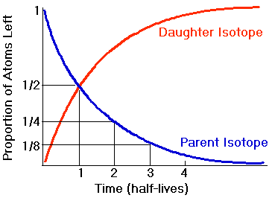
Radiometric Dating
Methods of establishing the age of materials include the techniques known as radiometric dating.
The atomic number of an element is the number of protons in the nucleus. The neutrons may vary in an element.
Atoms of the same elements that differ in the number of neutrons are called isotopes.
The mass number of an isotope is the total number or protons and neutrons in the nucleus.
Carbon-12 has .. protons and .. neutrons
Carbon-14 has .. Protons and .. neutrons

Slide 8
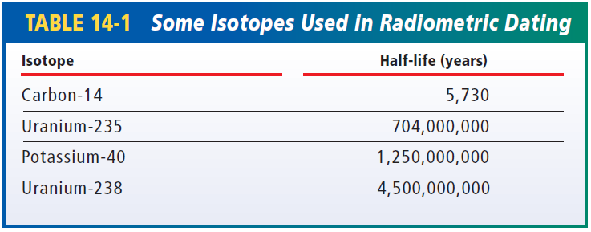
Half-Life
Some isotopes have unstable nuclei, which undergo radioactive decay; their nuclei release particles or radiant energy until the nuclei becomes stable.
These isotopes are called radioactive isotopes.
The length of time it takes for one-half of any size sample of an isotope to decay to a stable form is called the half-life of the isotope.

Slide 9
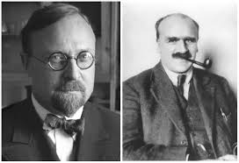
First Organic Compounds
All elements found in organic compounds are thought to have existed on Earth and in the rest of the solar system when the Earth formed. But how were these elements assembled into organic compounds?
Oparin and Haldane (1920) hypothesized that early atmosphere contained ammonia (NH3); hydrogen gas (H2);water vapor (H20); and compounds made of hydrogen and carbon, methane (CH4).

Slide 10
Oparin and Haldane
At high temperatures, gases might have formed simple organic compounds, such as amino acids.
When Earth cooled and water vapor condensed to form lakes and seas, these simple organic compounds would have collected in the water.
Over time, these compounds could have entered complex chemical reactions and ultimately would result in the macromolecules essential to life, such as proteins.

Slide 11
Synthesis of Organic Compounds
Miller and Urey set up an experiment using Oparin’s hypothesis as a starting point.
The Miller-Urey experiment, and other variations that have followed, produced a variety of organic compounds, including amino acids.
Since 1950s, similar experiments have combined a variety of chemicals and energy sources to produce an assortment of organic compounds, such as amino acids, ATP, and nucleotides.

Slide 12
Carbon Dioxide and Oxygen gas
The atmosphere of Early Earth was composed largely of CO₂, N₂, and H₂O.
Laboratory simulations of these atmospheric conditions have shown that both carbon dioxide and oxygen gas interfere with the production of organic compounds.
Therefore, the production of organic compounds might only have been possible in areas protected from the atmosphere.

Slide 13
Organic Compounds from beyond Earth
Some scientists hypothesize that organic compounds could have been carried to Earth by debris from space.
In 1970, a broad mixture of organic compounds was found in a newly fallen meteorite.

Slide 14
From Molecules to Cell-like Structures
Scientists have done extensive research on the physical structures that may have given rise to the first cells.
Cell-like structures happened spontaneously in the laboratory from solutions of simple organic chemicals:
Microspheres (spherical shape composed of protein molecules organized as a membrane)
Coaservates (collection of droplets composed of many molecules; lipids, amino acids and sugars)

Slide 15
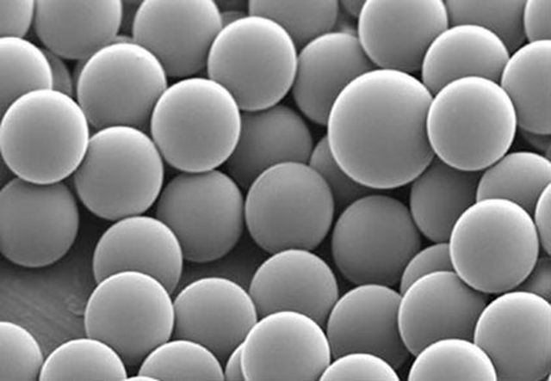
Cell structures and chemical reactions
Both coacervates and microspheres can form spontaneously under certain conditions.
Polymers that form microspheres can arise when solutions of simple organic chemicals are dripped onto the surface of hot clay.
Coacervates and microspheres have a number of cell-like properties, including the ability to take up certain substances from their surroundings. Coacervates can grow, and microspheres can bud to form smaller microspheres.
These properties show that some important aspects of cellular life can arise without direction from genes.

Slide 16
Review questions
Outline the major steps in the formation of Earth, as restructured by modern scientists.
If 1.0 g of a radioactive isotope had half-life of 1 billion years, how much of it would be left after each of the following intervals of time: 1 billion years, 2 billion years, 3 billion years, and 4 billion years?
What are two possible sources of simple organic compounds in early Earth?
What properties do microspheres and coacervates share with cells?
Some radioactive isotopes that are used in medicine have half-lives of a few years. Would these isotopes also be useful in dating rocks? Why or why not?

