Slide 1
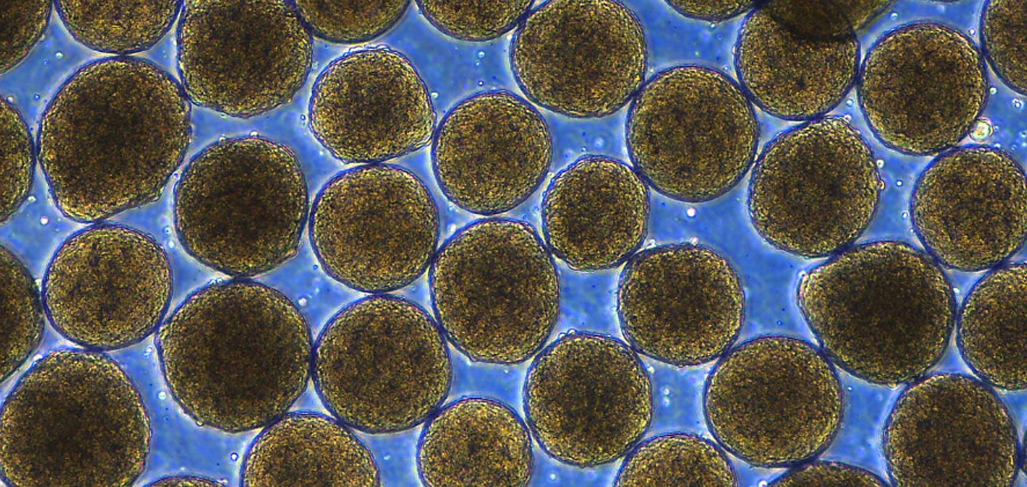
14.1 Biogenesis
Chapter 14: History of Life

Slide 2
Student Objectives
Compare the principle of biogenesis with the idea of spontaneous generation.
Summarize the results of experiments by Redi and by Spallanzani that tested the hypothesis of spontaneous generation.
Describe how Pasteur’s experiment disproved the hypothesis of spontaneous generation.

Slide 3
Where does life come from? How can we prove this?

Slide 4
Biogenesis
Biogenesis: all living things come from other living things.
Spontaneous generation: living things arise from nonliving things as well as from living things.
Before the 17th century, it was widely thought that spontaneous generation (abiogenesis) occurred.

Slide 5
Problem: Dry ponds
When there is no rain and a pond dries up, there are no larger organisms like frogs and fish. However, after it rains, and the pond is a body of water again, there are suddenly frogs and fishes. It was hypothesized that the rain brought with it frogs and fish.

Slide 6
Problem: Dirty shirt
It was hypothesized that life such as mice could be generated from a sweaty t-shirt and wheat, which were both contained in a jar.
Belgian doctor Jean van Helmont – concluded that mice could be created from a dirty shirt.
He placed grains of wheat and a dirty shirt in a container and in 21 days mice appeared.

Slide 7
Problem: Holy cow
It was hypothesized that maggots spontaneously generated from meat.
Aristotle and many others believed that rotting meat would give life to a new organism

Slide 8
Redi’s experiment
In 1668, The Italian scientist Fransesco Redi noticed and described the different developmental forms of flies.
He tested Aristotle’s hypothesis.
Conclusion: biogenesis

Slide 9
A vital force
About the same time that Redi carried out his experiment, other scientists began using a new tool – the microscope.
They discovered that microorganisms are simple in structure and amazingly numerous and widespread.
Many investigators at the time concluded that microorganisms arise spontaneously from a “vital force” in the air.

Slide 10
Spallanzani's experiment
Italian scientist who refuted abiogenesis
Boiled broth and then sealed the flasks shut immediately
Result?
Problem?

Slide 11
Pasteur’s experiment
Pasteur made a curve-necked flask that allowed the air inside the flask to mis with air outside the flask.
The curve in the neck prevented solid particles, such as microorganisms, from entering the body of the flask.
With Pasteur’s experiment, the principle of biogenesis became a cornerstone of biology.

Slide 12
Review questions
What does the term spontaneous generation mean?
Explain how Redi’s experiment disproved the hypothesis that flies formed in food by spontaneous generation.
What caused people to think the air contained a ‘vital force’ that produced living things?
Describe the argument that Spallanzani’s experiment failed to disprove the occurrence of spontaneous generation. Explain how Pasteur’s experiment addressed these criticisms.
If spontaneous generation does not occur and the principle of biogenesis is true, what scientific question remains?

