Slide 1
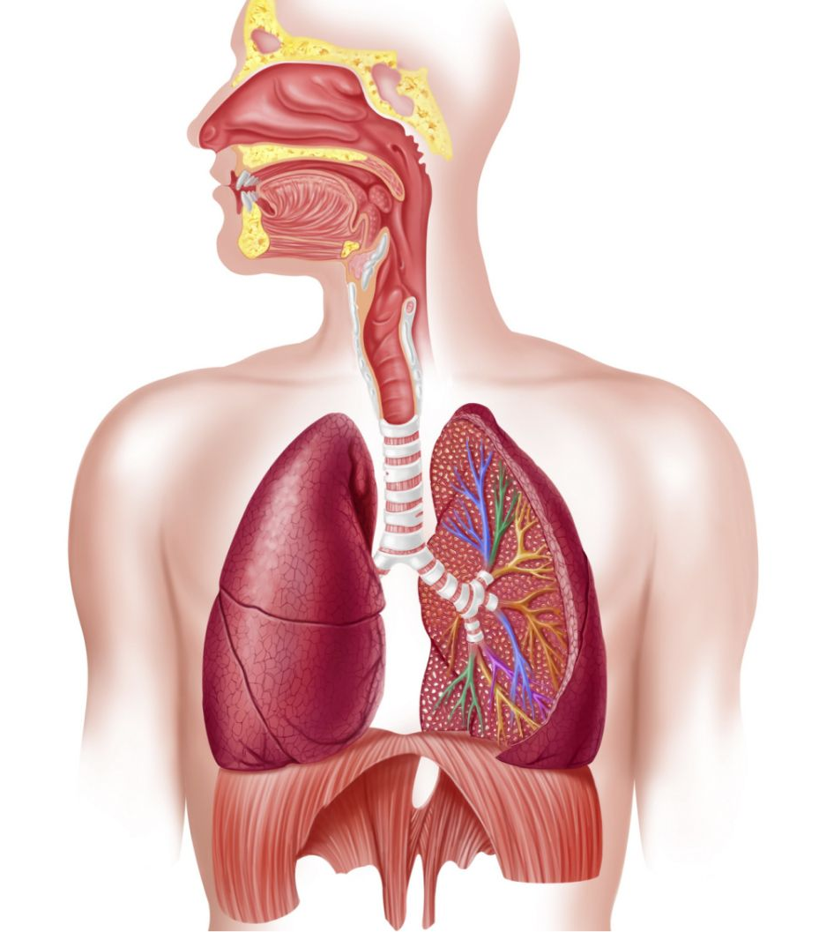
Respiratory System
Pichanon No.6
Supasit No.17
Nathakrit No.28

Slide 2
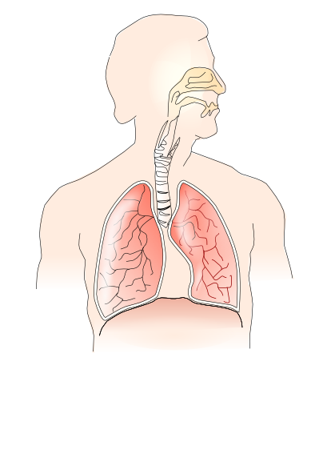
Respiratory System
The network of organs that help you breath.
3 main part:
Airway
Lungs
Muscle of respiration
These parts work together to move oxygen throughout body and clean out waste gas
Cavities:
Nasal (Nose)
Oral (Mouth)
Thoracic

Slide 3
Functions
Other than breathing
Talk
Smell
Moisturize body
Remove waste gas
Delivers oxygen to cell
Protect air way from harmful substances
Regulate body temperature

Slide 4
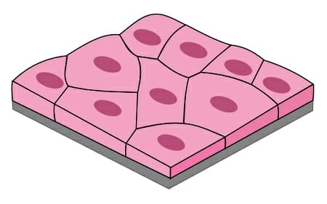
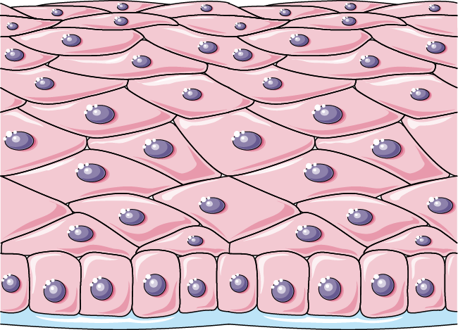
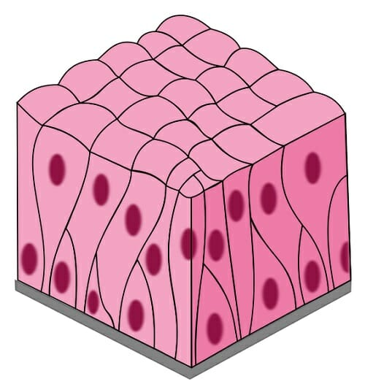
Tissues
Epithelial
Simple Squamous Epithelial
Within alveoli
Stratified Squamous Epithelial
Surface of mouth, tongue, throat
Defensive layer
Pseudostratified Columnar Epithelial
Lining of Nasal cavity, trachea, bronchi
Trap pathogens

Slide 5
Organs
Airway:
Nose
Mouth
Throat (pharynx)
Voice box (larynx)
Windpipe (trachea)
Bronchi
Lungs:
Alveoli
Muscle of Respiration:
Diaphragm

Slide 6
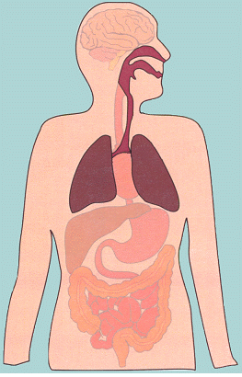
How does it operate ?
Inhale the air through nose and mouth
Air travels down through throat into wind pipe, then it divide into a passage called bronchial tube
Alveoli transfer oxygen into surrounding capillaries and transport waste gas into the air
The air travel back through the same method exiting nose and mouth
Inhaling and Exhaling
Inhaling
Diaphragm contract
Exhaling
Diaphragm relaxes

Slide 7
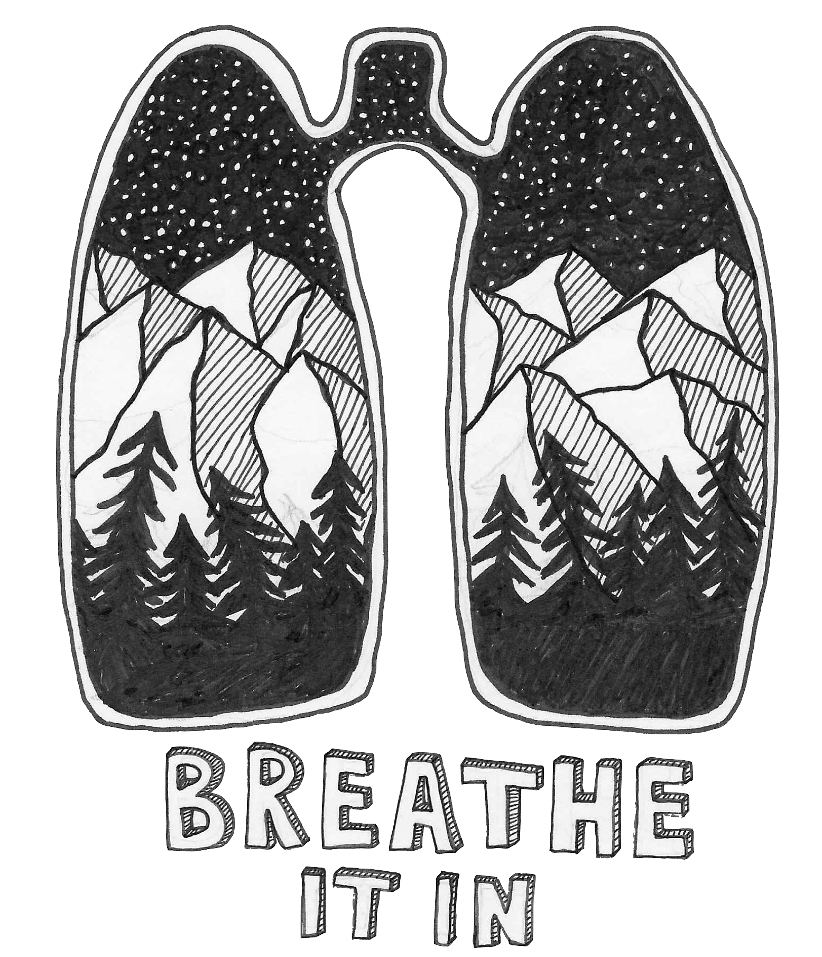
Fun Facts
Right lung are larger than left
Lung is the only organ that float on water
The air we breath in usually has 21% oxygen, we only use 5
Female and child have a higher breathing rate than male
It is estimated that adult’s lung contain 300 to 500 million alveoli

Slide 8
References
https://www.innerbody.com/anatomy/respiratory#continued
https://healthengine.com.au/info/respiratory-system
https://my.clevelandclinic.org/health/articles/21205-respiratory-system
https://www.webmd.com/lung/how-we-breathe
http://www.poultryhub.org/physiology/body-systems/respiratory-system-thermoregulation/#:~:text=The%20respiratory%20system%20is%20one,(thermoregulation)%20and%20vocal%20communication.
https://www.lung.ca/lung-health/lung-info/respiratory-system#:~:text=The%20NASAL%20CAVITY%20(nose)%20is,passages%20may%20be%20temporarily%20blocked.
https://respsyst.weebly.com/tissues.html
https://pulmonaryhypertensionnews.com/2017/12/20/8-fun-facts-lungs/
https://biologydictionary.net/respiratory-system-fun-facts/

