Slide 1
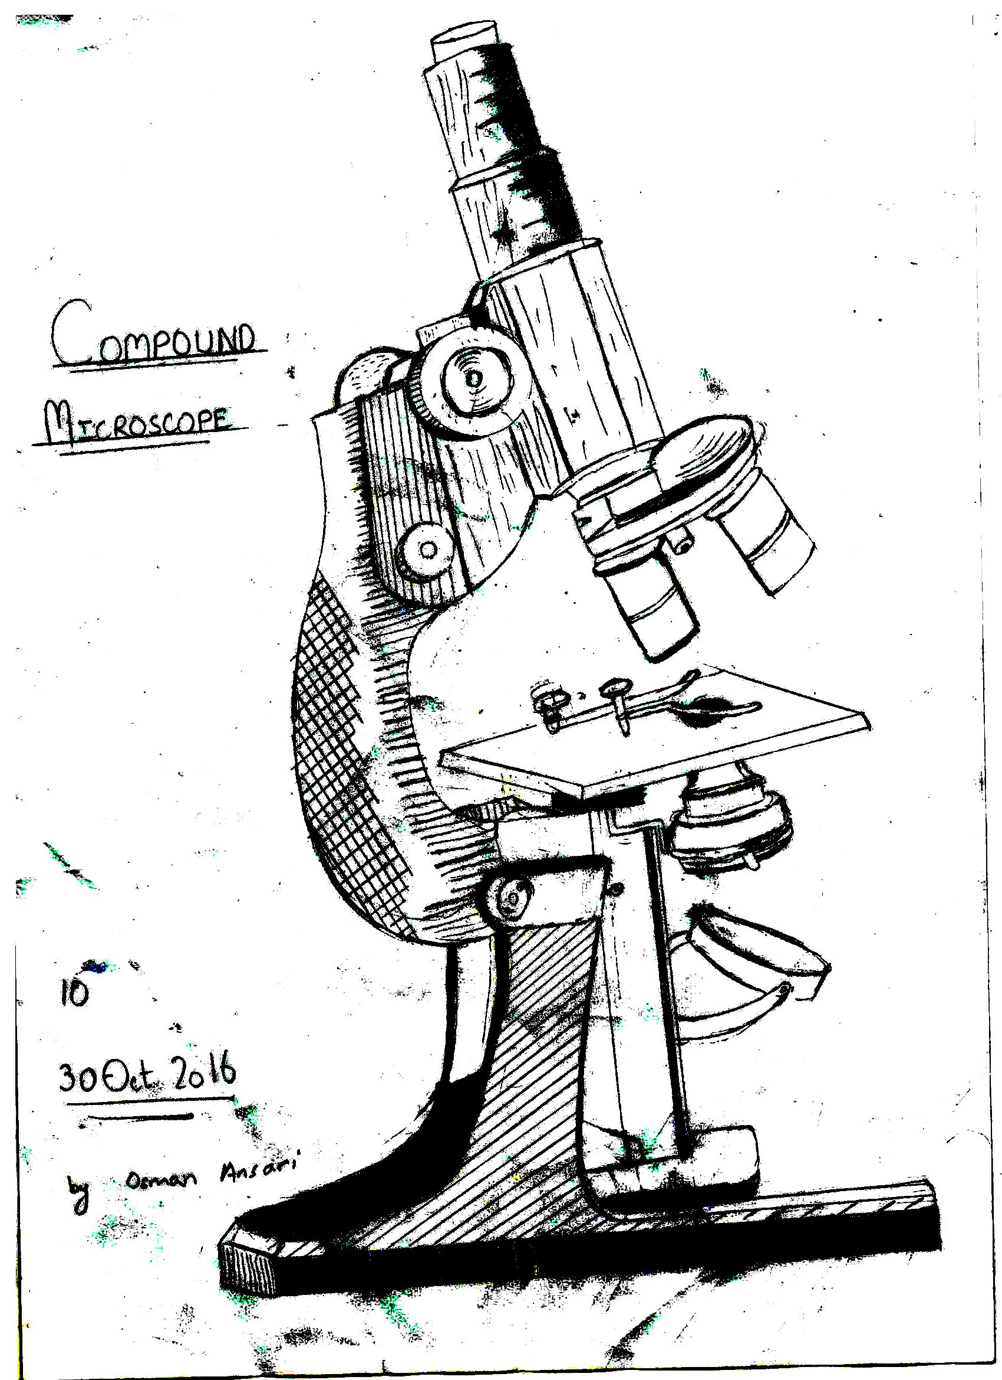
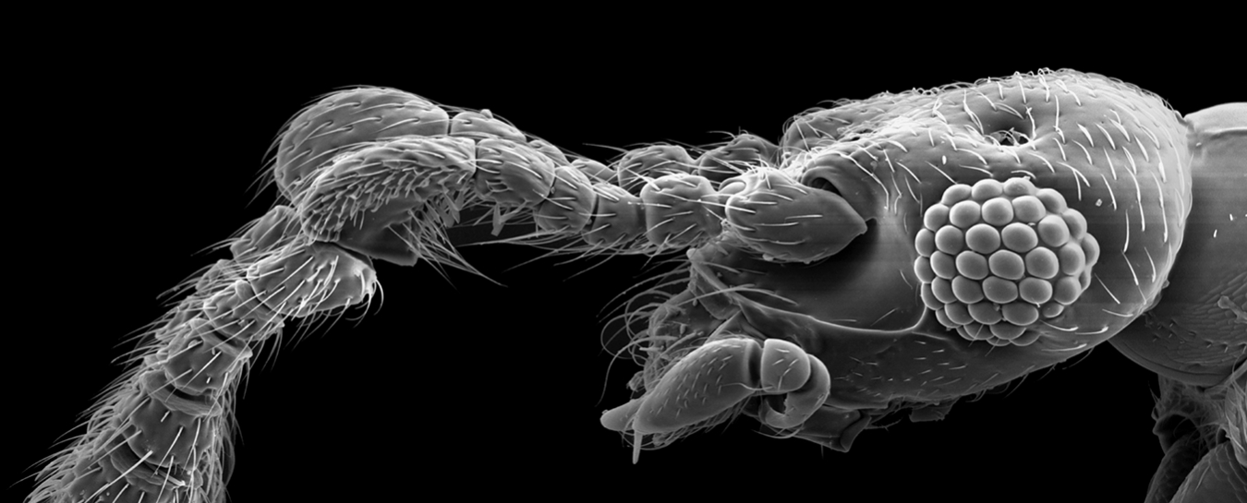
The Science of Life
Tools and Techniques

Slide 2
Microscopes as Tools
Tools are objects to improve the performance of a task.
Microscopes are tools that extend human vision by making enlarged images of objects. They are used to study organisms, cells, cell parts, and molecules.

Slide 3
Light Microscope
A compound microscope shines light through a specimen and has two lenses to magnify an image.
The specimen must be thin enough for light to pass through it.

Slide 4
Parts of Microscope
The Eyepiece (ocular lens) magnifies the image usually 10 times.
The Objective lens is located right above the specimen. Light passes through the specimen and then through the objective lens.
The Stage is a platform that supports a slide holding the specimen.
The Light Source is a light bulb that provides light for viewing the image.

Slide 5
Magnification and Resolution
Magnification is the increase of an object’s apparent size.
Ocular lens (10X)
Objective lens (up to 100X)
Resolution is the power to show details clearly in an image.

Slide 6
Electron Microscope
In an Electron Microscope, a beam of electrons produces an enlarged image of the specimen.
Images are in black and white, but computers can artificially color the images.
Specimen is places in vacuum chamber, so living specimens cannot be viewed in Electron microscope.

Slide 7
SEM: Scanning Electron Microscope
The SEM passes a beam of electrons over the specimen’s surface.
SEMs provide a three-dimensional image of the specimens surface.
The specimen is sprayed with a fine metal coating and a beam of electrons is aimed at it.
SEMs can magnify up to 100,000 times.

Slide 8
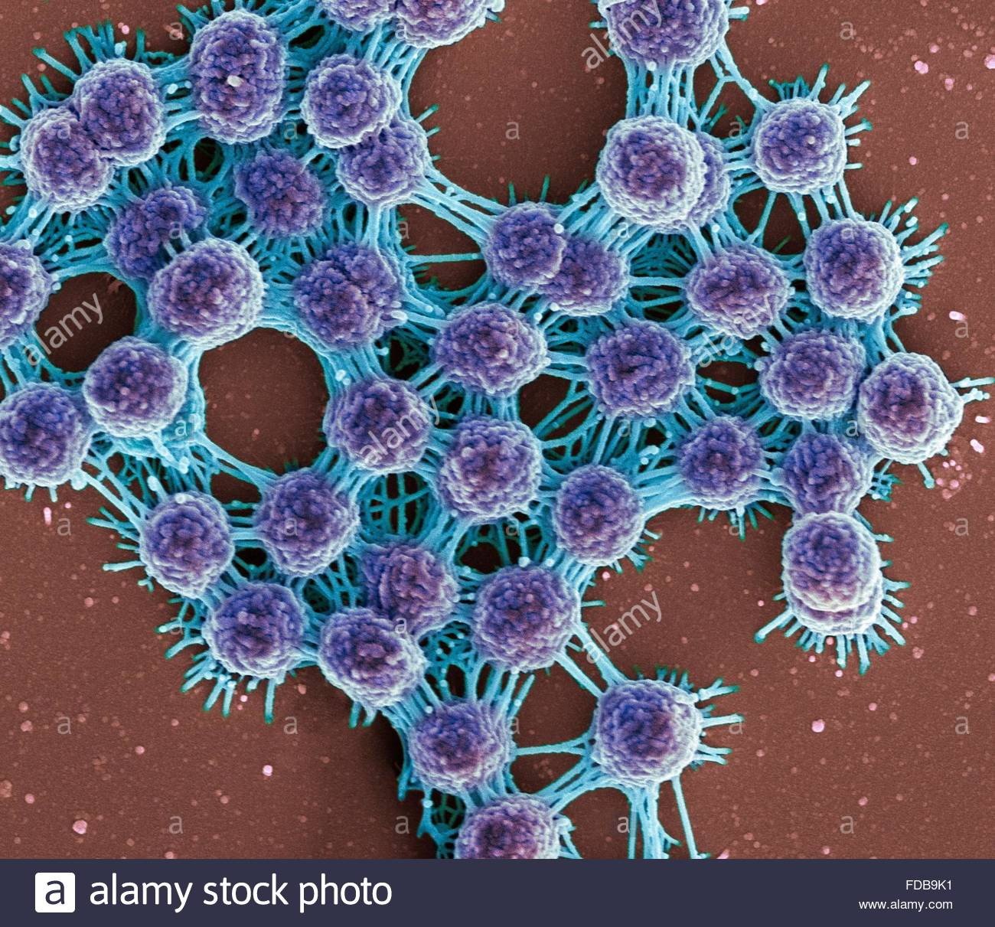

Slide 9
TEM: Transmission Electron Microscope
The TEM transmits a beam of electrons through a very thin slices specimen.
Magnetic lenses enlarge the image and focus it on a screen.
The TEM is great to view an internal structure.
TEM can magnify objects up to 200,000 times.

Slide 10
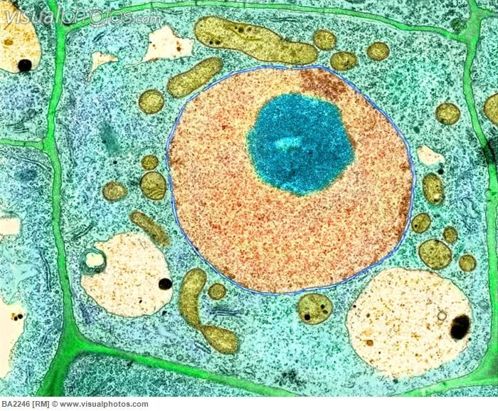

Slide 11
Units of Measurement

Slide 12
Safety

