Slide 1
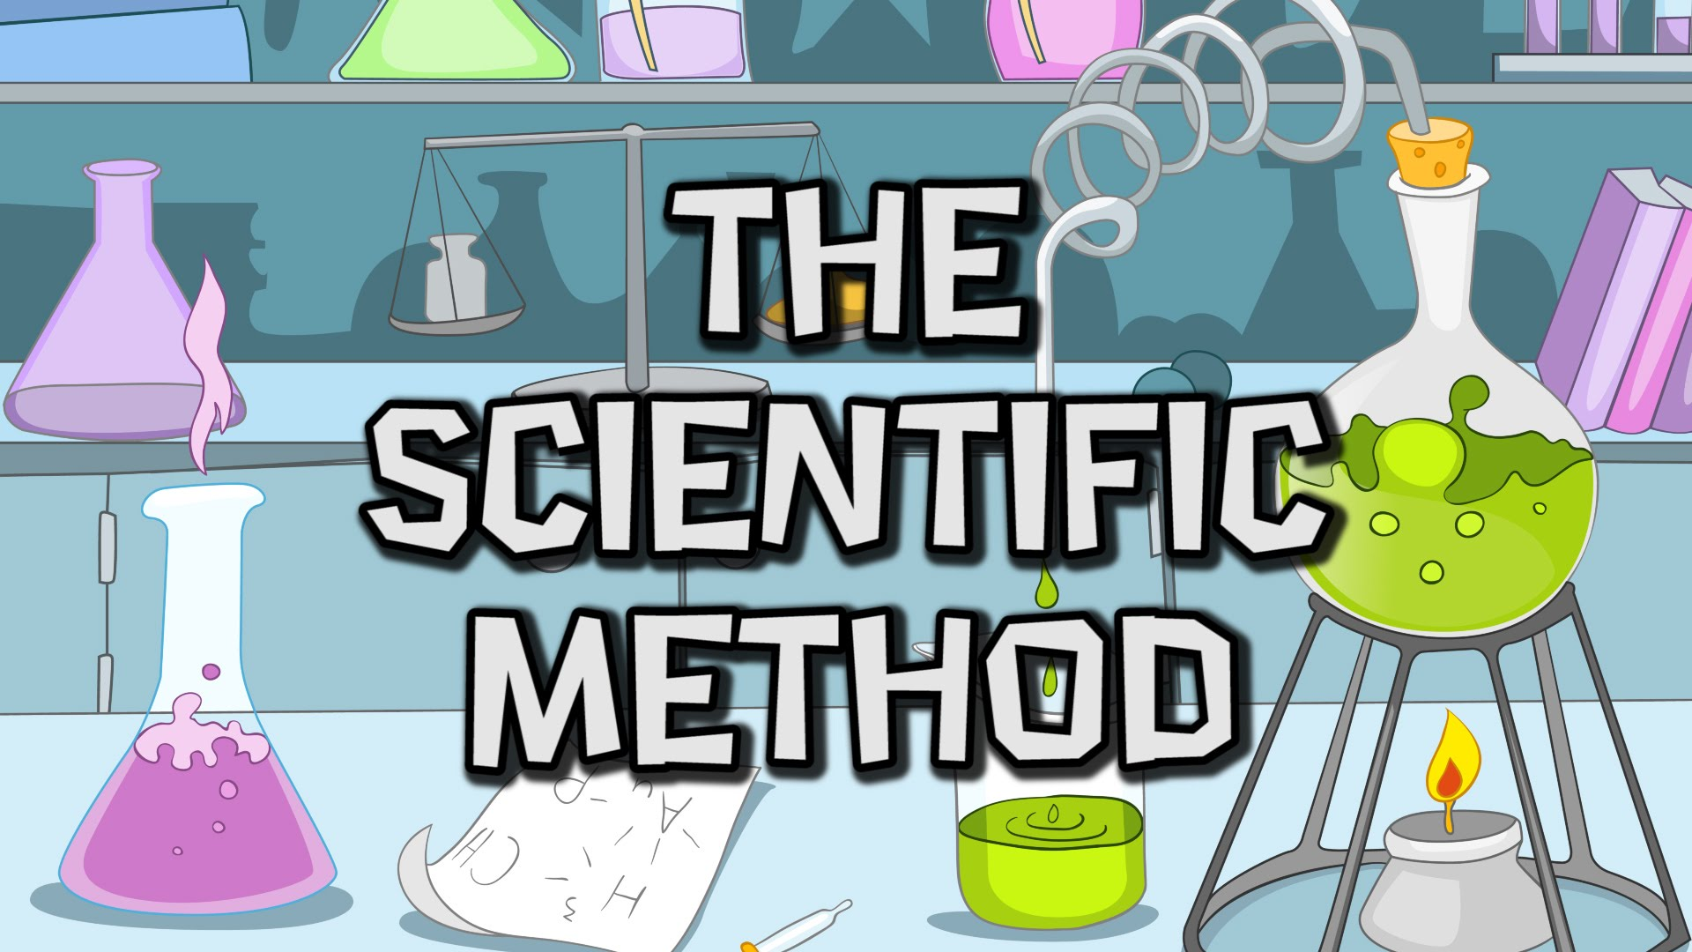
The Science of Life
The Study of Biology

Slide 2
Have you ever wondered anything about life?

Slide 3
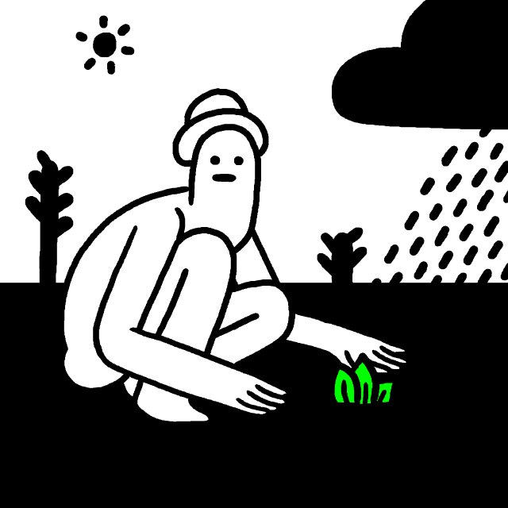
Science is a process
The Scientific Method is an organized approach to learn how the natural world works.
2 principles:
Events in the natural world have natural causes.
Science is uniformity. Fundamental laws of nature work the same way, everywhere, and at all times.

Slide 4
Steps of the Scientific Method
Observation and ask a question.
Try to answer the question by forming a hypothesis.
A prediction is a statement that forecasts what would happen during the test if the hypothesis is true.
An experiment is used to test the prediction and hypothesis.
Analyze data and draw conclusions.
Share your findings with scientific peers and to the public.

Slide 5
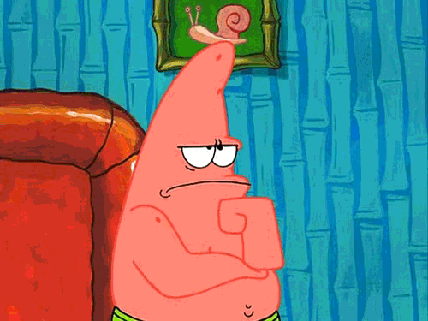
1. Observing and Asking a Question
The scientific question generally begins with an unexplained observation about nature.

Slide 6
2. Forming a Hypothesis
Biologists list possible answers to a scientific question – hypotheses.
Good hypotheses answer a question and a testable in the natural world.

Slide 7
3. Make a Prediction
A prediction is what is expected to happen is each hypotheses were true.

Slide 8
4. Designing an Experiment
Biologists often test hypotheses by setting up a controlled experiment.
The control group is a group for the scientist to compare results with the experimental group.
The experimental group is identical to the control group except for one variable.
This one variable changes is the independent variable.
The dependent variable is the result of what’s different between the 2 groups.

Slide 9
Testing the Experiment
Some controlled experiments are conducted ‘blind’. The experimenter doesn’t know which group is the experimental or control group.
Experiments should be repeated and scientist should collect enough data to find meaningful results.

Slide 10
5. Collecting and Analyzing Data
After data is collected it needs to be organized.
The goal is to determine whether the data are reliable, and whether is supports or fail to support the predictions in the hypothesis.
With statistics scientists can determine the relationship of the relationships between the variables involved.

Slide 11
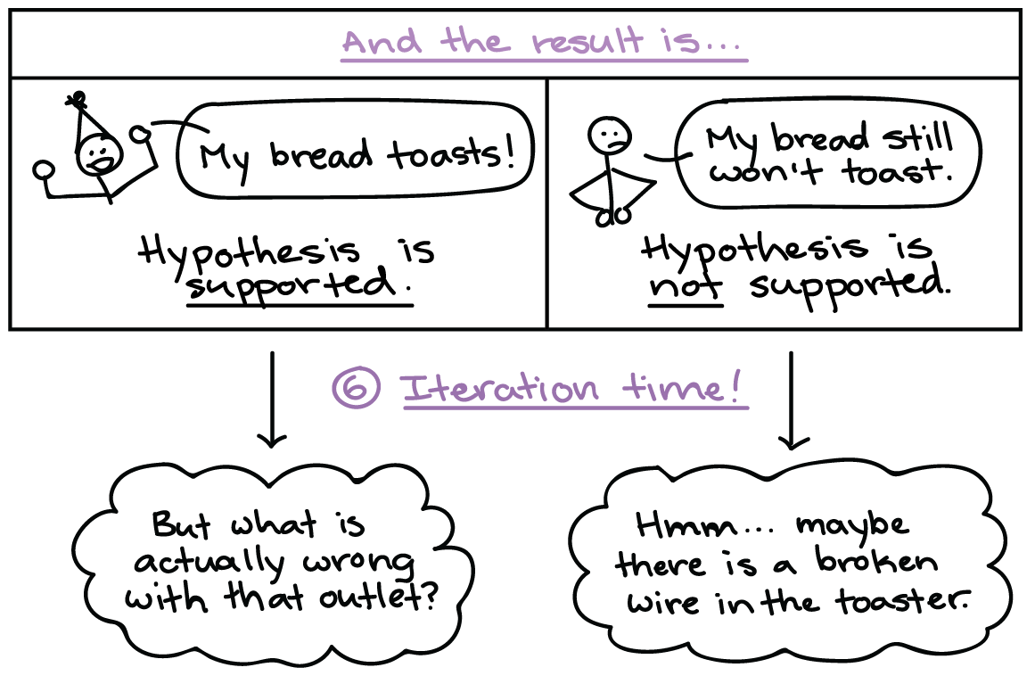
Drawing conclusions
Scientists draw conclusions to see whether their hypothesis is supported by the data.
An experiment can only disprove a hypothesis.

Slide 12
6. Communicating Ideas
Scientists work together.
They work together in teams and share research results with others.
Scientists can publish their papers to a scientific journal. Editors will do a peer review.
Experts in the field read and critique the research paper.

Slide 13
Honesty and Bias
The scientific community depends on honesty and good science.
Scientists are always trying to disprove their favorite ideas.
Scientists repeat experiments to verify previous findings.
Scientists try to avoid conflict of interest, because their reputation is on the line.

Slide 14
Construct a Theory
https://www.youtube.com/watch?v=lqk3TKuGNBA

