Slide 1
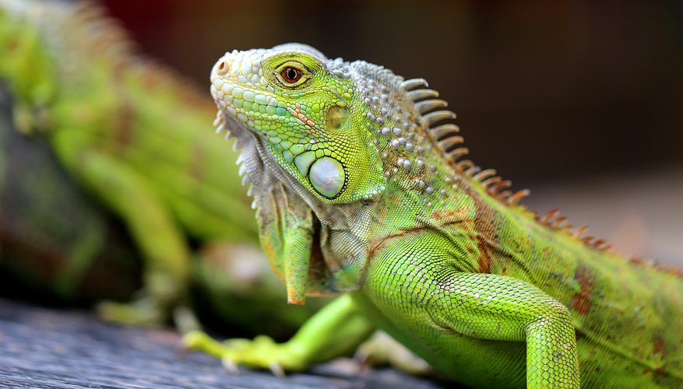
1.3 The Study of Biology
Unit 1: The Science of Life

Slide 2
Student Objectives
Othe main steps in the scientific method.
Summarize how obervations are used to form hypotheses.
List elements of a controlled experiment.
Describe how scientists use data to draw conclusions.
Compare a scientific hypothesis and a scientific theory.
State how communication in science helps prevent dishonesty and bias.

Slide 3
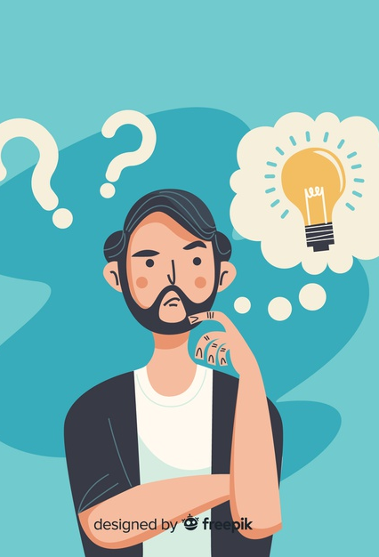
ave you ever wondered anything about life?

Slide 4
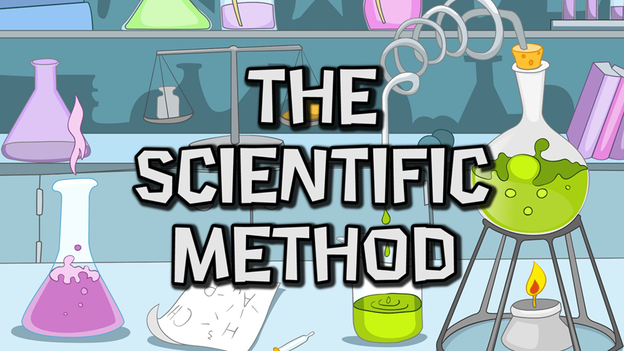

Slide 5
Science is a process
The Scientific Method is an organized approach to learn how the natural world works.
2 principles:
___________________________________.
____________________. Fundamental laws of nature work the same way, everywhere, and at all times.

Slide 6
Steps of the Scientific Method
____________ and ask a question.
Try to answer the question by forming a ____________.
A ____________ is a statement that forecasts what would happen during the test if the hypothesis is true.
An ____________ is used to test the prediction and hypothesis.
Analyze data and draw ____________.
__________________ with scientific peers and to the public.

Slide 7
1. Observing and Asking a Question
The scientific question generally begins with an unexplained _________ about nature.

Slide 8
2. Forming a Hypothesis
Biologists list possible __________ to a scientific question – hypotheses.
Good hypotheses answer a question and is testable in the natural world.

Slide 9
3. Make a Prediction
A prediction is what is _________ to happen if each hypothesis were true.

Slide 10
4. Designing an Experiment
Biologists often test hypotheses by setting up a controlled experiment.
The _____ ______ is a group for the scientist to compare results with the experimental group.
The experimental group is identical to the control group except for one _______.
This one variable changing is the independent variable.
The dependent variable is the result of what’s different between the 2 groups.

Slide 11
Testing the Experiment
Some controlled experiments are conducted ‘blind’. The experimenter doesn’t know which group is the __________ or ________ group.
Experiments should be repeated, and scientist should collect enough data to find meaningful results.

Slide 12
5. Collecting and Analyzing Data
After data is collected it needs to be organized.
The goal is to determine whether the data are reliable, and whether is supports or fail to support the predictions in the hypothesis.
With ________ scientists can determine the relationship between the variables involved.

Slide 13
5. Drawing conclusions
Scientists draw conclusions to see whether their hypothesis is supported by the data.
An experiment can only disprove a hypothesis.

Slide 14
6. Communicating Ideas
Scientists work together.
They work together in teams and share research results with others.
Scientists can publish their papers to a scientific journal. Editors will do a peer review.
Experts in the field read and critique the research paper.

Slide 15
Honesty and Bias
The scientific community depends on honesty and good science.
Scientists are always trying to disprove their favorite ideas.
Scientists repeat experiments to verify previous findings.
Scientists try to avoid conflict of interest, because their reputation is on the line.

Slide 16
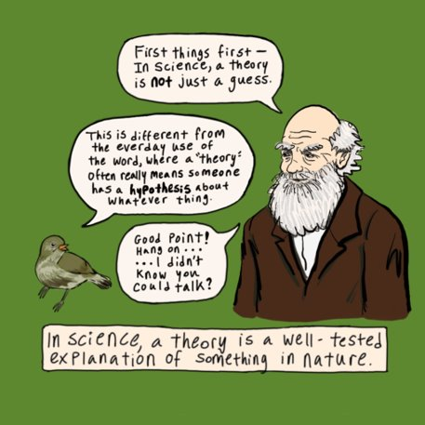
Construct a Theory
https://www.youtube.com/watch?v=lqk3TKuGNBA

Slide 17
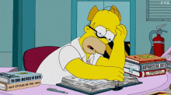
Review Questions!
Which two principles make the scientific method a unique process?
Define the roles of observations and hypotheses in science.
Summarize the parts of a controlled experiment.
Summarize how we make conclusions about the results of an experiment.
Why is the phrase 'it's just a theory' misleading?
Give another example of a conflict of interest.

