Slide 1
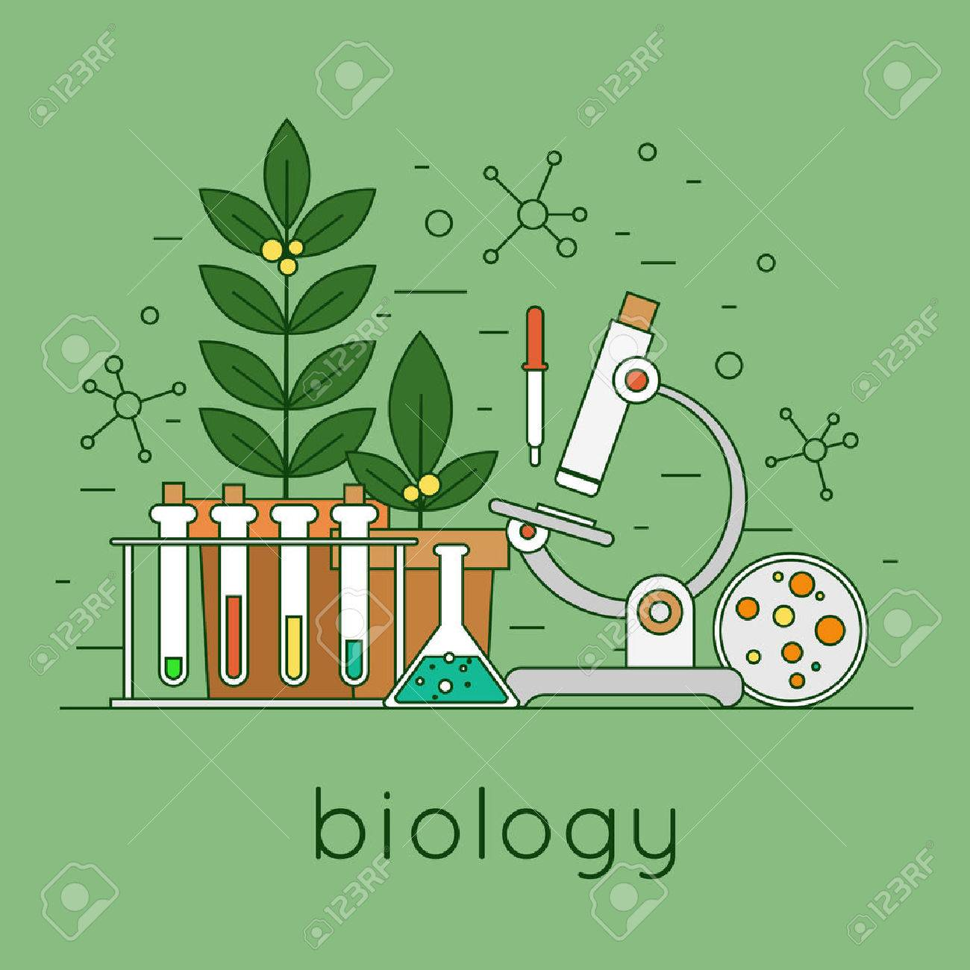
The Science of Life
Themes in Biology

Slide 2
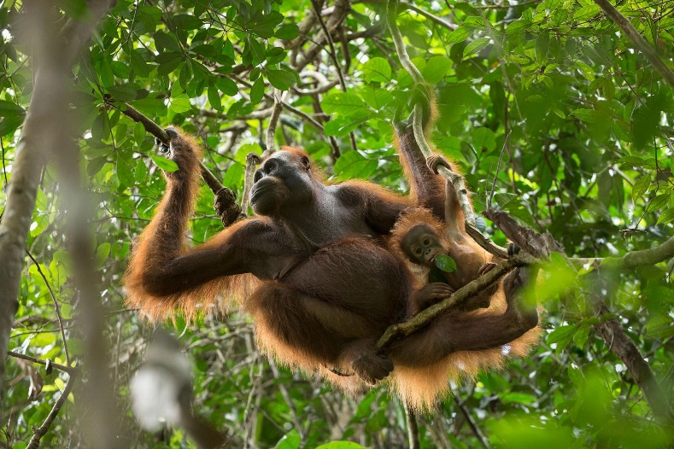
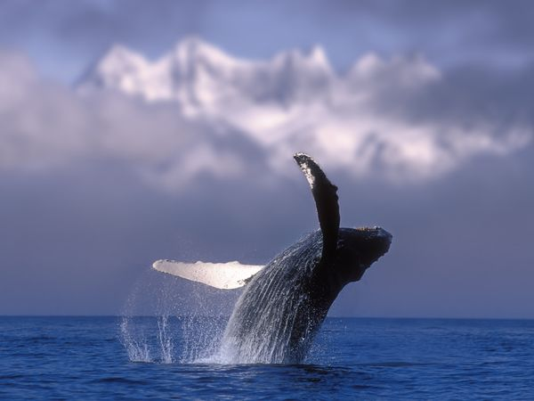
Themes in Biology
Diversity and Unity in life
Interdependence of organisms
Evolution of life

Slide 3
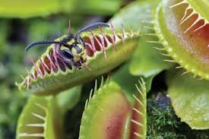
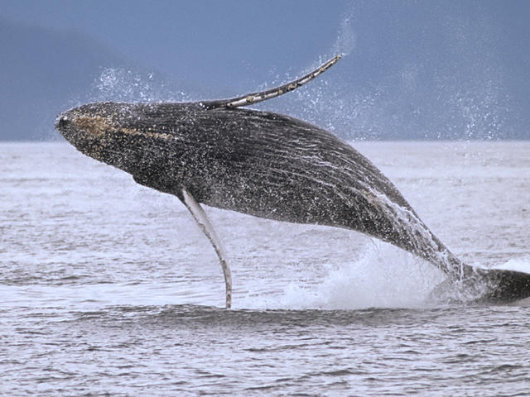
1. Diversity of Life
There are many different species living on Earth.
Whales that cross oceans made up of trillions of cells
Unicellular organisms that live in thick Antarctic ice
Plants that capture and eat insects
8.7 million different species on Earth (1.3 million have been identified)
Organisms change as they become suited to their own special environments.
How many species are there?

Slide 4
1. Unity of Life
There is Unity in life: features that all living things have in common.
Genetic code
Presence of organelles
Tree of life is a model of the relationships by ancestry among organisms.
Scientists believe all life comes from one single common ancestor.
What Percent banana are you?

Slide 5
Tree of Life
Organisms are categorized in 3 main branches:
Bacteria
Archaea
Eukarya
Organisms are also categorized in 6 major categories called kingdoms:
Bacteria: Bacteria
Archaea: Archaea
Eukarya: Animalia, Plantae, Fungi, Protista

Slide 6
2. Interdependence of Organisms
Ecology is a branch of biology that studies organisms interacting with each other and the environment.
Ecosystems are communities of living species and their physical environments.
Organisms depend on each other and their environment (living and non-living factors).
Scientists now recognize the impact of humans on the world’s environment.

Slide 7
3. Evolution of Life
Evolution is the process in which inherited characteristics within populations change over generations, such that genetically distinct populations and new species can develop.
Natural selection is a theory that organisms with favorable traits are more likely to survive and reproduce, and pass on these traits.
Adaptations are traits that improve an organism's ability to survive and reproduce.
What is Evolution?

