Slide 1
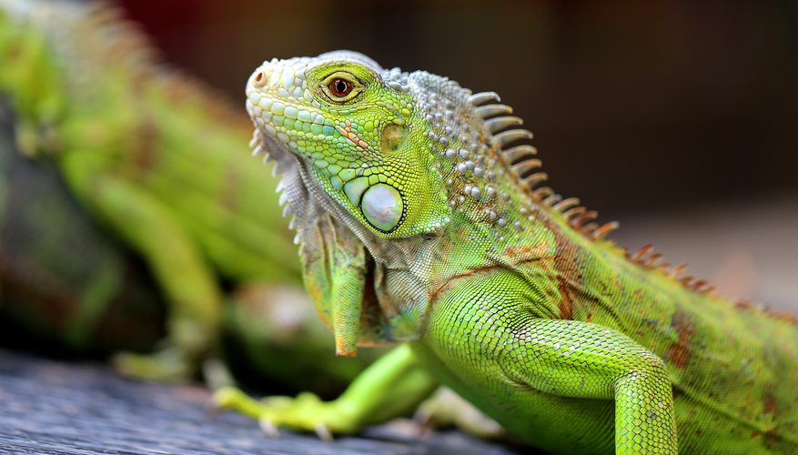
1.2 Themes in biology
Chapter 1: The Science of Life

Slide 2
Student Objectives
Identify three important themes that help explain the living world.
Explain how life can be diverse, yet unified.
Describe how living organisms are interdependent.
Summarize why evolution is an important theme in biology.

Slide 3
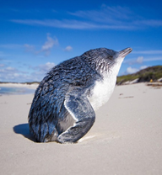
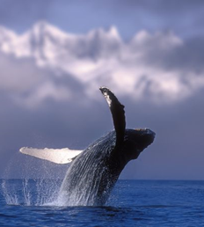
Themes in Biology
1. ____________________________
2. ____________________________
3. ____________________________

Slide 4
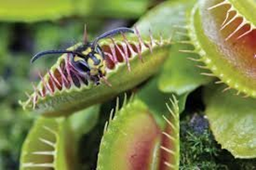
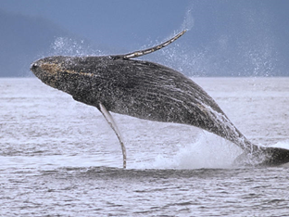
1. Diversity of Life
There are many different species living on Earth.
Whales that cross oceans made up of trillions of cells
Unicellular organisms that live in thick Antarctic ice
Plants that capture and eat insects
_____________ different species on Earth (1.3 million have been identified)
Organisms _______ as they become ______ to their own special _____________.
How many species are there?

Slide 5
1. Unity of Life
There is ______ in life: features that all living things have in ______.
Genetic code: What Percent banana are you?
Presence of organelles
Tree of life is a model of the relationships by ancestry among organisms.
Scientists believe all life comes from __________________________.

Slide 6
Tree of Life
Organisms are categorized in 3 main domains:
1. ___________
2. ___________
3. ___________
Organisms are also categorized in 6 major categories called kingdoms:
Bacteria: ___________
Archaea: ___________
Eukarya: ___________, ___________, ___________, ___________

Slide 7
2. Interdependence of Organisms
_________ is a branch of biology that studies organisms ________________ with each other and the ______________.
Ecosystems are _______________ of living species and their physical environments.
Organisms depend on each other and their environment (_________ and ____-_______ factors).
Scientists now recognize the impact of humans on the world’s environment.

Slide 8
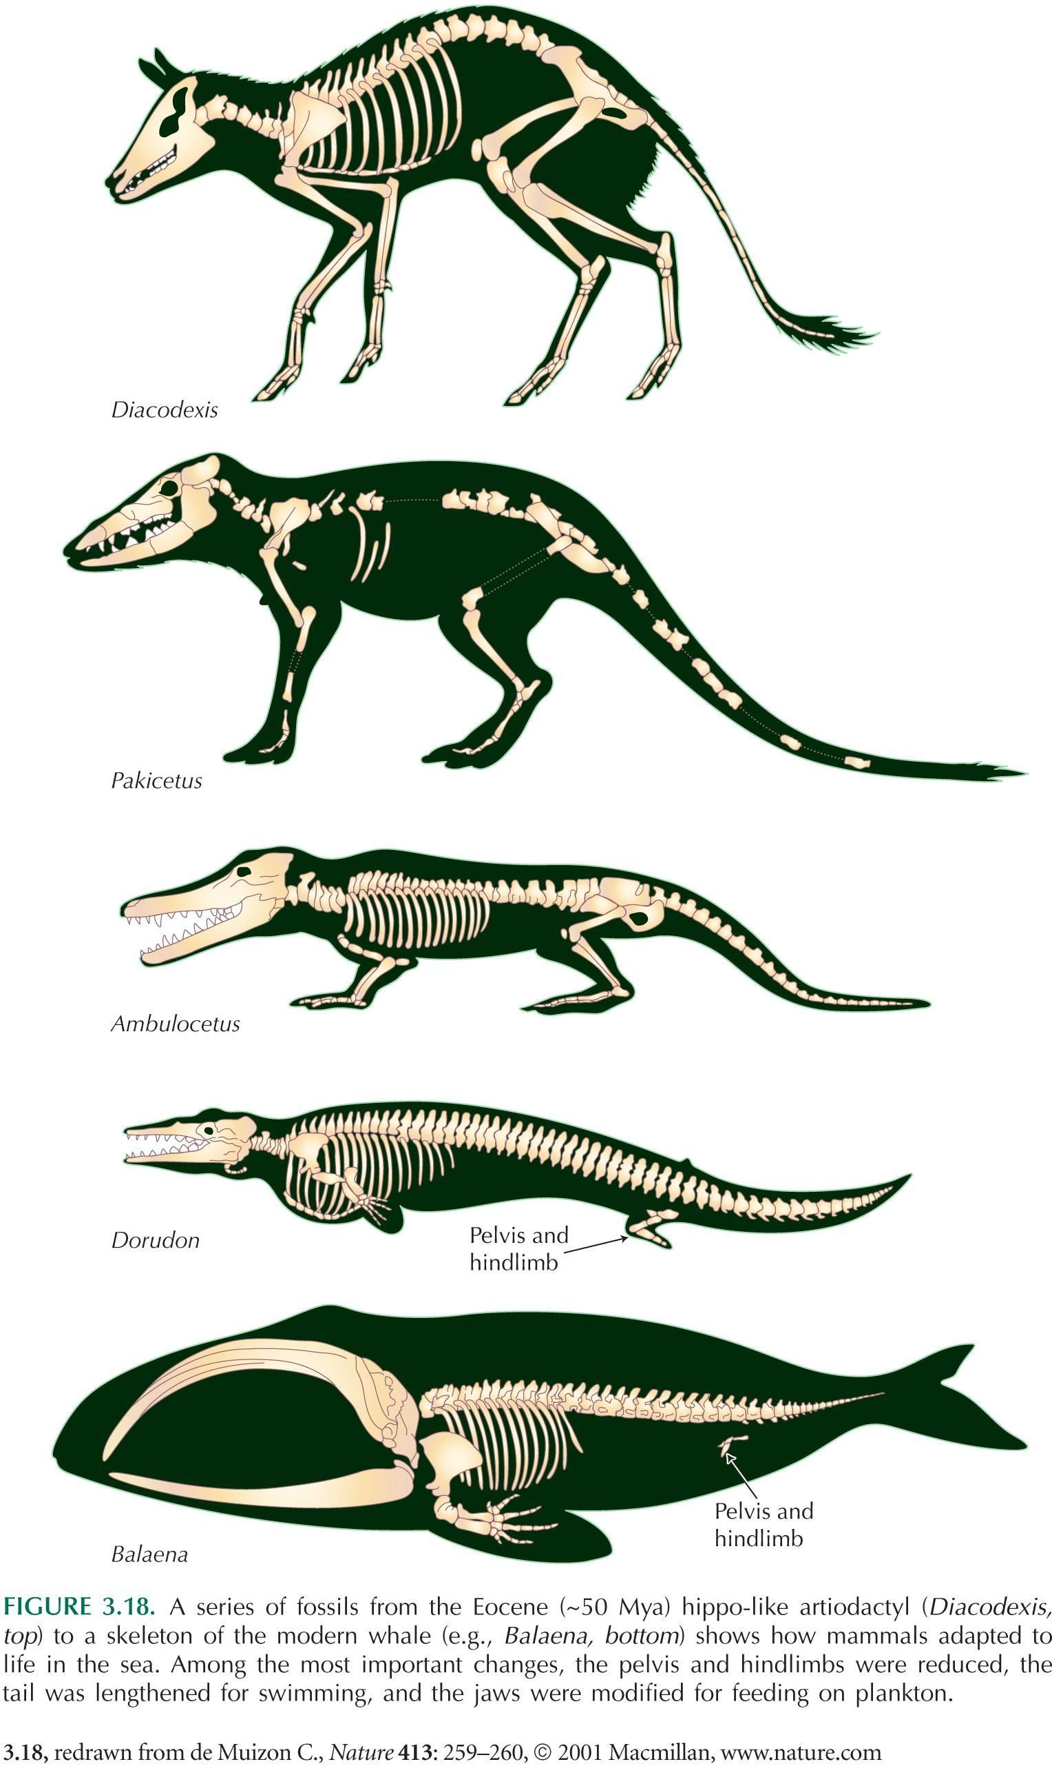
3. Evolution of Life
Evolution is the process in which inherited characteristics within populations change over generations, such that genetically distinct populations and new species can develop.
Natural selection is a theory that organisms with favorable traits are more likely to survive and reproduce, and pass on these traits.
Adaptations are traits that improve an organism's ability to survive and reproduce.
What is Evolution?

Slide 9
Review Questions!
Name three unifying themes found in biology.
How is the unity and diversity in the living world represented?
Identify three domains and the kingdoms found in each.
How are organisms interdependent?
Describe why evolution is important in explaining the diversity of life.
Distinguish between evolution and natural selection.

