Slide 1
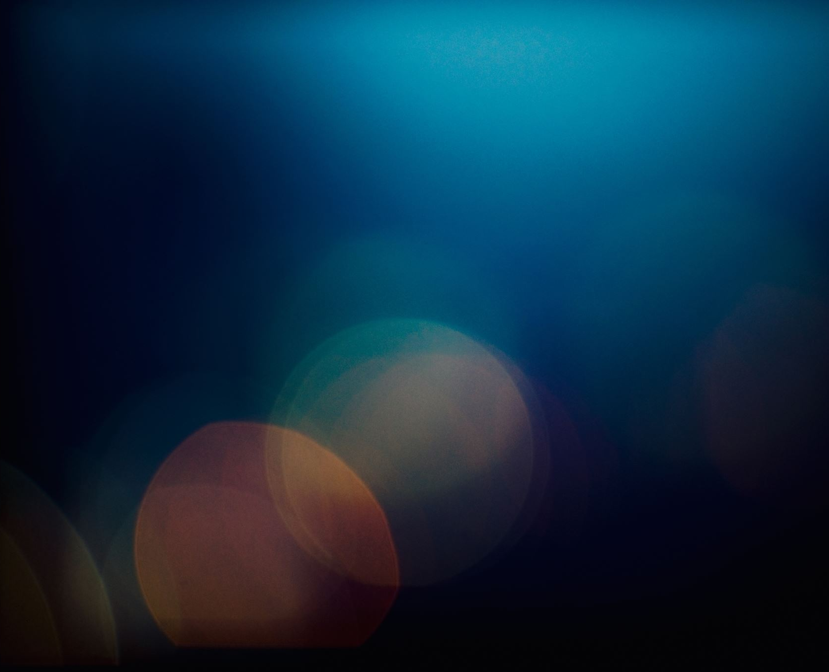
1.1 The World of Biology
Chapter 1: The Science of life

Slide 2
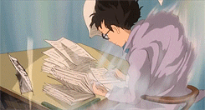
Student Objectives
Relate the relevance of biology to a person’s daily life.
Describe the importance of biology in human society.
List the seven characteristics of life.
Summarize the hierarchy of organization within complex multicellular organisms.
Distinguish between homeostasis and metabolism and between growth, development and reproduction.
Describe why viruses are not considered living organisms.

Slide 3
Biology and you
Biology = the study of life
Biologists use a organized and scientific framework to answer questions as:
How living things work
How they interact with the environment
How they change over time
Biologists study tiny organisms, such as bacteria, to very large organisms, such as elephants.
Biologists investigate subjects that affect you and the way you live.
Biology can help you make informed decisions on issues that impact you and our society.

Slide 4
7 Characteristics of life
1.Organization and Cells
2.Response to Stimuli
3.Homeostasis
4.Metabolism
5.Growth and Development
6.Reproduction
7.Change over time (Evolution)

Slide 5
1. Organization and Cells
Organization is the highest degree of order within an organism’s internal and external parts and its interactions with the living world.
All living organisms, whether made up of one cell or many cells, have some degree of organization.
Multicellular organisms
Unicellular organisms
A cell is the smallest unit that can perform all life’s processes:
Organelles: tiny structures that carry out functions for the cell to stay alive.
Biological molecules: chemical compounds that provide physical structure and bring movement, energy use, and other cellular functions.
Atoms: the simplest particle of an element that retain its properties.

Slide 6
2. Response to Stimuli
Organisms can respond to a stimulus – a physical or chemical change in the internal or external environment.
Organisms must be able to respond and react to changes in their environment.

Slide 7
3. Homeostasis
Homeostasis is the maintenance of a stable level of internal conditions even though environmental conditions are constantly changing.
Temperature
Water content
Uptake of nutrients by the cell

Slide 8
4. Metabolism
Living organisms use energy to power all the life processes, such as repair, movement, and growth.
Metabolism is the sum of all the chemical reactions that take in and transform energy and materials from the environment.
Photosynthesis
Chemosynthesis
Obtaining food from other organisms

Slide 9
5. Growth and Development
All living things grow and increase in size by the division or/and enlargement of cells.
Cell division is the formation of two new cells from an existing cell.
Development is the process by which an organism becomes a mature adult. Development involves cell division and cell differentiation, or specialization.

Slide 10
6. Reproduction
All organisms produce new organisms like themselves in a process called reproduction.
Not essential to the survival of a individual species, but critical for continuation of a species.
During reproduction, organisms transmit hereditary information to their offspring.
DNA (deoxyribonucleic acid) is a large molecule where hereditary information is encoded in.

Slide 11
6. Reproduction
In sexual reproduction, hereditary information recombines from organisms of the same species. The resulting offspring are similar, but not identical, to their parents.
In asexual reproduction, original organisms and the new organisms are genetically identical.

Slide 12
7. Change over Time (Evolution)
Populations of living organisms evolve or change over time.
The ability of organisms to change over generations is important for survival in a changing world.

Slide 13
Viruses
The Latin root for the word virus means "poison".
A virus is a nonliving particle made up of nucleic acid and a protein coat or nucleic acid and a lipid-protein (lipoprotein) coat.
Viruses are not living organisms, but they are still interesting to biologists because:
Cause many diseases
Useful for genetic research

Slide 14
'A kind of borrowed life'
Viruses are not considered alive, because they lack some of the key characteristics of living organisms.
No cytoplasm or organelles
No metabolism
No homeostasis
Do not grow as cells
Cannot reproduce outside host cell.
Viruses have genetic material, or a genome – either DNA or RNA.
They must enter a living cell and use the host’s cell ribosomes, ATP, enzymes, and other molecules to reproduce.

